Slide 1
Suspended Scaffold/False Cars and Suspended Scaffold/Temporary Work Platforms

Slide 2
In the conveyance industry, false cars and temporary work platforms are classified as suspended scaffolds under the OSHA standards if they have temporary guides or, temporary platform or, temporary suspension means.
There is not much difference between the industry safety practices we use and the OSHA regulations regarding safety while working from these conveyances.
During this presentation, we will reference industry practices as well as applicable OSHA standards for false cars, temporary work platforms, and suspended scaffolds.

Slide 3
Suspended Scaffold/False cars and suspended scaffold/running/working platforms
Objectives
Identify suspended scaffold/false cars and suspended scaffold/temporary work platforms
Describe types of common safety hazards
Apply safety hazard protection methods

Slide 4
Be Prepared.
Before beginning work, perform a written or verbal Job Hazard Analysis (JHA) to determine potential hazards or special precautions needed.
Choose the appropriate Personal Protective Equipment (PPE) for the job and have it ready before work begins.

Slide 5
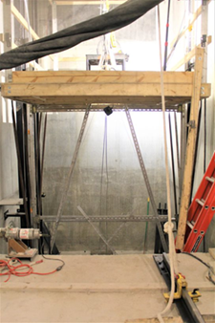
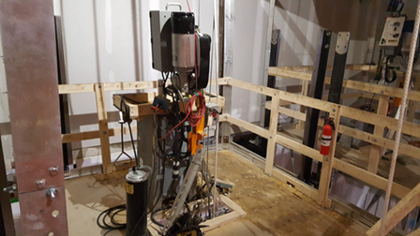
Suspended Scaffold/False Car means a temporary movable hoistway working platform, generally assembled on the jobsite by the Elevator Constructors for the purpose of installing elevator equipment. This conveyance will have temporary suspension means, car sling, platform, and guides, and require manual or automatic safeties.

Slide 6
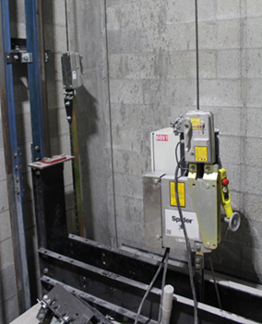
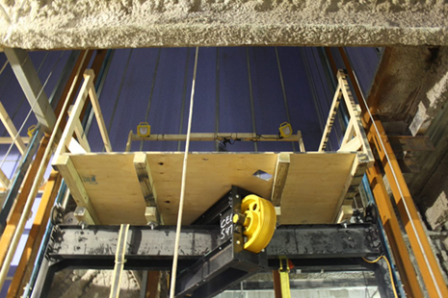
Suspended Scaffold/Temporary Work Platform means a permanent elevator car sling and platform using temporary hoist and suspension means for the purpose of installing elevator equipment. This conveyance will require the installation of governor actuated safeties or overspeed device. Before hoisting or roping of a platform, the governor or overspeed device must be installed and attached to the safety releasing arm and tested to ensure that the safety is operational. The suspended scaffold/temporary work platforms shown below are using a temporary hoist and temporary suspension means.

Slide 7
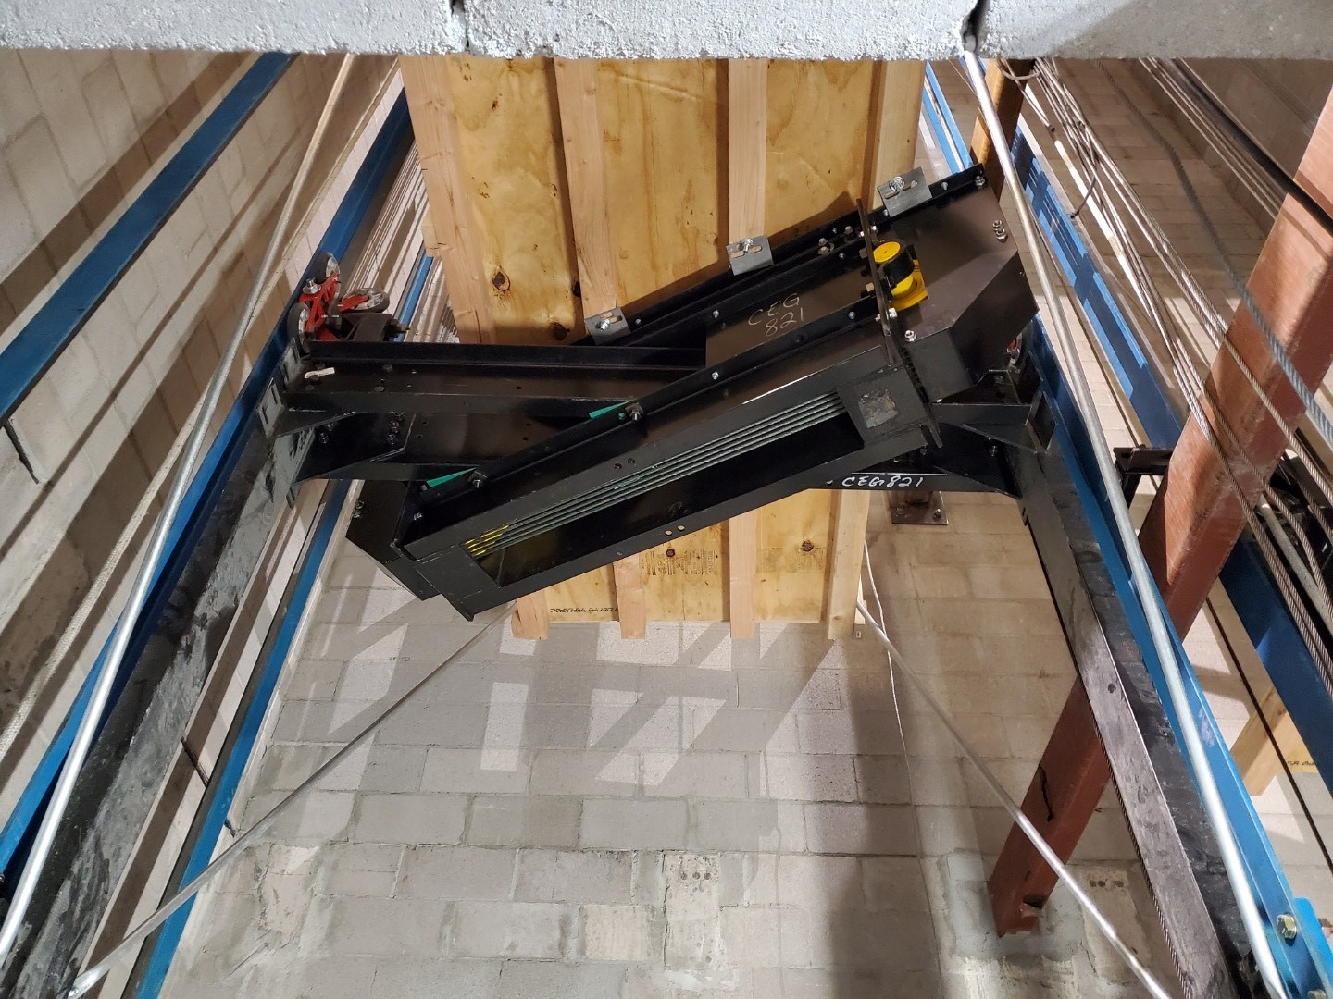
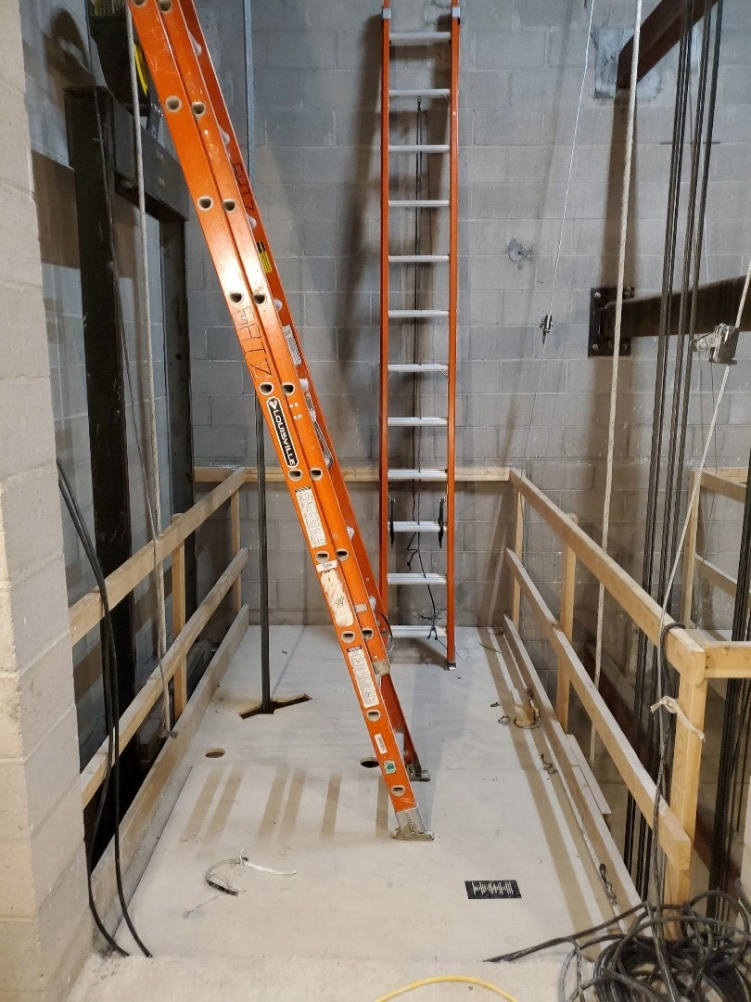
Elevator:
A work platform using the permanent guides, hoist machine, car sling, platform, and suspension means. This installation requires the installation of the permanent governor. The governor rope must be attached to the safety releasing arm and tested to ensure that the safety is operational.

Slide 8
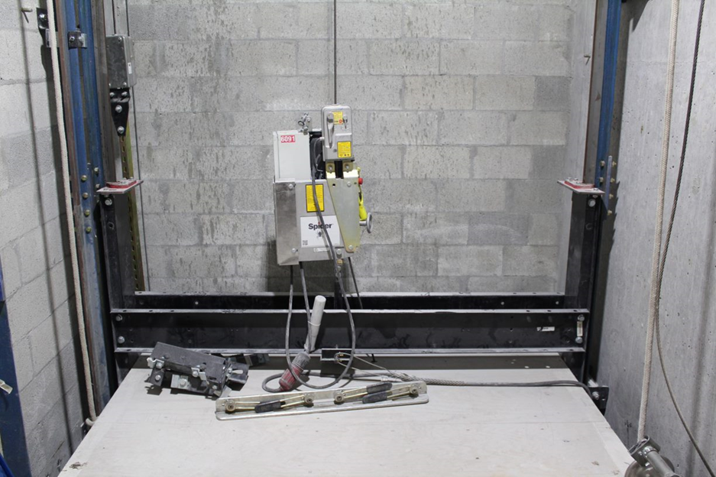
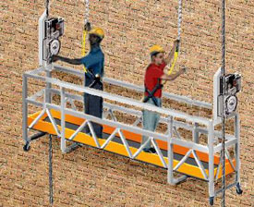
1926.450(b):
Suspension scaffold means one or more platforms suspended by ropes or other non-rigid means from an overhead structure(s).
Two-point suspension scaffold (swing stage) means a suspension scaffold consisting of a platform supported by hangers (stirrups) suspended by two ropes from overhead supports and equipped with means to permit the raising and lowering of the platform to desired work levels.

Slide 9
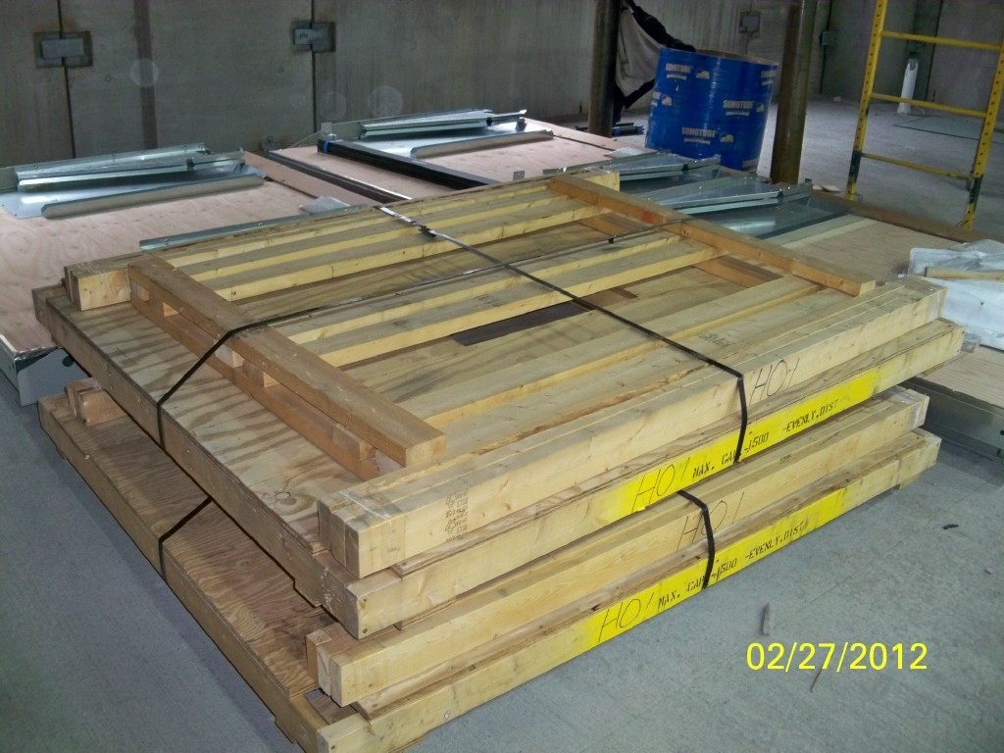
Suspension scaffolds/false cars are pre-engineered by the manufacturer. Always follow manufacturer’s instructions when installing platforms and guardrail systems.
Platform and guard rail package

Slide 10
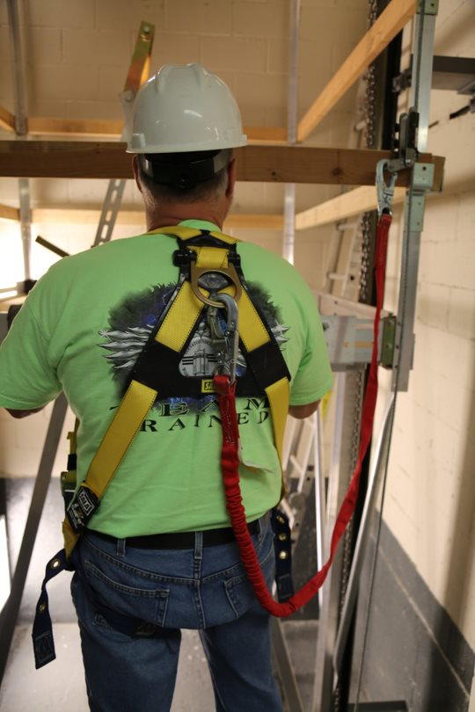
Fall Protection Required
If a fall hazard exists, the conveyance must meet the fall protection requirements of OSHA 1926.502. Always follow your company safe work practices for fall hazards.
Notes:
If classified as an elevator, 1926.501(b)(1)
Unprotected sides and edges. Each employee on a walking/working surface (horizontal and vertical surface) with an unprotected side or edge which is 6 feet (1.8 m) or more above a lower level shall be protected from falling by the use of guardrail systems, safety net systems, or personal fall arrest systems.
Each employee on a scaffold more than 10 feet (3.1 m) above a lower level shall be protected from falling to that lower level.
If classified as a false car – temporary work platform/suspension scaffold, 1926.451(g)(1)(ii)
Each employee on a single-point or two-point adjustable suspension scaffold shall be protected by both a personal fall arrest system and guardrail system;

Slide 11
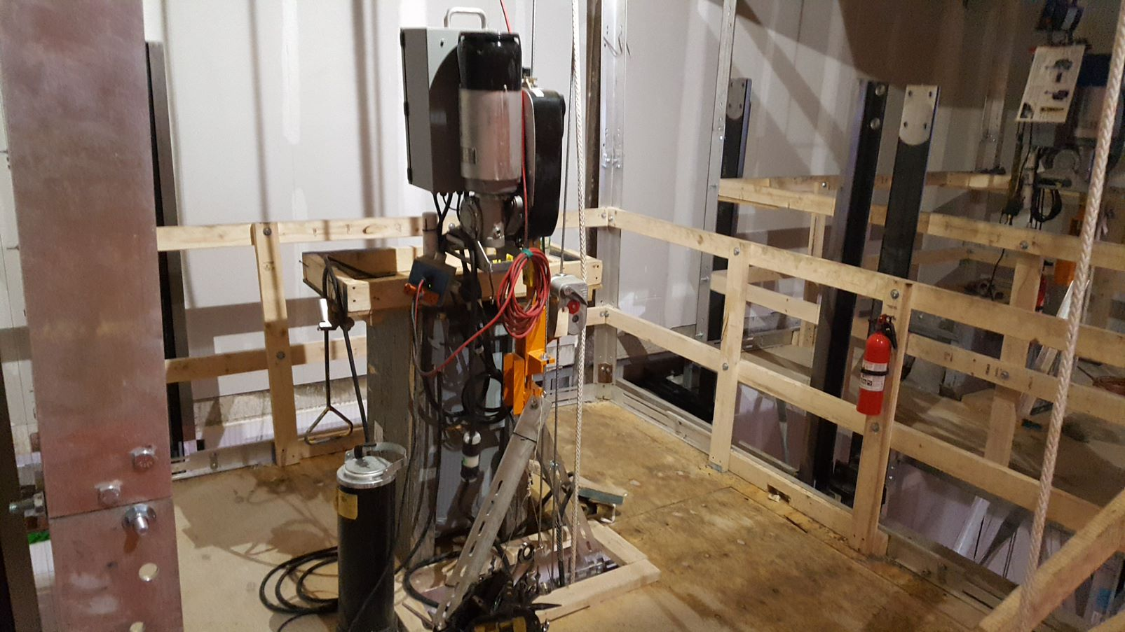
Guardrail system: Must meet the requirements of OSHA 1926.502(1)
42″ top rail (+- 3″)
21″ mid rail
3 ½″ toe board
Posts shall not be more than 8′ apart.
Top rails must be capable of withstanding a force of 200 lbs. and mid-rails a force of 150 lbs, applied in any outward or downward direction.
While not a regulation, for safe access and egress, guardrail systems must be removable at hoistway entrances, escalator/moving walk wellways, and at the entrance to false car/running platforms

Slide 12
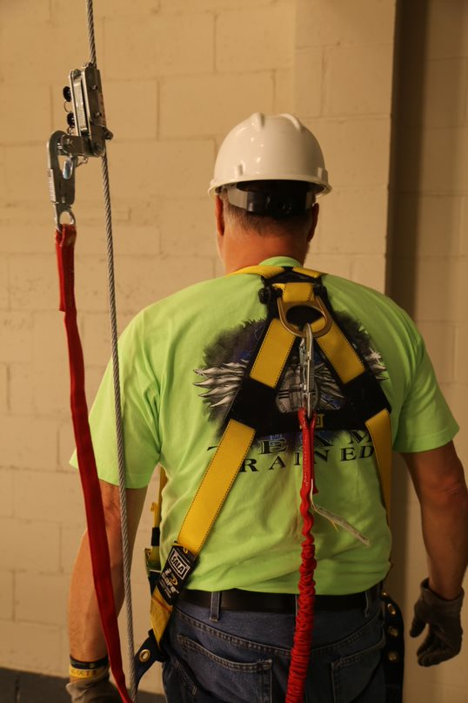
Personal Fall Arrest Systems are designed to catch workers after they have fallen.
The components of a PFAS are:
Anchorage
Lifeline/Rope grab
Connectors
Lanyard
Body Harness
Notes:
Personal fall arrest systems are for workers to wear if there is a danger of falling from elevation. They are designed to stop the fall with as little shock and recoil as possible, or to completely prevent a fall. OSHA requires employers to properly fit and train each worker who will use a PFAS.
A full-body harness has straps worn around your trunk and thighs, with the D-ring in back to attach the harness to other parts of the system. If you fall, a properly fitted harness spreads the stopping force over your thighs, pelvis, chest, and shoulders.
Follow manufacturers’ instructions for wearing harnesses and inspect your equipment before each use.

Slide 13
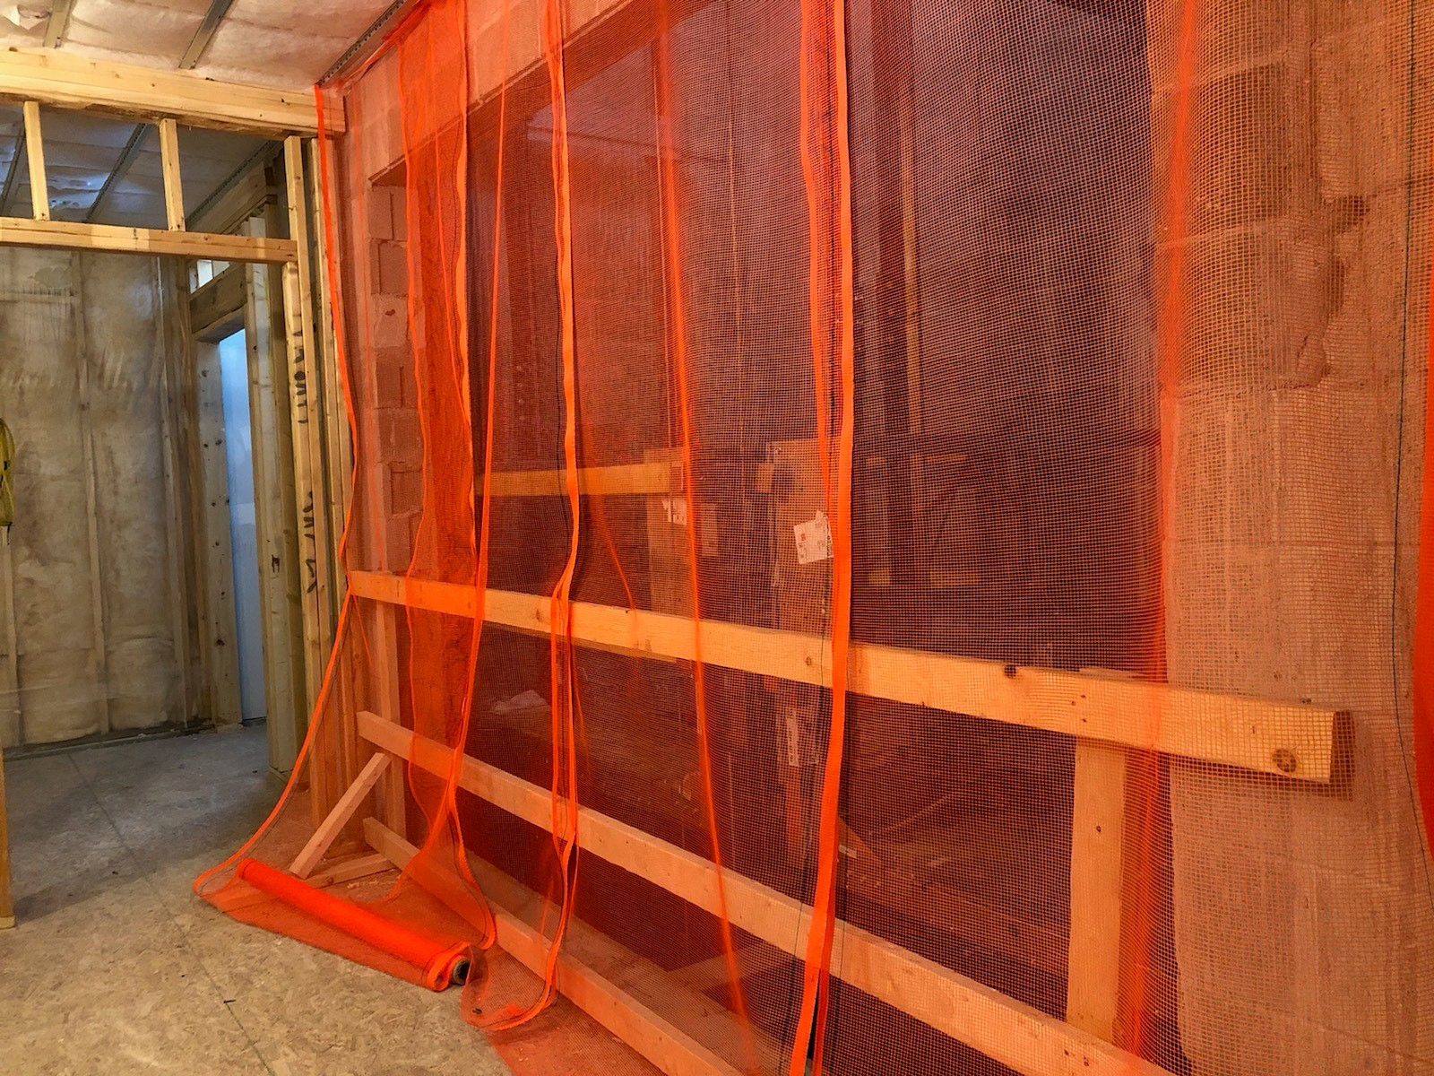
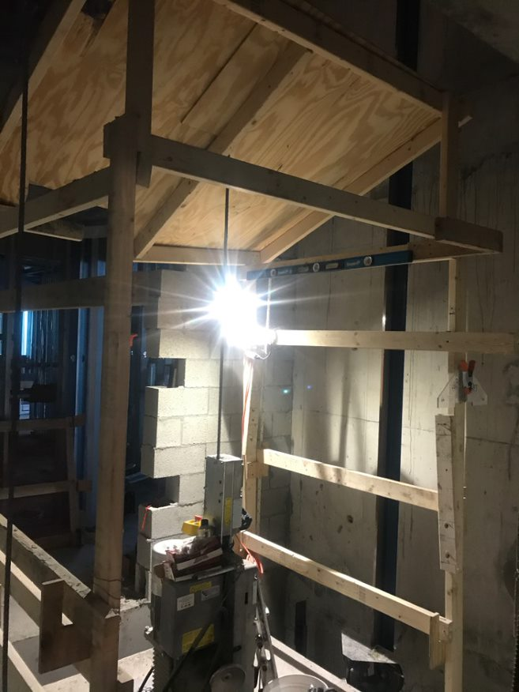
Overhead Protection
In addition to fall protection, overhead protection must be provided to protect workers from objects falling down the hoistway.
This can be accomplished by fully enclosing the hoistway openings or separate adjacent hoistways with protective netting, installing a canopy structure on the conveyance, or barricade the area to prohibit people from entering.
Notes:
Protection from falling objects. When an employee is exposed to falling objects, the employer shall have each employee wear a hard hat and shall implement one of the following measures: [1926.501(c)]
(1) Erect toeboards, screens, or guardrail systems to prevent objects from falling from higher levels; or, [1926.501(c)(1)]
(2) Erect a canopy structure and keep potential fall objects far enough from the edge of the higher level so that those objects would not go over the edge if they were accidentally displaced; or, [1926.501(c)(2)]
(3) Barricade the area to which objects could fall, prohibit employees from entering the barricaded area, and keep objects that may fall far enough away from the edge of a higher level so that those objects would not go over the edge if they were accidentally displaced. [1926.501(c)(3)]

Slide 14
Testing/Inspection
Post installation testing
After False Car or temporary working platform installation, a load test must be performed. The test should be performed, at the hoisting point, at 1.5X the Working Load Limit.
Section B.1.1 of the EN1808 – Safety Requirements for suspended access equipment provides the calculation for performing a static test of the hoist:
The static test coefficient is equal to 1.5.
A hoist shall be statically loaded for 15 minutes to 1.5 times it’s Working Load Limit.
A traction hoist shall not show any signs of the wire rope slipping or creeping through the traction sheave. The wire rope should be lubricated in accordance with the manufacturer’s instructions.
The service brake shall hold the load without slipping or creeping.
No load bearing components of the hoist shall fail, deform, or weaken and the load shall be held in position.
After the load is released, the hoist should operate in accordance with the manufacturer’s instructions.
Notes:
EN1810 - This European Standard specifies the requirements, test methods, marking and information to be provided by the manufacturer/supplier for Suspended Access Equipment (SAE).

Slide 15
Testing/Inspection
Temporary hoists must have the safeties tested before each shift, and the hoist cable must be inspected daily.
Always follow the hoist manufacturer’s instructions for testing and inspection.
Notes:
1926.451(d)(10):
Ropes shall be inspected for defects by a competent person prior to each workshift and after every occurrence which could affect a rope's integrity. Ropes shall be replaced if any of the following conditions exist:
(i) Any physical damage which impairs the function and strength of the rope. [1926.451(d)(10)(i)]
(ii) Kinks that might impair the tracking or wrapping of rope around the drum(s) or sheave(s). [1926.451(d)(10)(ii)]
(iii) Six randomly distributed broken wires in one rope lay or three broken wires in one strand in one rope lay. [1926.451(d)(10)(iii)]
(iv) Abrasion, corrosion, scrubbing, flattening or peening causing loss of more than one-third of the original diameter of the outside wires. [1926.451(d)(10)(iv)]
(v) Heat damage caused by a torch or any damage caused by contact with electrical wires. [1926.451(d)(10)(v)]
(vi) Evidence that the secondary brake has been activated during an overspeed condition and has engaged the suspension rope. [1926.451(d)(10)(vi)]

Slide 16
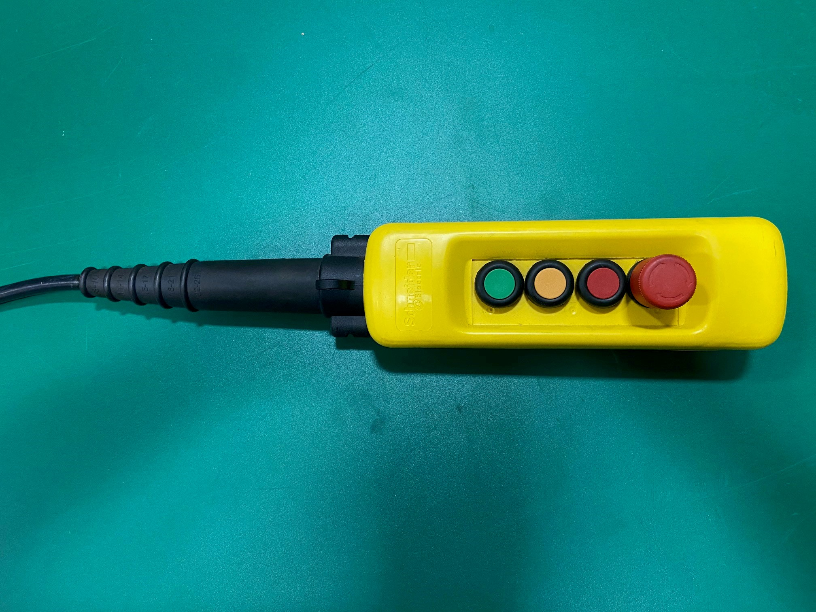
Power Cables and Run Buttons
Power cables and temporary run button cords should always have a strain relief on the cord.
Temporary run buttons must ALWAYS have a minimum of 5 wires with an independently wired emergency stop switch, and must have safe, up, and down buttons.
Never use a pendant station with only an up and down button.
Temporary run button cords should NEVER be spliced. OSHA Standard 1926.405(g)(2)(iii) states: Flexible cords shall be used only in continuous lengths without splice or tape (see note on OSHA standard for hard service flexible cords no. 12 or larger)
Notes:
Splices. Flexible cords shall be used only in continuous lengths without splice or tap. Hard service flexible cords No. 12 or larger may be repaired if spliced so that the splice retains the insulation, outer sheath properties, and usage characteristics of the cord being spliced. [1926.405(g)(2)(iii)]

Slide 17
Summary
The hoistway is your space. No other trades should ever work above you or below you.
Always follow your company’s policies and procedures when assembling and operating suspended scaffolds/false cars and suspended scaffolds/working platforms.
Inspect and test equipment according to the manufacturer’s instructions.
Identify and follow capacities for suspended scaffolds/false cars and suspended scaffolds/working platforms.

Slide 18
Check Your Knowledge
Overhead protection can be accomplished by installing guardrails at all hoistway openings.
True
False
b. False.
Overhead protection can be accomplished by installing debris netting at all hoistway openings.

Slide 19
Check Your Knowledge
How often must the safeties be tested on a temporary hoist?
Daily
Weekly
Monthly
Before each shift
d. Before each shift

Slide 20
Check Your Knowledge
Temporary run buttons must ALWAYS have a minimum of 5 wires with an independently wired emergency stop switch, and must have safe, up, and down buttons.
True
False
d. True

Slide 21
Through the Alliance between OSHA’s 10 Regional Offices and the Elevator Contractors of America (ECA), Elevator Industry Work Preservation Fund (EIWPF), International Union of Elevator Constructors (IUEC), National Association of Elevator Contractors (NAEC), National Elevator Industry Educational Program (NEIEP), and National Elevator Industry Inc. (NEII), collectively known as The Elevator Industry Safety Partners, developed this Industry Specific Training for informational purposes only. It does not necessarily reflect the official views of OSHA or the U.S. Department of Labor. May 2021
Under the Occupational Safety and Health Act, employers are responsible (http://www.osha.gov/as/opa/worker/employer-responsibility.html) for providing a safe and healthy workplace and workers have rights (https://www.osha.gov/workers). OSHA can help answer questions or concerns from employers and workers. OSHA's On-Site Consultation Program (https://www.osha.gov/consultation) offers free and confidential advice to small and medium-sized businesses, with priority given to high-hazard worksites. For more information, contact your regional or area OSHA office (https://www.osha.gov/contactus/bystate), call 1-800-321-OSHA (6742), or visit https://www.osha.gov/.

Slide 22
Suspended Scaffold/False Cars and Suspended Scaffold/Temporary Work Platforms

