Slide 1

1926 Construction
Focus Four
Caught In/Between Hazards

Slide 2
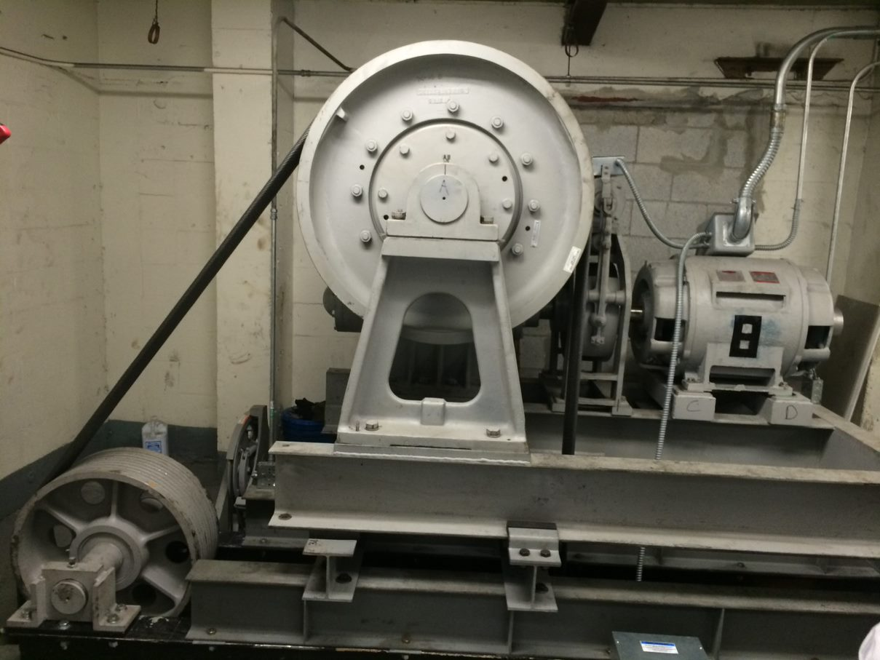
Caught In/Between Hazards
Focus Four
Objectives
By the end of the session, students will be able to:
List the three main causes of caught in and caught between fatalities.
Describe how to control hazards that cause caught in or caught between deaths.
Describe safe equipment operation when there is a rollover hazard.
Describe three key employer requirements that protect workers from caught in or
caught between hazards

Slide 3
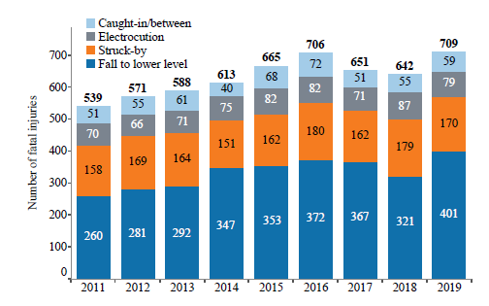
Caught In/Between Hazards
Caught In/Between Hazards
Focus Four
Caught In and Caught Between Fatalities
Caught in and caught between deaths represented about 8.4% of construction Focus Four fatalities in 2019.
Have you or anyone you know sustained a caught in/between injury?
What happened?
Notes:
Source: CPWR Data Bulletin – Fatal Injury Trends in Construction
Ask students:
If they know anyone who has been seriously injured ask them to describe what happened and how it could have been prevented.

Slide 4
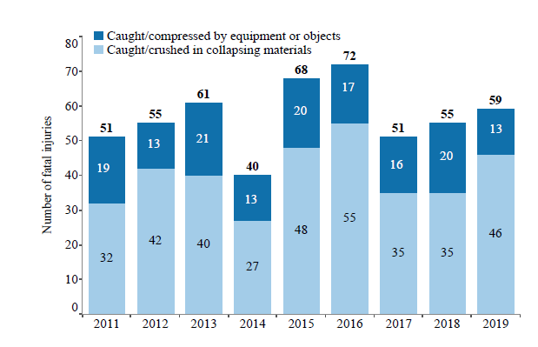
Caught In/Between Hazards
Caught In/Between Hazards
Focus Four
Caught In and Caught Between Fatalities
30% of the caught in/between fatalities were caught/compressed by equipment or objects.
This is the type of hazard Elevator Constructors are most likely to be exposed to.
Notes:
Source: CPWR Data Bulletin – Fatal Injury Trends in Construction

Slide 5
Caught In/Between Hazards
Caught In/Between Hazards
Focus Four
Elevator Industry-Related
Caught In/Between Hazards
Since 2012, 41% of Elevator Constructor deaths have been caught in/ between related.
Notes:
Source: IUEC

Slide 6

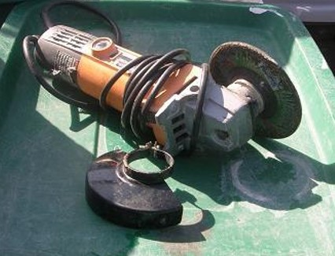
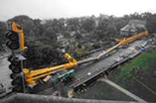
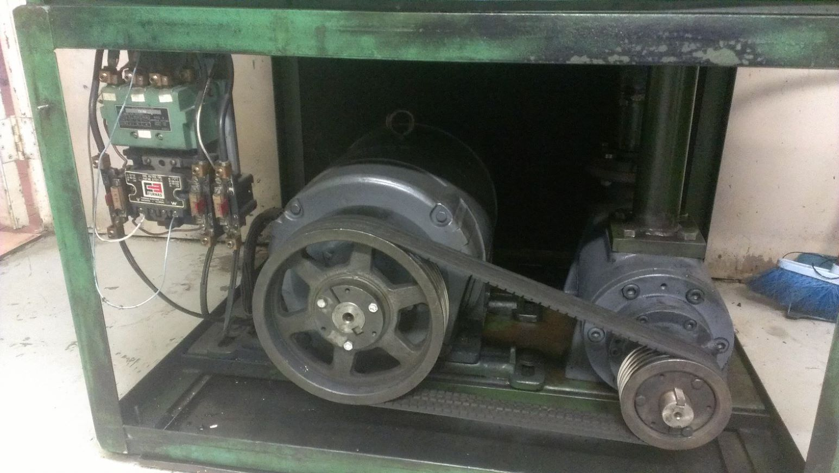
Caught In/Between Hazards
Caught In/Between Hazards
Focus Four
Types of caught in and caught between hazards
Trench cave-in
Moving parts of a machine,
engine, or power tool
Unguarded belts or pulleys
Vehicle rollover

Slide 7
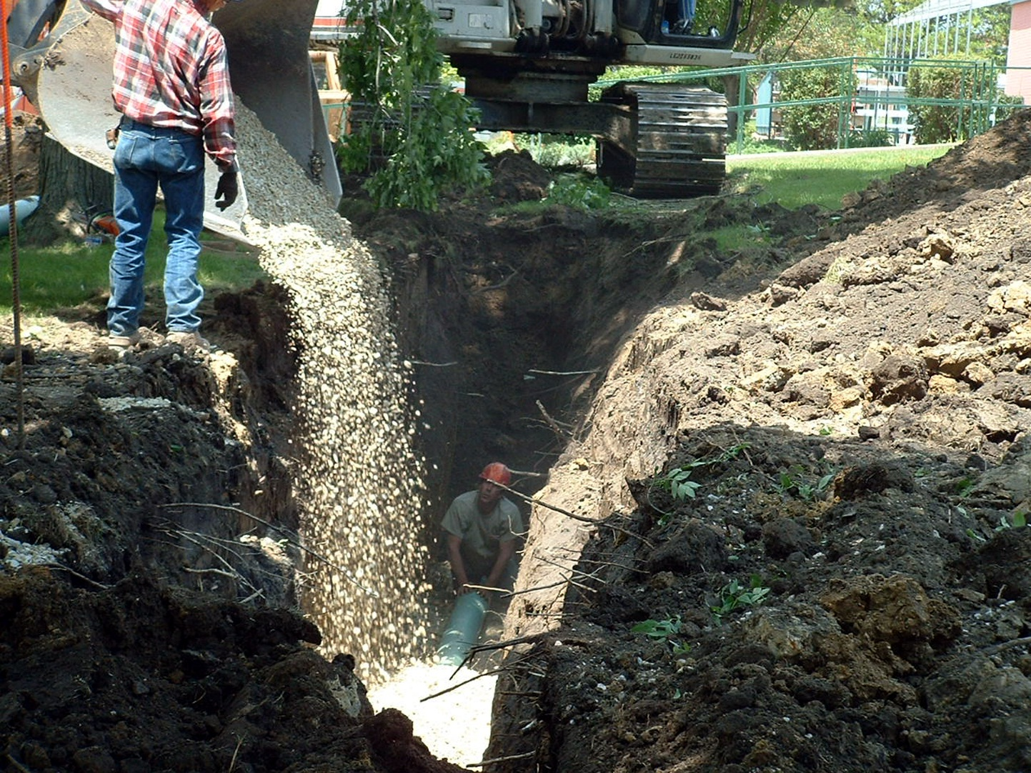
Caught In/Between Hazards
Caught In/Between Hazards
Focus Four
Trench Cave-ins
Cave-ins happen suddenly with
little or no warning; they are the greatest risk in trenches
Most deaths from cave-ins occur in trenches 5 to 15 ft. deep
Soil moves too fast to escape. It takes just over a half a second for a six-foot trench to collapse
Human reaction time is a half a second; that leaves less than a second to escape
Notes:
Eighty percent of trenching deaths occur in construction—half of these workers are laborers.
Indications that a cave in may happen: (from Smart Mark Excavations ppt)
1. Ground settlement or narrow cracks in sidewalls, slopes, or surface next to excavation
2. Changes or bulges in wall slope.
3. Flakes, pebbles, or clumps of soil separating and falling into the excavation.
4. Sidewalls softening or trench bottom boiling.
A trench has can have many hazards. In the caught in / caught between part of the focus four we are only concerned with trench collapse. For additional hazards and how to address them see the Smart Mark module on Excavation.

Slide 8
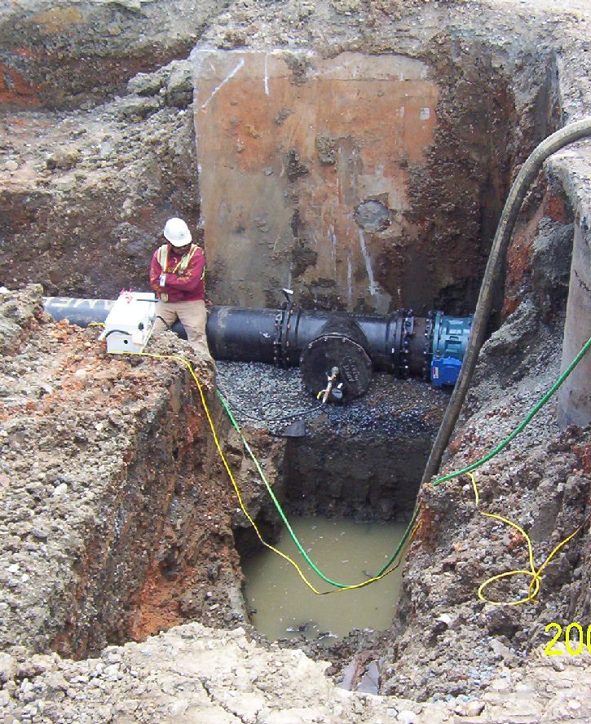
Caught In/Between Hazards
Caught In/Between Hazards
Focus Four
What Causes Trench Cave-ins?
Unstable soil
Excessive weight, such as machinery or a spoil pile that is close to the edge of the trench
Water in trenches
Vibration from vehicle traffic or equipment near the trench
Notes:
Cave-ins are more likely:
During changes in weather conditions, such as freezing, thawing, or sudden heavy rain
When the excavation is dug in unstable soil or in soil that has been previously disturbed
When there is excessive vibration from construction equipment or vehicle traffic around the excavation
If needed, use barriers to restrain the “spoil” (soil, rocks, other materials) and keep if from falling into the trench.

Slide 9
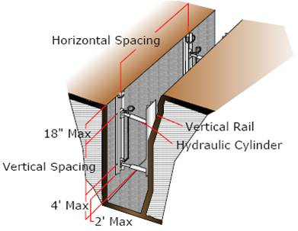
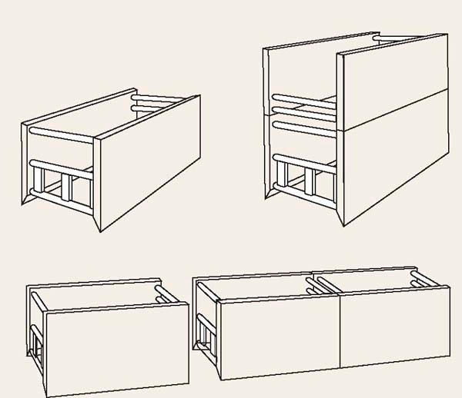
Caught In/Between Hazards
Caught In/Between Hazards
Focus Four
What Must Employers Do to Make a Trench Safe?
Train workers about trench hazards
Designate a “competent” person before a trench digging starts
Call before digging; all utilities must be marked
The competent person identifies the soil type; the type of trench protection depends on the type of soil
Notes:
“A Competent Person” is someone who “is capable of identifying existing and predictable hazards … that are … dangerous to employees [and] has authority to make corrective measures.”

Slide 10
Caught In/Between Hazards
Caught In/Between Hazards
Focus Four
Additional Employer Responsibilities
Provide cave-in protection for trenches 5 feet or deeper, unless they are in solid rock
The competent person must inspect the trench before each shift and OK workers to enter
Provide a way of escape/egress, a ramp or ladder within 25’
Equipment, like water pumps and ventilators, must be in good condition
Notes:
OSHA says these guidelines apply to all trenches.
Often workers do not control these issues, but they can check to see if they have been done before entering a trench.
The competent person must inspect a trench:
• Before every shift
• If bad air is expected or suspected — for example, if the trench is in a sewer or near a dump or stored chemicals
• After anything that can increase hazards, such as rain, vibration, soil movement, or increased load nearby.
If bad air is suspected, the competent person must test the air.
• OSHA says the air must have 19.5 to 23.5% oxygen.
• Check for substances that can burn or explode — like methane.
• Check for toxics like chlorine, carbon monoxide, sewer gases, and hydrogen sulfide. These toxics can kill. Carbon monoxide has no smell. Hydrogen sulfide smells like rotten eggs.
The competent person will decide if blowers can keep the air safe.

Slide 11
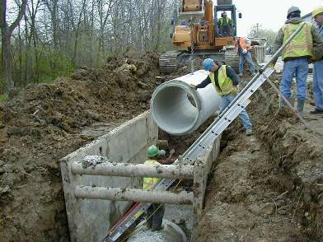
Caught In/Between Hazards
Caught In/Between Hazards
Focus Four
There are Four Methods to Support a Trench
Sloping
Benching
Shoring
Shielding

Slide 12
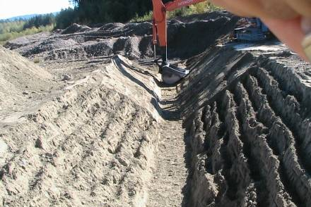
Caught In/Between Hazards
Caught In/Between Hazards
Focus Four
Sloping
Soil angled to increase stability

Slide 13
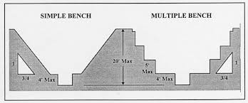
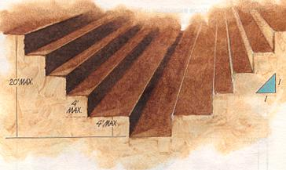
Caught In/Between Hazards
Caught In/Between Hazards
Focus Four
Benching
Steps in trench wall
Notes:
The worker is properly protected from a potential trench cave-in by utilizing the bench system.

Slide 14
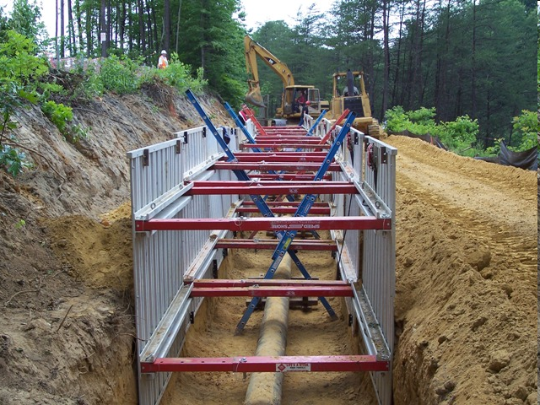
Caught In/Between Hazards
Caught In/Between Hazards
Focus Four
Shoring
A support system made of posts, wales, struts, and sheeting
Hydraulic shoring (shown here) is very common
Notes:
Many trenches are in narrow places and sloping or benching are not an option. In such situations, support systems such as shoring or shielding must be used.
Shoring systems are made of metal or timber designed to support the sides of a trench and prevent cave-ins. Shoring can be custom-tailored to the trench. It can be used in narrow confines, and is more easily installed around underground utilities. But, shoring requires a greater technical knowledge to be installed correctly, and these systems are usually not suitable for deeper excavations.

Slide 15
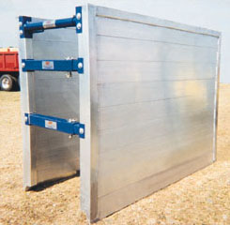
Caught In/Between Hazards
Caught In/Between Hazards
Focus Four
Shielding
A protective frame or box is used as a
trench shield system
Notes:
Shielding systems use box-like structures, commonly referred to as trench boxes, that are placed inside trenches or excavations and are strong enough to protect workers inside if there is a cave-in. Shielding is designed to be moved along the trench as the work progresses, and can usually be installed faster and used in deeper trenches than portable shoring systems. In fact, when used properly, shields can be much safer, effective, and cheaper than sloping methods.

Slide 16
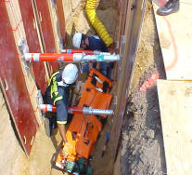
Caught In/Between Hazards
Caught In/Between Hazards
Focus Four
Excavation Rescue
Excavation rescue must be done carefully because rescue operations might:
  Cause additional cave-ins
  Create more soil pressure on buried victim
  Injure the victim more severely
Notes:
Rescue teams must have special training.
Never go into a trench that is caving in or has bad air — even to rescue co-workers. You can be killed.

Slide 17
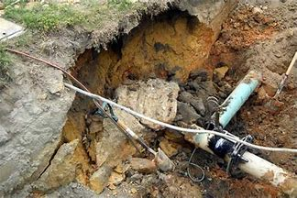
Caught In/Between Hazards
Caught In/Between Hazards
Focus Four
The Weight of Soil Makes Breathing Impossible
Soil is made up of a variety of things such as sand, loam, and rock
The amount of water in the soil also adds to the weight
A cubic yard may weigh between 2,000 and 3,000 lbs.
A person can’t breathe
buried in dirt
Notes:
Soil is a mixture of rock, clay, sand, organic matter, water, air, a variety of small particles, and empty spaces called voids. The proportions of solid matter, water, and air can vary depending on the source and history of the soil. Generally, soil is made up of about ½ voids.
If the void spaces are totally filled with water the soil is called “saturated”. If they are completely filled with air, the soil is called oven dry.
Normally, some part of the voids are filled with water. This percentage is referred to as the “percent of saturation”.
Solid rock weighs about 167 pounds per cubic foot. An average cubic foot of soil is about ½ rock. If soil is saturated to 100% with water, it weighs about 114 pounds per cubic foot.
If water saturated soil weighs 114 pounds per cubic foot, a cubic yard would weigh 27 times as much since there are 27 cubic feet per cubic yard. This equates to 3,078 pounds.
As little as one cubic foot of soil to cause a serious injury. Two cubic feet (approximately 200 pounds) can be enough to seriously restrict a buried victim’s ability to breathe. Without oxygen, in four to six minutes a victim will sustain brain damage and after ten minutes will likely suffer permanent brain damage or die.

Slide 18
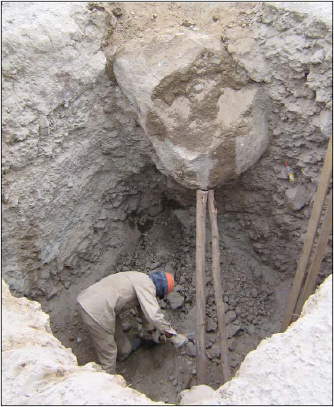
Caught In/Between Hazards
Caught In/Between Hazards
Focus Four
Recognize Any Hazard(s)?

Slide 19
Caught In/Between Hazards
Caught In/Between Hazards
Focus Four
YES
Potential crushing hazard from overhead boulder.
No protective system in this excavation.

Slide 20
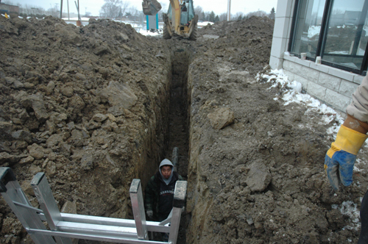
Caught In/Between Hazards
Caught In/Between Hazards
Focus Four
Recognize Any Hazard(s)?

Slide 21
Caught In/Between Hazards
Caught In/Between Hazards
Focus Four
YES
Next to a residential structure
Worker in an unprotected vertical wall trench [pipe work] is exposed to being totally engulfed by the trench if it collapses.
No protective systems in use
Ladder at the end of the trench

Slide 22
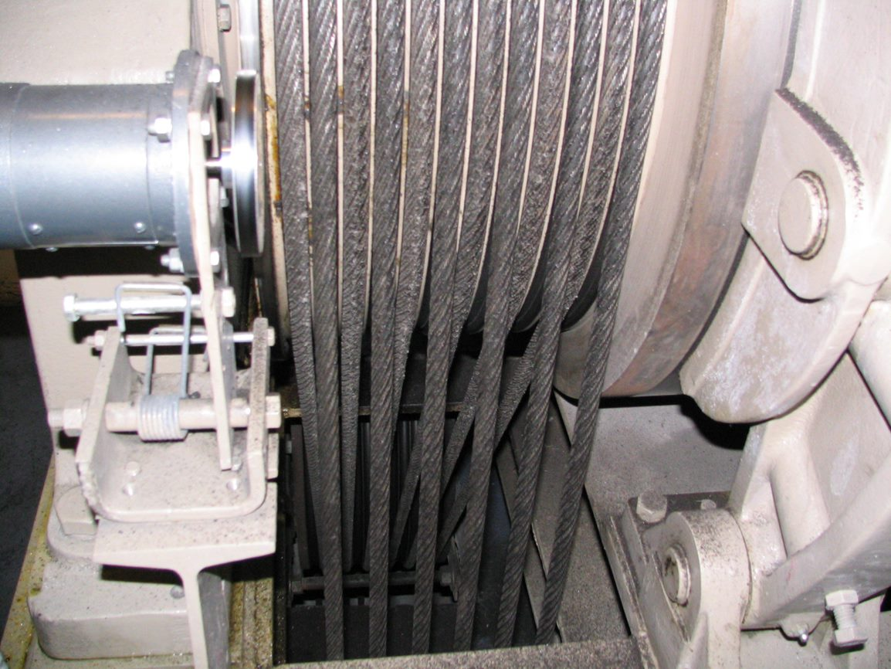
Caught In/Between Hazards
Caught In/Between Hazards
Focus Four
What are some other caught in/ between hazards?
Caught in machinery or mechanical equipment
Vehicle Rollovers
Notes:
The next section of the PowerPoint reviews these two types of hazards.
Others that may be discussed if time permits:
Pinned between equipment and a solid object (wall or equipment)
Equipment service and maintenance

Slide 23
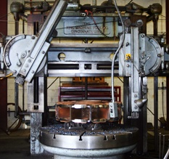
Caught In/Between Hazards
Caught In/Between Hazards
Focus Four
What Are Examples of Mechanical or Moving Equipment?
Saws
Presses
Conveyors
Bending, rolling, or shaping machines
Powered hand tools
Forklifts
Personnel hoists
Elevators
Escalators
Notes:
Almost all machines that construction workers use are equipped with guards that protect workers.
Any machine that grinds, shears, presses, punches, squeezes, cuts, rolls, mixes, or has pinch points or sharp edges that could cause potential harm to any worker should have a guard shielding the hazard.

Slide 24
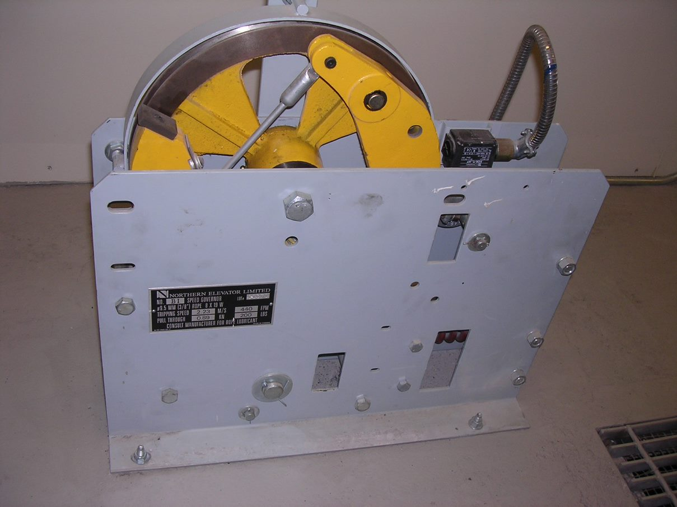
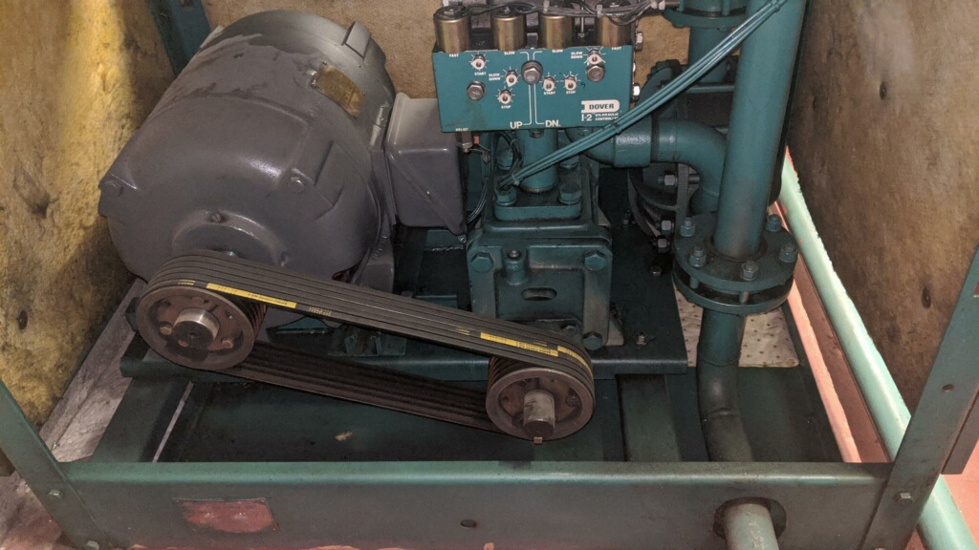
Caught In/Between Hazards
Caught In/Between Hazards
Focus Four
Machine room equipment
Rotating equipment can start without warning. Drive sheaves, governors, and pump motors all have the potential to cause serious injury. Be aware of your surroundings. Perform LOTO and control stored energy before servicing or repairing any equipment.

Slide 25
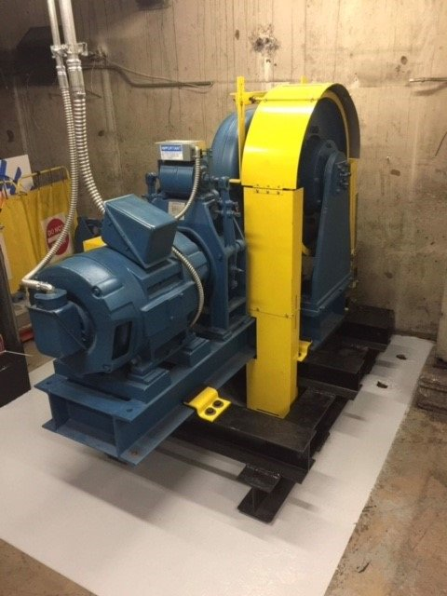
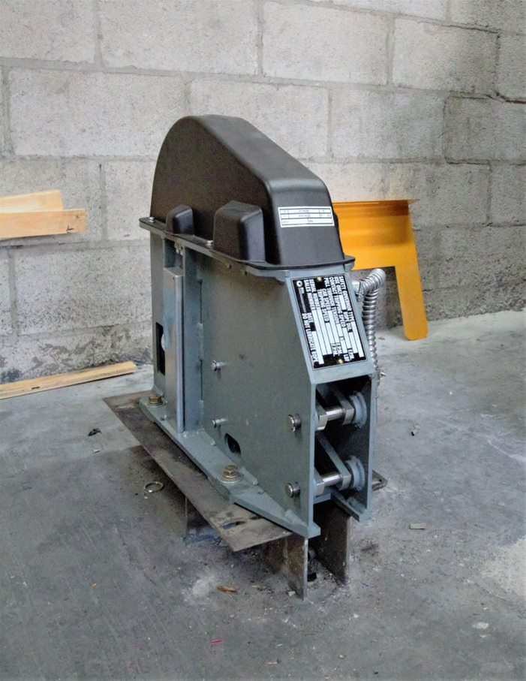
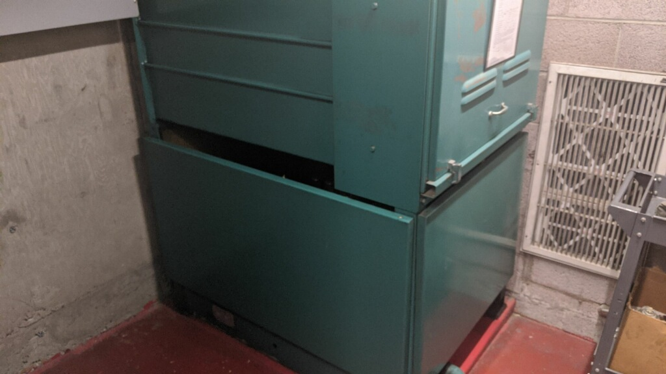
Caught In/Between Hazards
Caught In/Between Hazards
Focus Four
Machine room equipment cont.
Machine guarding is required by OSHA 1926.300(b). If you remove a guard while performing any work, replace it. Always perform LOTO before removing or re-installing guards.

Slide 26
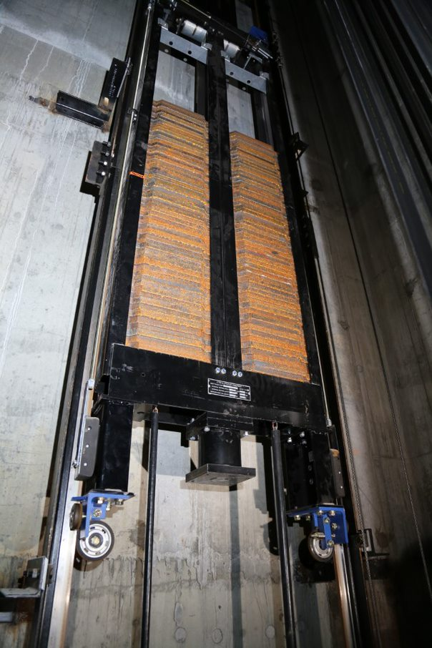
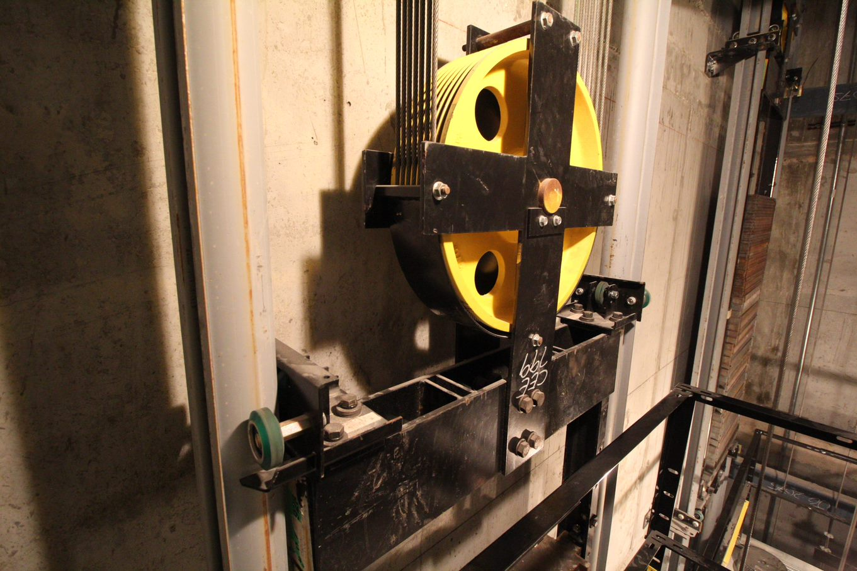
Caught In/Between Hazards
Caught In/Between Hazards
Focus Four
Counterweight
The counterweight runs in the opposite direction of the car and passes with only a few inches of clearance. The counterweight runs silent and appears without warning. Always be aware of the position of the counterweight when running on car top inspection.
Never stand on a divider beam in an active hoistway.

Slide 27
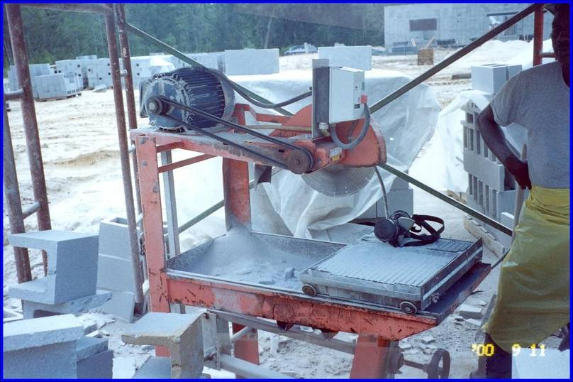
Caught In/Between Hazards
Caught In/Between Hazards
Focus Four
Recognize Any Hazard(s)?

Slide 28
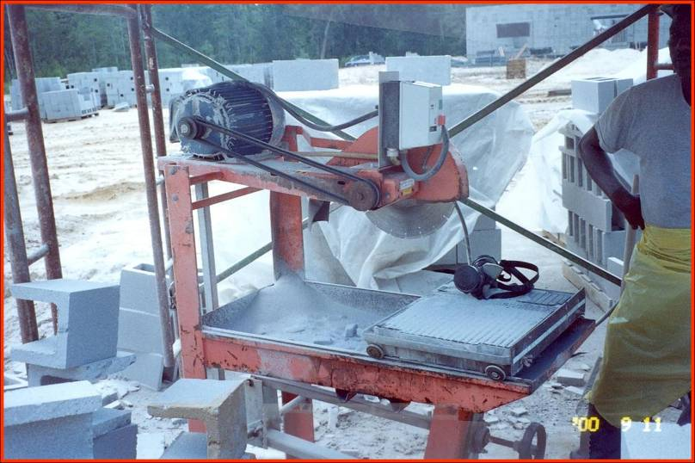
Caught In/Between Hazards
Caught In/Between Hazards
Focus Four
YES
Unguarded belt and pulley. Worker can get hand and/or clothing caught in running nip point

Slide 29
Caught In/Between Hazards
Caught In/Between Hazards
Focus Four
Close Call – Unintended Movement
Description of Incident
A repair crew was performing a 5-year load test on a swing-door hydraulic elevator, specifically, a pressure relief test.
The elevator was approximately 3 feet above the lowest landing, with 1,500 lbs. of test weight inside. The car calls were somewhat accessible, on the right side looking in.
The pit ball valve was shut off. The power was on and the pit switch was in the run position. The Apprentice was at the elevator.
The TM was in the machine room located approximately 150’ from the elevator. Both had constant, direct communication via cell phone.
The Apprentice placed an upper floor car call and held a jumper device in the swing door interlock. The TM was awaiting pump motor actuation to capture relief pressure.
When no pump actuation was initiated, it was decided they needed to move the elevator to reset the test.

Slide 30
Caught In/Between Hazards
Caught In/Between Hazards
Focus Four
Close Call – Unintended Movement
Description of Incident, cont.
The Apprentice removed the jumper device from the interlock, and laid down across the first floor sill with his torso inside the hoistway.
He reached down into the pit and cracked the pit valve, not expecting the car to move.
The elevator began to descend, and the Apprentice immediately closed the valve. The elevator pinned him to the hoistway sill between the toe guard.
The TM heard the control valve release and the Apprentice grunting and struggling. The Mechanic deenergized the main line disconnect and ran to the elevator.
Upon reaching the elevator, the Apprentice had managed to maneuver himself to relieve some of the pressure on his chest.
The TM proceeded to free the Apprentice by removing the toe guard and took him to the ER. Miraculously, the Apprentice sustained no injuries.

Slide 31
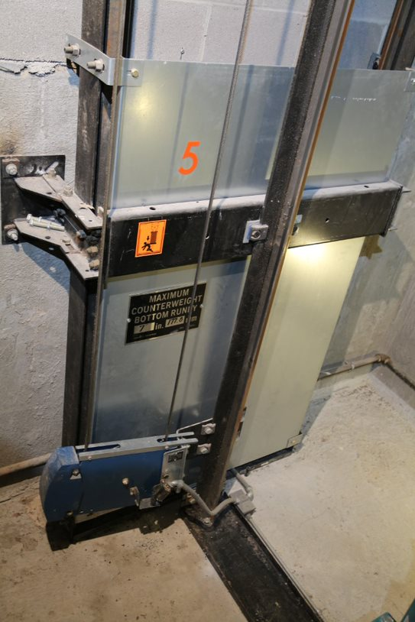
Caught In/Between Hazards
Caught In/Between Hazards
Focus Four
Pit
Always follow your company safety procedures for entering a pit. Be aware of car position when accessing the pit. There are many pinch points to be cautious of, such as between the toe guard and hoistway sill, between the car and pit ladder, or around the counterweight. Counterweight guards should be installed before any movement of the conveyance.

Slide 32
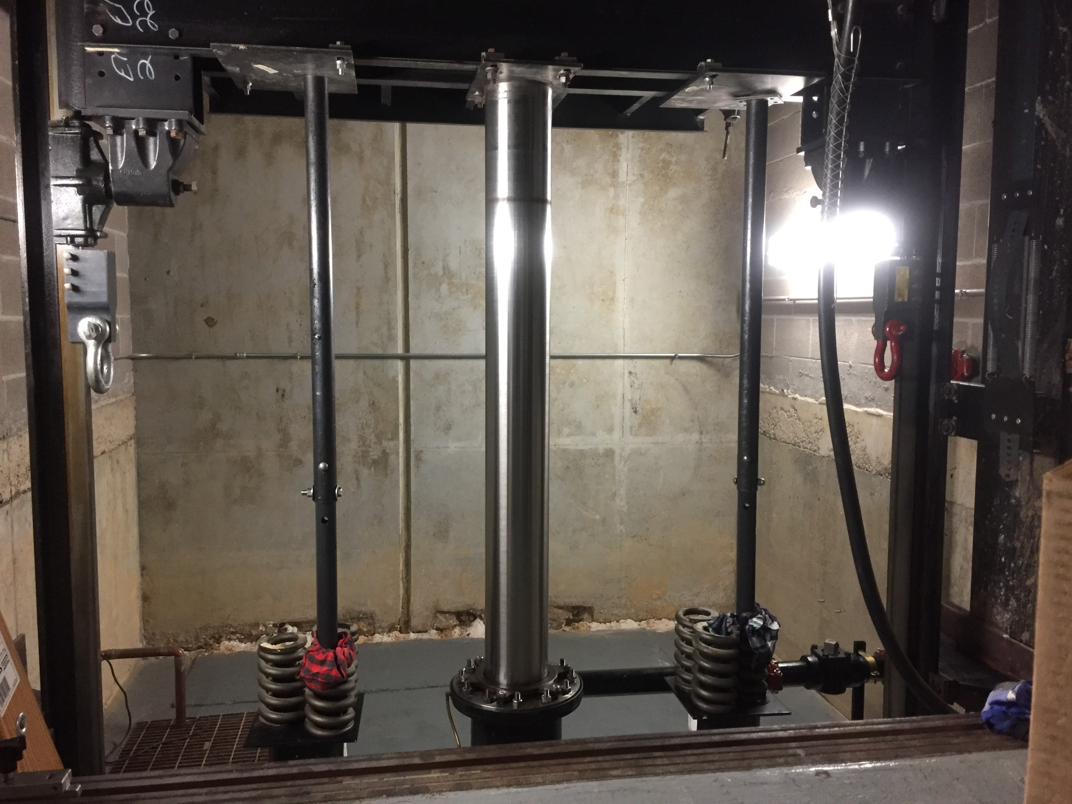
Caught In/Between Hazards
Caught In/Between Hazards
Focus Four
Pit cont.
Working Under a Hydraulic Elevator
Hydraulic elevators are supported by a column of oil. Before entering the pit, secure the elevator car from unintended movement and perform LOTO according to your company safety policy. In this picture, stored energy is controlled by landing the car on pipe stands and performing LOTO. Rail blocks are used as a safety backup for the pipe stands.

Slide 33
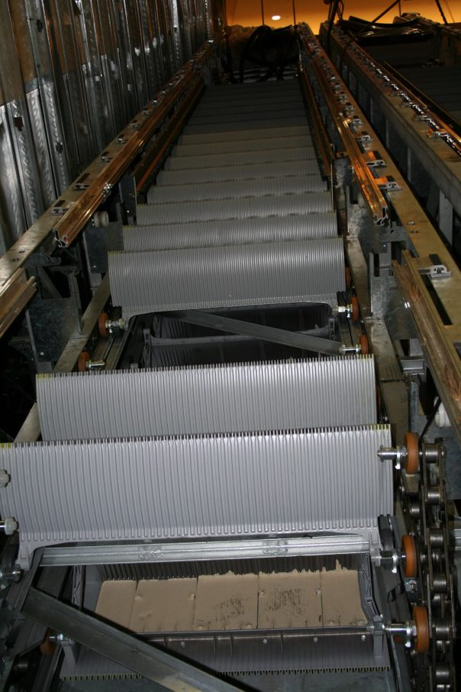
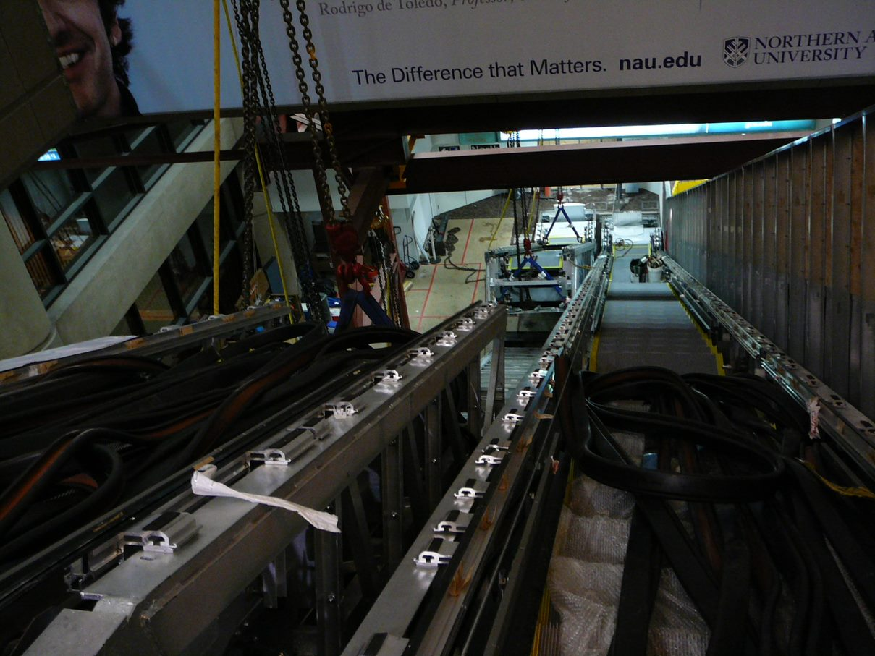
Caught In/Between Hazards
Caught In/Between Hazards
Focus Four
Escalators and Moving Walks
During hoisting operations, be aware of pinch points. Loads sometimes shift quickly and without notice. Units that deliver with some steps/ pallets removed can create an unbalanced load on the system.

Slide 34
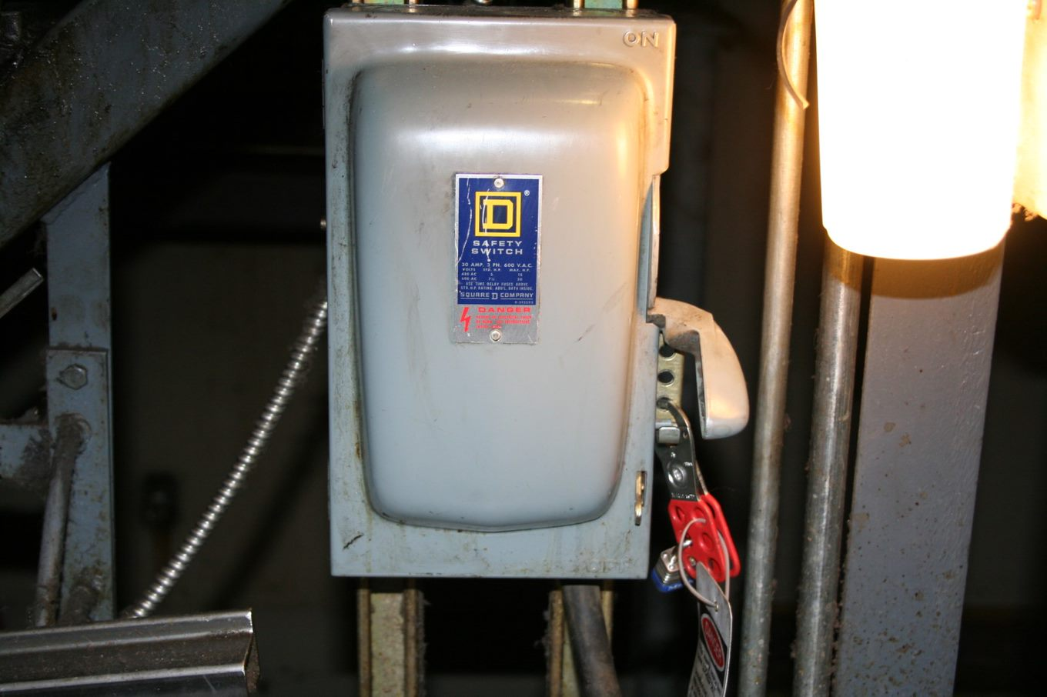
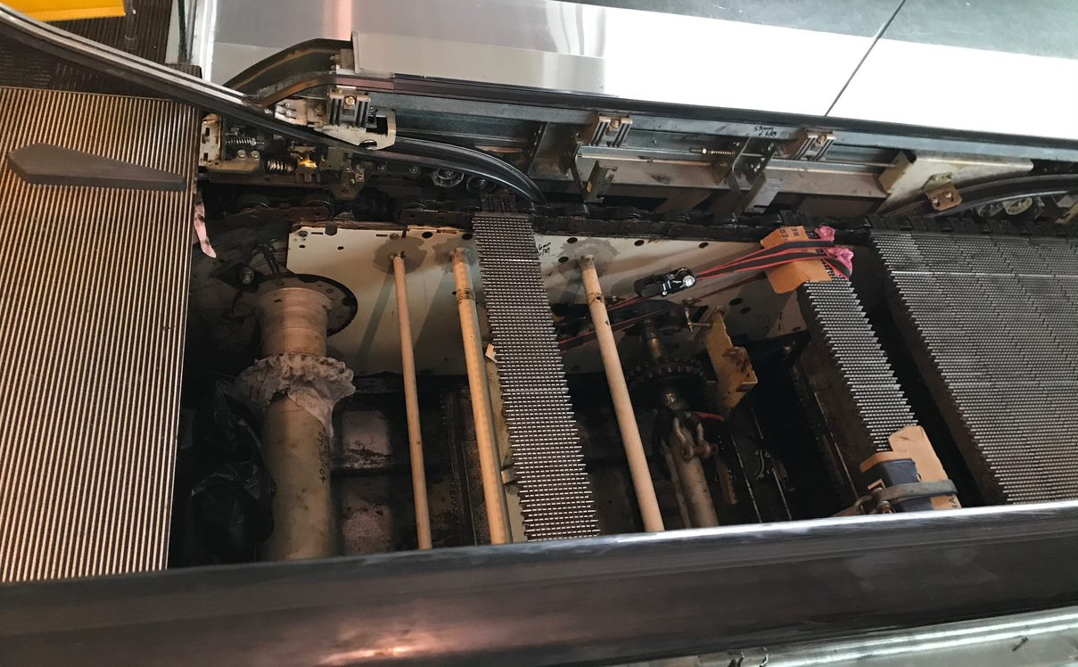
Caught In/Between Hazards
Caught In/Between Hazards
Focus Four
Escalators and Moving Walks
Never enter the step or tread band without performing LOTO and mechanically securing the unit from stored energy or unintended movement.

Slide 35
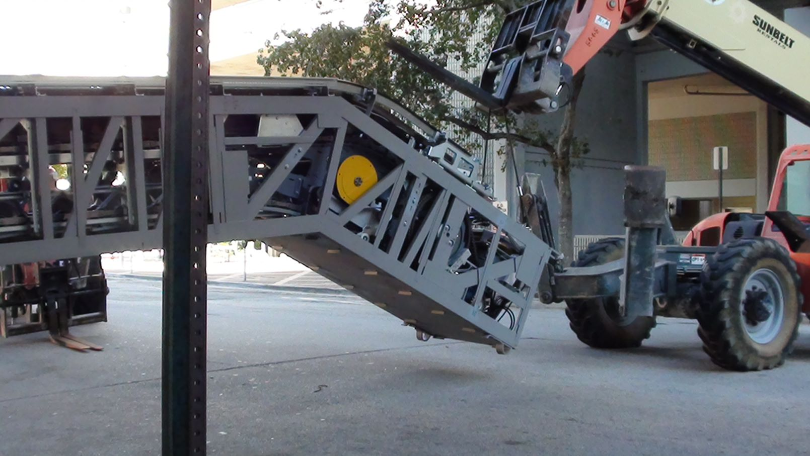
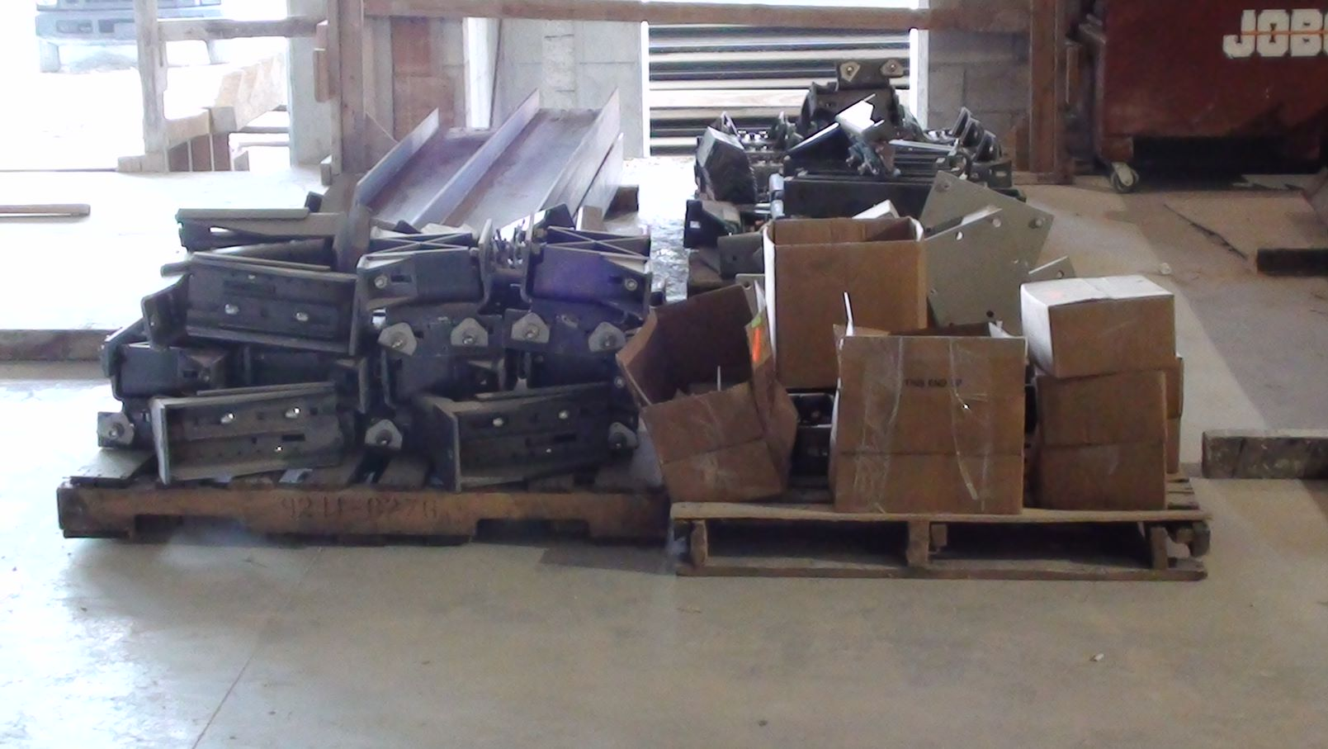
Caught In/Between Hazards
Caught In/Between Hazards
Focus Four
Unloading Equipment
When unloading equipment, remember that loads can shift. Never place yourself where a shifting load can pin you.

Slide 36
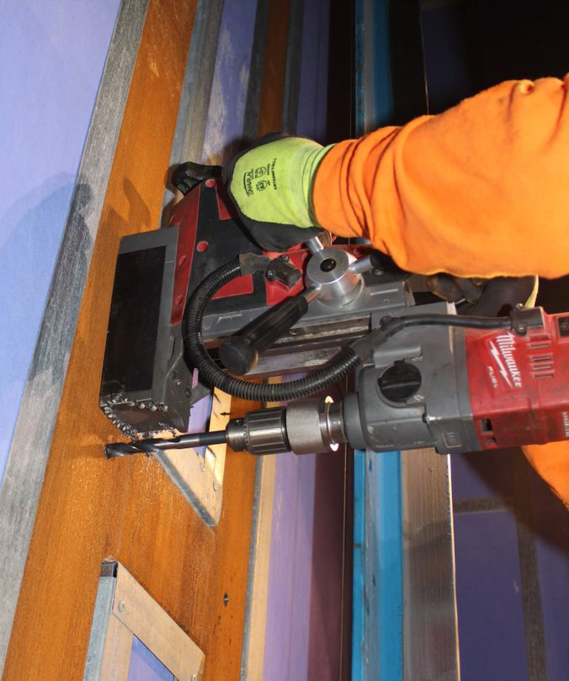
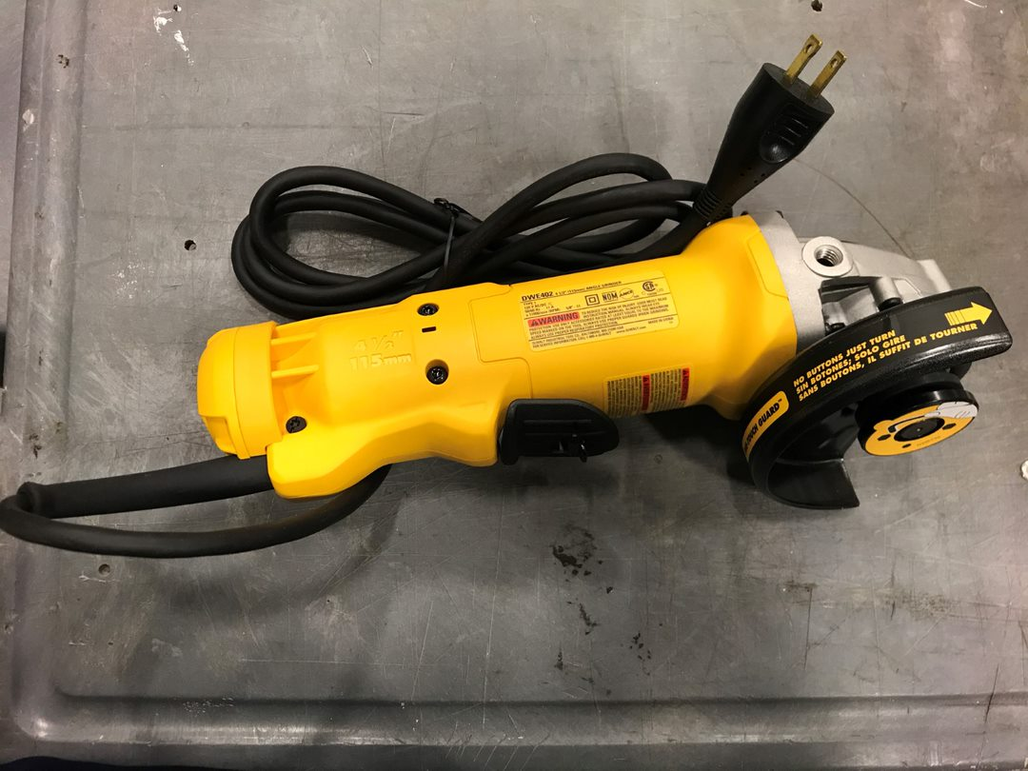
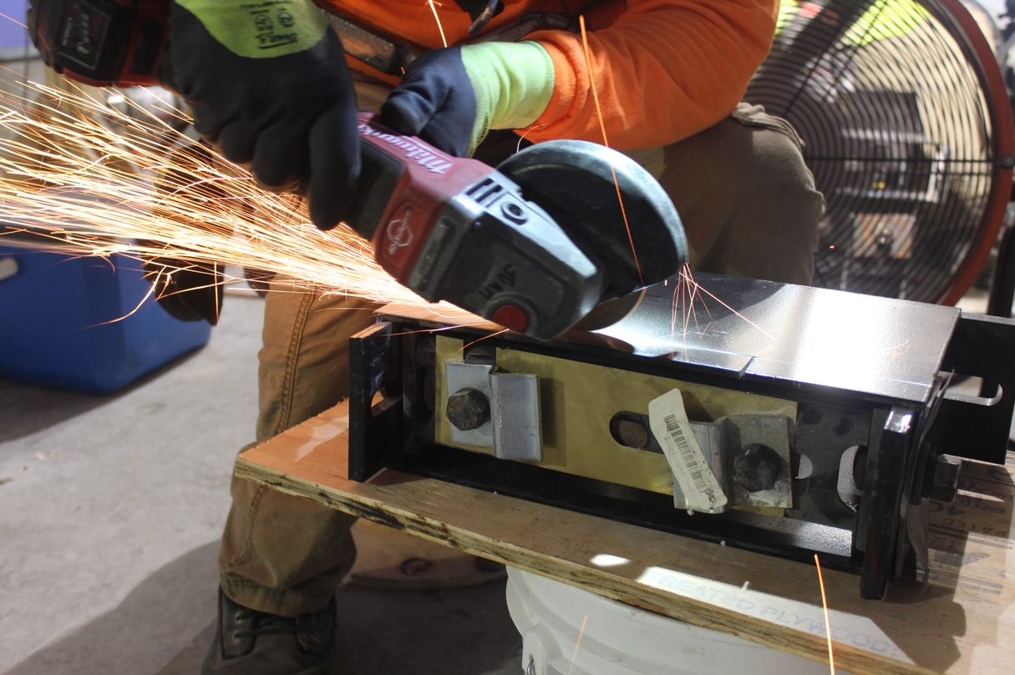
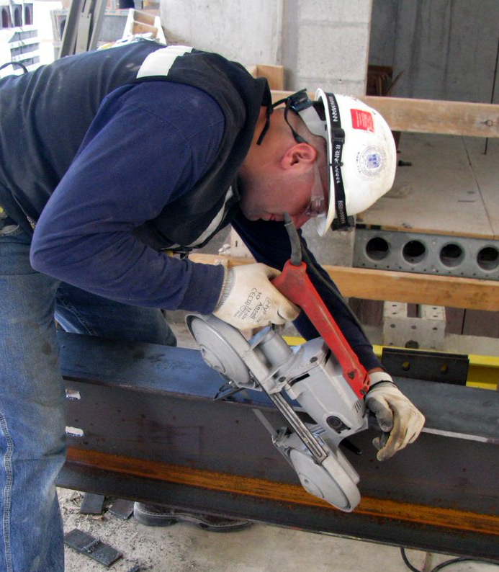
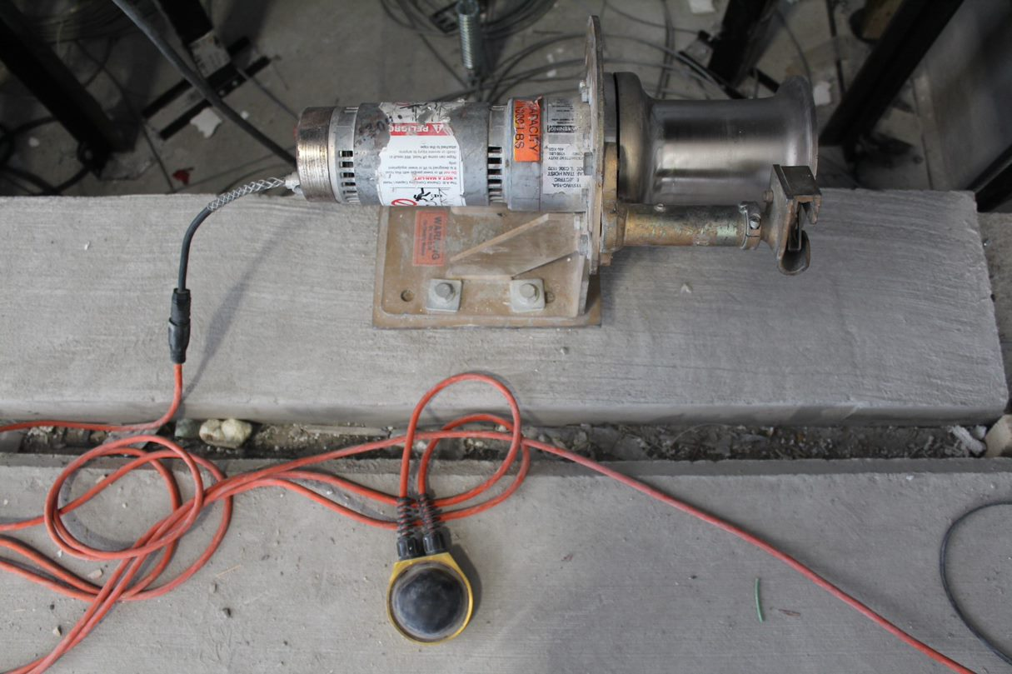
Caught In/Between Hazards
Caught In/Between Hazards
Focus Four
How Can Workers Be Protected From Moving Parts or Equipment?
Notes:
The next two slides address two methods workers can be protected from being caught in machinery or equipment:
1. Machine guards
2. Lock out tag out

Slide 37

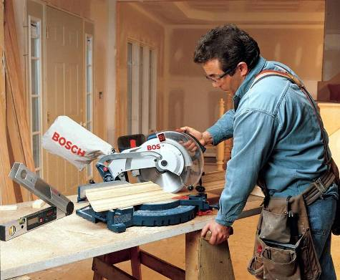
Caught In/Between Hazards
Caught In/Between Hazards
Focus Four
Machine Guards
Employer training in safe use of equipment*
Notes:
Machine guards prevent moving parts of a machine from coming in contact with any part of a worker’s body. Remember:
Guards are there to protect workers
Install and maintain guards on all tools and heavy equipment.
Guards must remain in place at all times and eye protection must be worn.
Machine guards should prevent moving parts of the machine from coming into contact with workers' arms, hands, or any other part of the body. Machine guards should allow workers to use the machines comfortably and efficiently without hindering work.
Guards should be maintained in good condition.

Slide 38
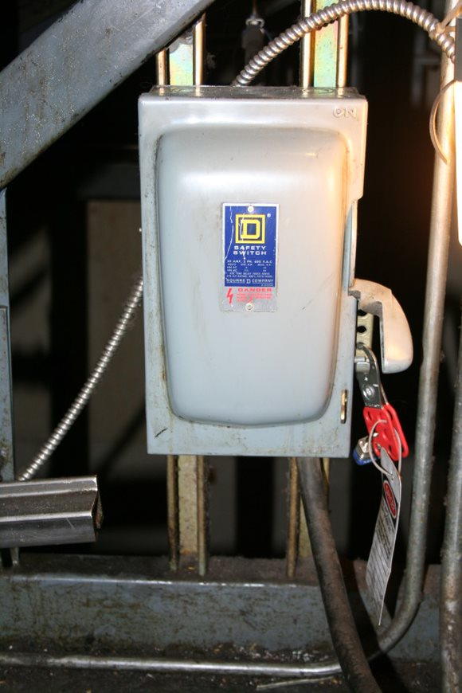
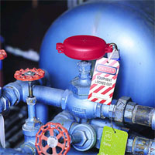
Caught In/Between Hazards
Caught In/Between Hazards
Focus Four
Lockout/Tagout
OSHA says that employers should:
  Set up a written lockout/ tagout program to make sure equipment is disconnected and locked before it is repaired.
  Train you to use the program.
Notes:
Dozens of construction workers are killed every year because they did not de-energize equipment or lock it out before working on it. Most of the deaths are electrocutions, but workers sometimes are crushed or have amputations or other injuries. All types of energy need to be controlled: electric, hydraulic, pneumatic, mechanical, and pressurized liquids, vapors, and gases.
• A lockout device is a lock that controls an energy source. It often has a special tag with a worker’s name. The lock is attached to an isolating device like a circuit breaker, a pipe valve, or a switch that can prevent turning on an energy source or equipment. Lock out can include using a blocking or blanking devices. These are devices used to prevent inadvertent movement in of gas or liquid in pipes.
One form of blocking is called a blind. A blind is a metal disk placed in a pipe joint that prevents the accidental release of liquid, steam, or other substances. Before installing blinds or blocks, workers must bleed down steam, air, or hydraulic lines to get rid of any pressure.
Coiled springs, spring-loaded devices, or suspended loads must also be released so that their stored energy will not result in inadvertent movement of mechanical parts.

Slide 39
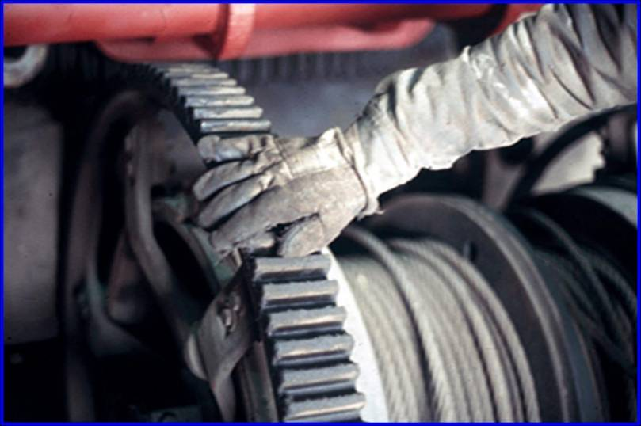
Caught In/Between Hazards
Caught In/Between Hazards
Focus Four
Recognize Any Hazard(s)?

Slide 40
Caught In/Between Hazards
Caught In/Between Hazards
Focus Four
YES
Gloves, long sleeve shirts, jewelry, or loose-fitting clothing can be hazardous if caught in moving parts.

Slide 41
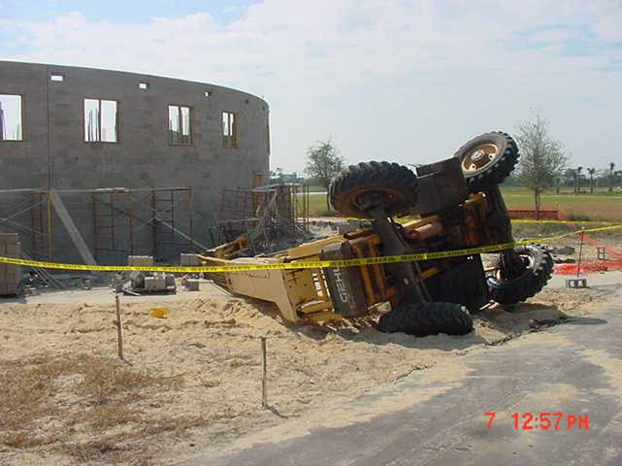
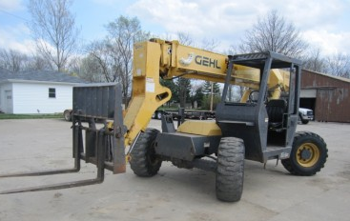
Caught In/Between Hazards
Caught In/Between Hazards
Focus Four
Vehicle Rollovers
Always keep vehicle on stable ground and be aware of terrain transitions.
Notes:
The all-terrain forklift in this picture tipped over. The operator of the forklift was moving forward with the boom extended and lost control when he went from the pavement to the sandy soil.

Slide 42

Caught In/Between Hazards
Caught In/Between Hazards
Focus Four
Session Review:
List three main causes of caught in and caught between fatalities.
Describe how to control hazards that cause caught in
or caught between deaths.
Describe safe equipment operation when there is a
roll-over hazard.
Describe three key employer requirements that protect workers from caught in or caught between hazards.
Notes:
Answers:
1. What are three main causes? There are four so students can recall three or four of them. They should remember the number one cause, and that is cave-ins.
1. Trench cave-in
2. Moving parts of a machine an engine, or a power tool
3. Unguarded belts or pulleys
4. Vehicle roll over
2. Describe how to control hazards that cause this type of fatality:
For cave-ins
a. Benching
b. Shoring
c. Sloping
d. Trench boxes
e. Competent person doing inspection properly and addressing hazards
2. Machine guarding
Guards in place
Lock out tag out procedures used when appropriate
3. Describe safe equipment operation when there is a rollover hazard
1. ROPS Equipment must be installed
2. Training for operators
3. Seatbelts and how to react in the event the machine begins to roll over.
4. Describe three key employer requirements that protect workers from caught in or caught between hazards
1. Train workers about trench hazards
2. Designate a “competent” person before a trench digging starts.
3. Trenches 5 feet or deeper require cave in protection, unless they are in solid rock.
4. The type of trench protection depends on the type of soil, the competent person identifies the soil type.
5. Provide machine guarding
6. Make sure equipment that is subject to roll over hazards has ROPS and seatbelts.

Slide 43
Caught In/Between Hazards
Caught In/Between Hazards
Focus Four
Caught In and Caught Between
Hazards Summary
Trench protection is required for 5 ft. deep or more Methods of trench protection:
  sloping, benching, shoring, shielding
Trench inspections must be conducted by a competent person
Only those who are trained and equipped should perform trench rescues
Use lockout/tagout procedures when servicing or repairing machines
Use heavy equipment that has a ROPS, and fasten the seatbelt.
Notes:
Trench protection may be required below 5 feet, depending on the conditions of the trench and the hazards posed.
Also, some states require cave-in protection at 4 ft. Check your state requirements.
ROPS: Roll Over Protection Structure

Slide 44

Caught In/Between Hazards
Caught In/Between Hazards
Focus Four
Recognize Any Hazard(s)?
Source: Indian River Community (now State) College

Slide 45
Caught In/Between Hazards
Caught In/Between Hazards
Focus Four
YES
Truck box not blocked
Do not work
between the frame
and dump box of
a dump truck
Source: Indian River Community (now State) College
Notes:
Workers should never put themselves under any mechanical lifting device where the failure of the regular operational components would cause the load to fall.
Elevator, forklift, dump truck, backhoe, excavator, crane….

Slide 46

Caught In/Between Hazards
Caught In/Between Hazards
Focus Four
Recognize Any Hazard(s)?

Slide 47
Caught In/Between Hazards
Caught In/Between Hazards
Focus Four
YES
Employee could be caught between track of dozer and wall

Slide 48

Caught In/Between Hazards
Caught In/Between Hazards
Focus Four
Recognize Any Hazard(s)?

Slide 49
Caught In/Between Hazards
Caught In/Between Hazards
Focus Four
YES
The wrecking ball is loosely attached to arm; could come loose and strike operator’s cab
A worker could be caught between the wrecking ball and the dumpster

Slide 50
Caught In/Between Hazards
Caught In/Between Hazards
Focus Four
Through the Alliance between OSHA’s 10 Regional Offices and the Elevator Contractors of America (ECA), Elevator Industry Work Preservation Fund (EIWPF), International Union of Elevator Constructors (IUEC), National Association of Elevator Contractors (NAEC), National Elevator Industry Educational Program (NEIEP), and National Elevator Industry Inc. (NEII), collectively known as The Elevator Industry Safety Partners, developed this Industry Specific Training for informational purposes only. It does not necessarily reflect the official views of OSHA or the U.S. Department of Labor. May 2021
Under the Occupational Safety and Health Act, employers are responsible (http://www.osha.gov/as/opa/worker/employer-responsibility.html) for providing a safe and healthy workplace and workers have rights (https://www.osha.gov/workers). OSHA can help answer questions or concerns from employers and workers. OSHA's On-Site Consultation Program (https://www.osha.gov/consultation) offers free and confidential advice to small and medium-sized businesses, with priority given to high-hazard worksites. For more information, contact your regional or area OSHA office (https://www.osha.gov/contactus/bystate), call 1-800-321-OSHA (6742), or visit https://www.osha.gov/.

Slide 51

Caught In/Between Hazards
Caught In/Between Hazards
Focus Four

