Slide 1
New Hire Training
Scaffolds

Slide 2
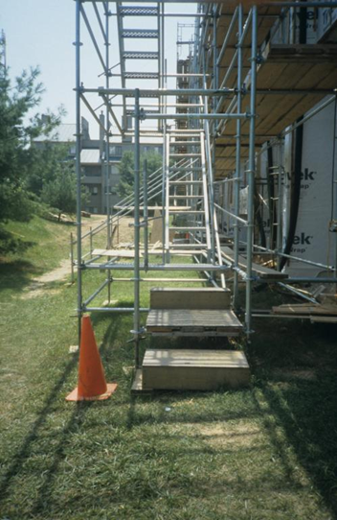
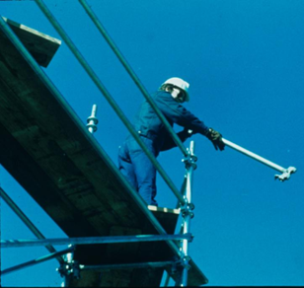
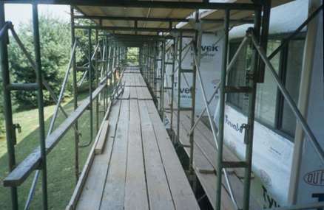
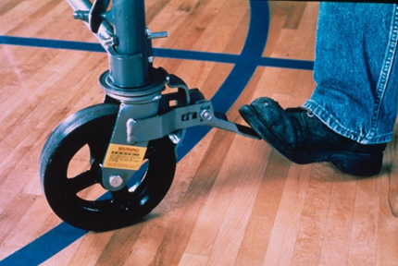
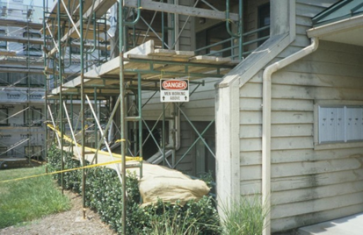
Scaffolds
source: www.elcosh.org/NIOSH/John Rekus
Notes:
Approximately 65% of construction workers frequently work on scaffolds. Scaffold-related accidents account for approximately 4,500 injuries and 50 fatalities every year.
“In a Bureau of Labor and Statistics (BLS) study, 72% of workers injured in scaffold accidents attributed the accident either to the planking or support giving way, or to the employee slipping or being struck by a falling object.” (OSHA SLTC)

Slide 3
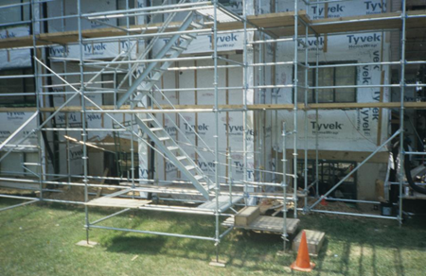
Scaffolds
Introduction
There are many different types of scaffold you will be exposed to as an elevator constructor
You must be able to identify the types of scaffolds commonly used in our industry
Recognizing hazards associated with scaffolds will keep you and others safe
Knowing how to prevent hazards associated with scaffolds is just as important
Employers are required to provide training and protect workers from scaffold hazards
NIOSH/John Rekus/elcosh.org

Slide 4
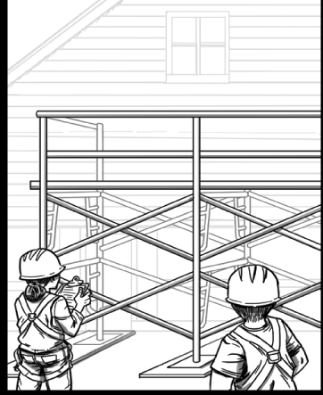
Scaffolds
The Competent Person
The competent person oversees assembly, disassembly, inspection, and safe use of scaffolds
Trains all employees who erect, disassemble, move, operate, repair, maintain, inspect, or work on scaffolds
Source: OSHA
Notes:
CFR 1926.450(b) Definitions. Competent person means one who is capable of identifying existing and predictable hazards in the surroundings or working conditions which are unsanitary, hazardous, or dangerous to employees, and who has authorization to take prompt corrective measures to eliminate them.

Slide 5
Scaffolds
The Competent Person
The competent person is employer appointed
The competent person has the capability to identify hazards
The competent person executes qualified person design
The competent person has the authority to take prompt corrective action

Slide 6
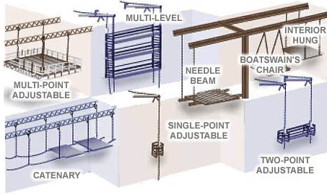
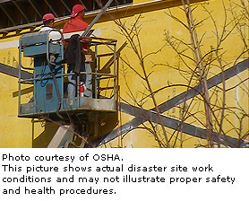
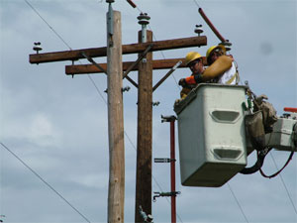
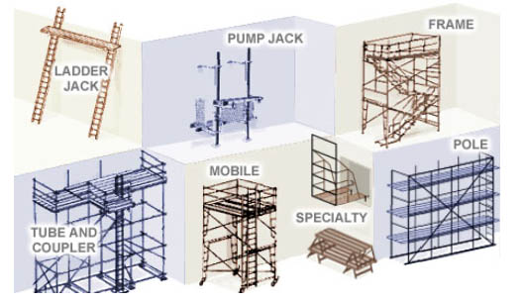
There are 3 Basic Types of Scaffolds
Scaffolds
Suspended
Aerial lifts
Supported
Source: OSHA
Notes:
CFR 1926.450(b) Definitions.
Supported scaffold means one or more platforms supported by outrigger beams, brackets, poles, legs, uprights, posts, frames, or similar rigid support.
Suspension scaffold means one or more platforms suspended by ropes or other non-rigid means from an overhead structure(s).
CFR 1926.453(a)(1)(i-v)
Aerial lifts include the following types of vehicle-mounted aerial devices used to elevate personnel to job-sites above ground:
Extensible boom platforms;
Aerial ladders;
Articulating boom platforms;
Vertical towers;
A combination of any such devices.
Aerial equipment may be made of metal, wood, fiberglass reinforced plastic (FRP), or other material; may be powered or manually operated; and are deemed to be aerial lifts whether or not they are capable of rotating about a substantially vertical axis.

Slide 7
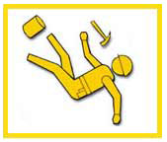
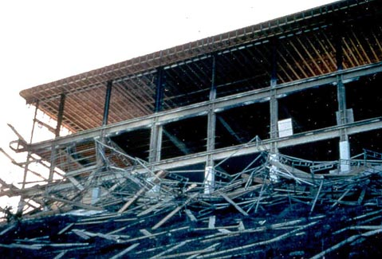
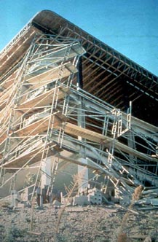
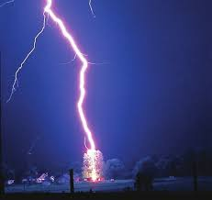
Hazards Associated with Scaffolds
Scaffolds
Falls
Falling object(s)
Electrical hazards (power lines)
Collapse hazards
Planking hazards
Weather conditions
Collisions or struck-by
Source: OSHA
Notes:
Falls – slips, unsafe access, lack of fall protection, or failure of scaffold platforms or planks are factors that lead to fall incidents.
Falling object(s) – materials, debris, or tools may fall from a scaffold at any time and hit workers below.
Electrical hazards – work on scaffolds near power lines exposes workers to electric shock or electrocution.
Collapse hazards – scaffolds can collapse if not secured, level, or stable or if they are overloaded.
Planking hazards – planks that are in poor condition (cracked, dry-rot, or otherwise weakened) or planks that are not placed properly are hazardous due to potential for failure or for people/objects to fall through them.
Weather conditions – rain, snow, wind, lightning
Collisions or struck by a construction vehicle or MV which could lead to tip-over
An estimated 2.3 million construction workers, or 65 percent of the construction industry, work on scaffolds. Protecting these workers from scaffold-related accidents may prevent some of the 4,500 injuries and over 60 deaths every year (Bureau of Labor Statistics (BLS), 2003 and 2004 data for the private sector), at a savings for American employers of $90 million in workdays not lost. In a recent BLS study, 72 percent of workers injured in scaffold accidents attributed the accident either to the planking or support giving way, or to the employee slipping or being struck by a falling object. All of these accidents can be controlled by compliance with OSHA standards.

Slide 8
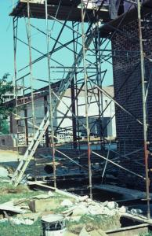
Scaffolds
How can you reduce or eliminating hazards
Provide proper access
Install guardrails
Use your Personal Fall Arrest System (PFAS)
Provide protection from falling objects
Avoid electrical hazards
Ensure safe scaffold construction and disassembly
Source: OSHA

Slide 9
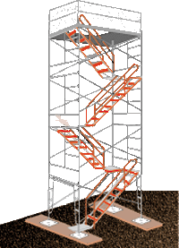
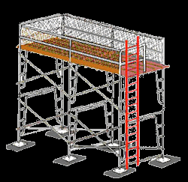
Scaffolds
What is proper access?
Required when platforms are more than two feet above or below a point of access
Examples of permitted access - ladders, stair towers, ramps, walkways
Do not use crossbraces or unapproved ladder-like ends for access
Source: OSHA
Notes:
1926.451(e) "Access." This paragraph applies to scaffold access for all employees. Access requirements for employees erecting or dismantling supported scaffolds are specifically addressed in paragraph (e)(9) of this section.
1926.451(e)(1) When scaffold platforms are more than 2 feet (0.6 m) above or below a point of access, portable ladders, hook-on ladders, attachable ladders, stair towers (scaffold stairways/towers), stairway-type ladders (such as ladder stands), ramps, walkways, integral prefabricated scaffold access, or direct access from another scaffold, structure, personnel hoist, or similar surface shall be used. Crossbraces shall not be used as a means of access.
1926.451(e)(9)(i) The employer shall provide safe means of access for each employee erecting or dismantling a scaffold where the provision of safe access is feasible and does not create a greater hazard. The employer shall have a competent person determine whether it is feasible or would pose a greater hazard to provide, and have employees use a safe means of access. This determination shall be based on site conditions and the type of scaffold being erected or dismantled.

Slide 10
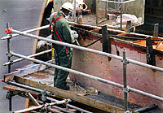
Scaffolds
Guardrails
Must be installed on open sides and ends of scaffolds
If front edge (working edge) is more than 14 inches from work, a guardrail and/or PFAS system must be used
Source: OSHA
Notes:
1926.451(b)(3) Except as provided in paragraphs (b)(3)(i) and (ii) of this section, the front edge of all platforms shall not be more than 14 inches (36 cm) from the face of the work, unless guardrail systems are erected along the front edge and/or personal fall arrest systems are used in accordance with paragraph (g) of this section to protect employees from falling.

Slide 11
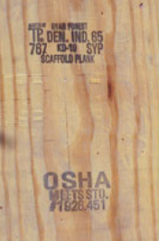
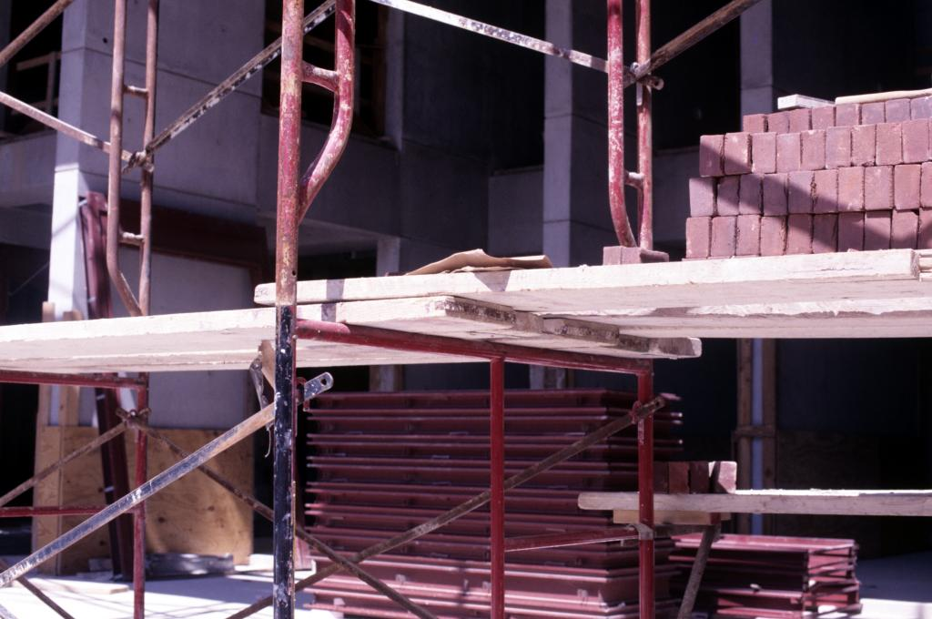
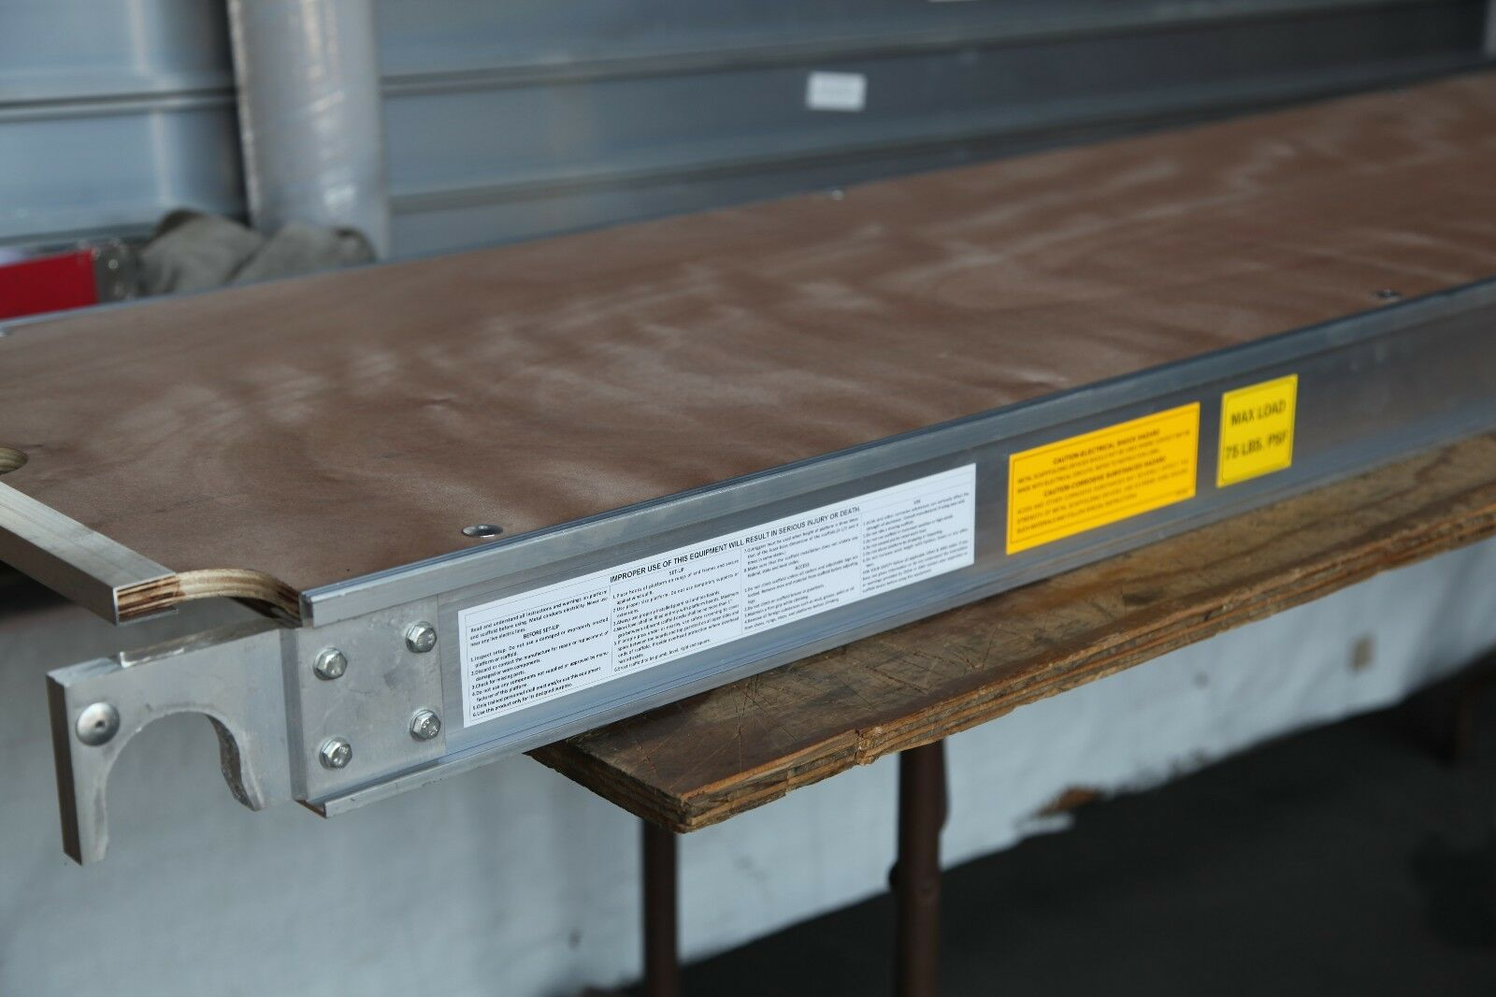
Scaffolds
Platforms
Each platform must be fully planked or decked between the front uprights and the guardrail supports
Planks must only be scaffold grade lumber and overlap at supports
Decks should be in good condition and should be inspected before use
Notes:
Each platform must be fully planked or decked between the front uprights and the guardrail supports [29 CFR 1926.451(b)(1)]
No gaps greater than 1 inch are permitted between adjacent planks or deck units, or between the platform and the uprights, unless the employer can demonstrate that a wider space is necessary. In such cases, the gap will be as small as possible and not exceed 9½ inches. [29 CFR 1926.451(b)(1)(i) and (ii)]
Scaffold platforms and walkways must be at least 18 inches wide, unless they are used in areas that the employer can demonstrate are so narrow that they must be less than 18 inches wide. In such cases, the platforms must be as wide as feasible, and fall protection must be provided. [29 CFR 1926.451(b)(2)(i) and (ii)]
To prevent slippage, platforms must be cleated or otherwise restrained at each end, or else overlap their support at least 6 inches. [29 CFR 1926.451(b)(4)]
On scaffolds where platforms are overlapped to create a long platform, the overlap may only occur over supports, and may not be less than 12 inches, unless the platforms are restrained (i.e., nailed together) to prevent movement. [29 CFR 1926.451(b)(7)]

Slide 12
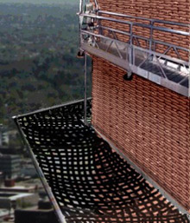
Protection From Falling Objects
Scaffolds
Protection must be provided when there is potential of being struck by falling objects
Methods of protection:
Barricades, toeboards, screens or paneling, canopy or mesh nets.
Always wear a hardhat when working around or below scaffolds
Source: OSHA
Notes:
1926.451(h)(1)
In addition to wearing hardhats each employee on a scaffold shall be provided with additional protection from falling hand tools, debris, and other small objects through the installation of toeboards, screens, or guardrail systems, or through the erection of debris nets, catch platforms, or canopy structures that contain or deflect the falling objects. When the falling objects are too large, heavy or massive to be contained or deflected by any of the above-listed measures, the employer shall place such potential falling objects away from the edge of the surface from which they could fall and shall secure those materials as necessary to prevent their falling.

Slide 13
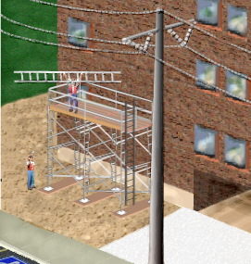
Protection From Electrical Hazards
Scaffolds
There are minimum safe distances your scaffold must be from power lines based on voltage:
Insulated lines:
less than 300 volts – 3 feet
300 volts to 50 kilovolts – 10 feet
Over 50 kilovolts – 10 ft plus .4 inches for each 1 kV over 50 kV
Uninsulated lines:
Less than 50 kilovolts – 10 feet
More than 50 kilovolts – 10 feet plus .4 inches for each 1 kV over 50 kV
When exceeding minimum distance as necessary to perform work, utility company must be notified to
De-energize or relocate line
OR
Install protective coverings to prevent contact
Source: OSHA
Notes:
1926.451(f)(6)
The clearance between scaffolds and power lines shall be as follows: Scaffolds shall not be erected, used, dismantled, altered, or moved such that they or any conductive material handled on them might come closer to exposed and energized power lines than as follows:
Insulated lines
i. Less than 300 volts – 3 feet
ii. 300 volts to 50 kilovolts – 10 feet
iii. More than 50 kilovolts – 10 feet plus 0.4 inches for each 1 kV over 50 kV
b. Uninsulated lines
i. Less than 50 kV – 10 feet
ii. More than 50 kV – 10 feet plus 0.4 inches for each 1 kV over 50 kV

Slide 14
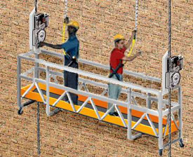
Scaffolds
Suspension Scaffolds
Requirements:
Scaffold must solidly attach
to the structure
All parts must be in good repair
Scaffold must have guardrails: toprail, midrail, and toeboard
Platforms must be at least 20”wide, no wider than 36”
The scaffold must be evaluated by a competent person
Wire ropes must be inspected prior to a work shift by a competent person
Source: OSHA
Notes:
All suspension scaffold support devices, such as outrigger beams, cornice hooks, parapet clamps, and similar devices, shall rest on surfaces capable of supporting at least 4 times the load imposed on them by the scaffold operating at the rated load of the hoist (or at least 1.5 times the load imposed on them by the scaffold at the stall capacity of the hoist, whichever is greater). [1926.451(d)(1)]
Each employee on a single-point or two-point adjustable suspension scaffold shall be protected by both a personal fall arrest system and guardrail system; [1926.451(g)(1)(ii)]
Platforms shall not be more than 36 inches (0.9 m) wide unless designed by a qualified person to prevent unstable conditions. [1926.452(p)(1)]
The platform shall be securely fastened to hangers (stirrups) by U-bolts or by other means which satisfy the requirements of §1926.451(a). [1926.452(p)(2)]
Platforms shall be of the ladder-type, plank-type, beam-type, or light-metal type. Light metal-type platforms having a rated capacity of 750 pounds or less and platforms 40 feet (12.2 m) or less in length shall be tested and listed by a nationally recognized testing laboratory. [1926.452(p)(4)]
Scaffolds and scaffold components shall be inspected for visible defects by a competent person before each work shift, and after any occurrence which could affect a scaffold's structural integrity. [1926.451(f)(3)]
Ropes shall be inspected for defects by a competent person prior to each workshift and after every occurrence which could affect a rope's integrity.

Slide 15
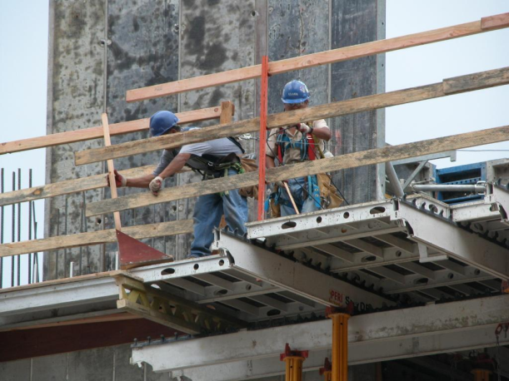
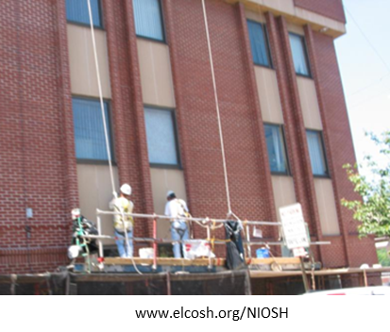
Summary
Scaffolds
Employers must:
Designate a competent person for scaffold
Ensure that employees are trained in proper assembly, disassembly, and use of scaffolds
www.elcosh.org/Steve Clark/Laborers
Train employees to recognize scaffold hazards
Utilize strategies to prevent and reduce scaffold hazards

Slide 16
Through the Alliance between OSHA’s 10 Regional Offices and the Elevator Contractors of America (ECA), Elevator Industry Work Preservation Fund (EIWPF), International Union of Elevator Constructors (IUEC), National Association of Elevator Contractors (NAEC), National Elevator Industry Educational Program (NEIEP), and National Elevator Industry Inc. (NEII), collectively known as The Elevator Industry Safety Partners, developed this Industry Specific Training for informational purposes only. It does not necessarily reflect the official views of OSHA or the U.S. Department of Labor. March 2025
Under the Occupational Safety and Health Act, employers are responsible (http://www.osha.gov/as/opa/worker/employer-responsibility.html) for providing a safe and healthy workplace and workers have rights (https://www.osha.gov/workers). OSHA can help answer questions or concerns from employers and workers. OSHA's On-Site Consultation Program (https://www.osha.gov/consultation) offers free and confidential advice to small and medium-sized businesses, with priority given to high-hazard worksites. For more information, contact your regional or area OSHA office (https://www.osha.gov/contactus/bystate), call 1-800-321-OSHA (6742), or visit https://www.osha.gov/.

