Slide 1
Introduction to Stairways and Ladders
1

Slide 2
Introduction
Stairways and Ladders
Falls are the leading cause of fatalities in constructions
Falls from ladders make up about one-third of these fatalities
Approximately 25,000 injuries per year due to falls from stairways and ladders
Falls are preventable

Slide 3
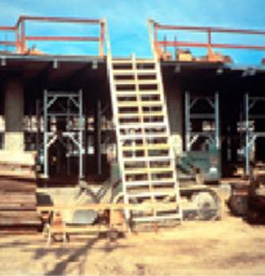
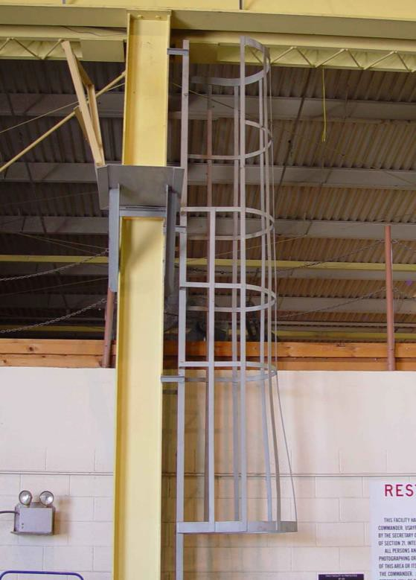
Types of Ladders & Stairways
Stairways and Ladders
Fixed ladders
Source: OSHA
Source: TEEX Harwood

Slide 4
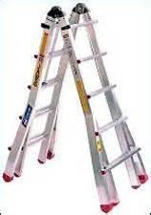
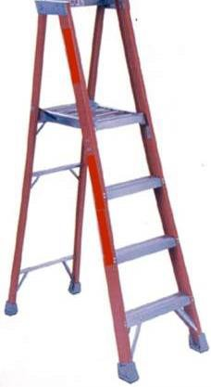
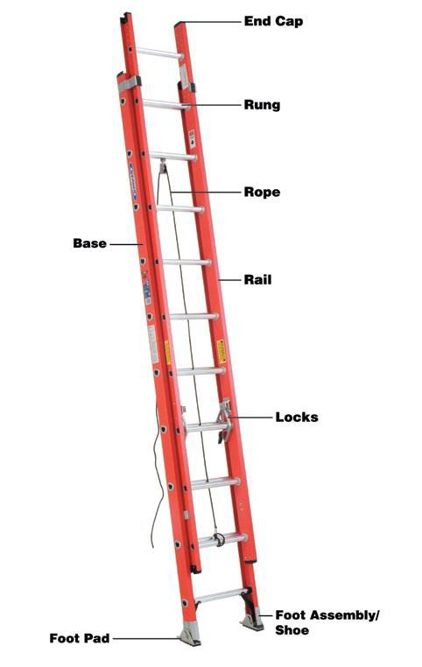
Types of Ladders & Stairways
Stairways and Ladders
Portable ladders
Source of photos: OSHA

Slide 5
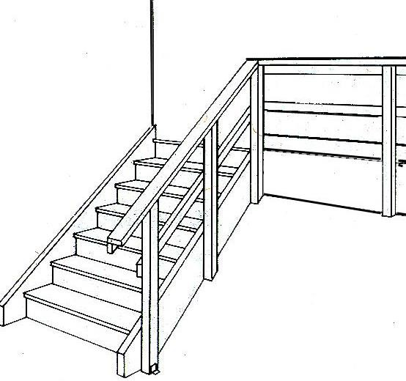
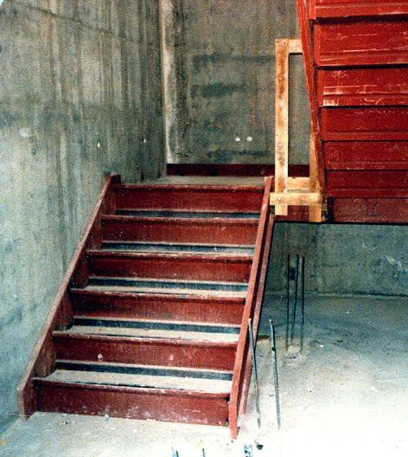
Types of Ladders & Stairways
Stairways and Ladders
Stairways
Source of graphics: OSHA

Slide 6
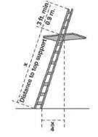
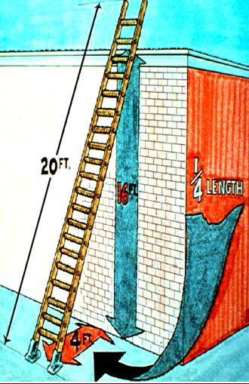
Reducing or Eliminating Hazards
Stairways and Ladders
Ladder-use practices
Extend side rails 3 feet above
the upper landing surface
Don’t exceed load/capacity
Use only as designed
Angle ladder so the horizontal distance of bottom is ¼ the working length of the ladder
Source of graphics: OSHA

Slide 7
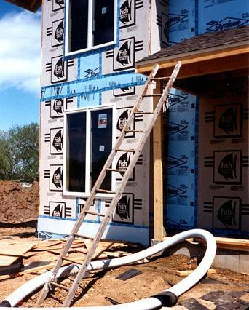
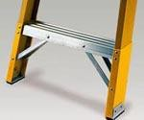
Reducing or Eliminating Hazards
Stairways and Ladders
Pitch fixed ladders no more than 90 degrees from the horizontal
Avoid use of ladder on surfaces that are:
Unstable
Not level
Slippery
Secure ladders to prevent movement
This ladder is not on a stable surface and is not properly positioned.
Source of photos: OSHA

Slide 8
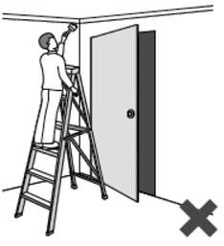
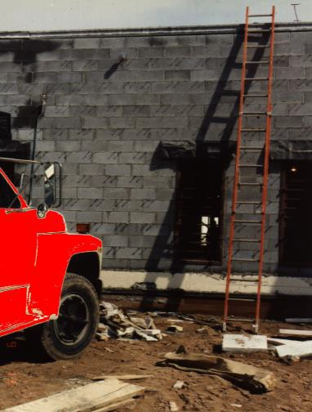
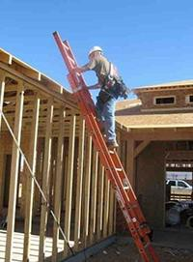
Reducing or Eliminating Hazards
Stairways and Ladders
Prevent movement/displacement
Secure
Barricade
Keep clear areas around top and bottom
Equally support rails of non-self-supporting ladder at the top
Source of photos: OSHA

Slide 9
Stairways and Ladders
Reducing or Eliminating Hazards
Ascending or descending ladder
Maintain 3-point contact
Face ladder
Stay inside side rails
Never carry tools/objects in hands
Be extra careful getting on or off
Source: OSHA
Source: OSHA

Slide 10
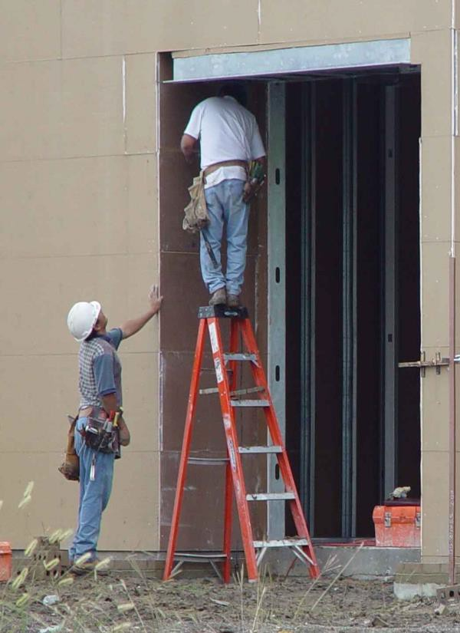
Reducing or Eliminating Hazards
Stairways and Ladders
Don’t move, shift, or extend while in use
When exposed to energized electrical equipment, use nonconductive side rails
Don’t use the top two steps of a stepladder
Don’t climb the cross-bracing on the rear section of a stepladder
Source: TEEX – Harwood

Slide 11
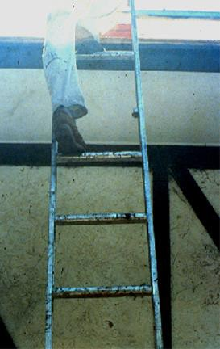
Stairways and Ladders
Reducing or Eliminating Hazards
Remove defective ladders from service
Broken or missing parts
Corrosion
Other faulty or defective components
Mark defective or tag “Do Not Use”
Repair to original design criteria
Source: OSHA

Slide 12
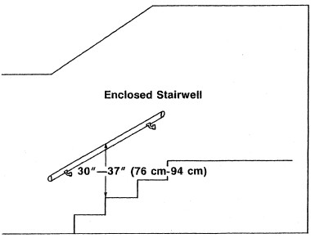
Reducing or Eliminating Hazards
Stairways and Ladders
Install handrail on stairways
4 or more risers
30 inches of rise
Source: OSHA

Slide 13
Summary
Stairways and Ladders
Key components for ladder safety:
A competent person must inspect
Use the correct ladder for the job
Use the correct angle, supports, treads, cross braces, and rails
Don’t overload
Your employer must train you in proper use of a ladder

Slide 14
Summary
Stairways and Ladders
Key components for stairway safety
–Treads
Rails
Handrails
Stair rails
Guardrails
Landings and Platforms

Slide 15
Through the Alliance between OSHA’s 10 Regional Offices and the Elevator Contractors of America (ECA), Elevator Industry Work Preservation Fund (EIWPF), International Union of Elevator Constructors (IUEC), National Association of Elevator Contractors (NAEC), National Elevator Industry Educational Program (NEIEP), and National Elevator Industry Inc. (NEII), collectively known as The Elevator Industry Safety Partners, developed this Industry Specific Training for informational purposes only. It does not necessarily reflect the official views of OSHA or the U.S. Department of Labor. March 2025
Under the Occupational Safety and Health Act, employers are responsible (http://www.osha.gov/as/opa/worker/employer-responsibility.html) for providing a safe and healthy workplace and workers have rights (https://www.osha.gov/workers). OSHA can help answer questions or concerns from employers and workers. OSHA's On-Site Consultation Program (https://www.osha.gov/consultation) offers free and confidential advice to small and medium-sized businesses, with priority given to high-hazard worksites. For more information, contact your regional or area OSHA office (https://www.osha.gov/contactus/bystate), call 1-800-321-OSHA (6742), or visit https://www.osha.gov/.

