Slide 1

Rigging and Hoisting
1926.251

Slide 2
Rigging and Hoisting
Objectives
By the end of this presentation, students will be able to:
Identify types of hoisting and rigging equipment.
Describe methods used to inspect rigging equipment for damage, defects, or missing components.
Identify tools and hardware used for rigging and hoisting work.
Identify different sling configurations, sling capacities, and hitch capacities and describe how each affects total lift capacity .
Describe the different types of manual hoisting equipment and power hoisting equipment used in rigging and hoisting work.
Recognize hazards associated with rigging and hoisting.

Slide 3
Rigging and Hoisting
The term rigging applies to all aspects of moving and hoisting heavy parts and machinery, as well as assembling the hoisting beam or cathead and attaching the components of the hoisting assembly.
Also included in rigging is the application of slings, chains, chokers, etc. to the load in preparation for hoisting (the actual raising or lifting operation). Hoisting may be done by hand or with the use of power equipment.

Slide 4
Rigging and Hoisting
Designated person
Competent person
Qualified person
29 CFR 1926.32(l) states: "Qualified" means one who, by possession of a recognized degree, certificate, or professional standing, or who by extensive knowledge, training and experience, has successfully demonstrated his ability to solve or resolve problems relating to the subject matter, the work, or the project.
The term "designated" personnel means selected or assigned by the employer or the employer's representative as being qualified to perform specific duties.
29 CFR 1926.32(f) states: "Competent person" means one who is capable of identifying existing and predictable hazards in the surroundings or working conditions, which are unsanitary, hazardous, or dangerous to employees, and who has authorization to take prompt corrective measures to eliminate them.

Slide 5
Rigging and Hoisting
  What are some tools, hardware, and equipment used for rigging and hoisting?
Notes:
Shown (clockwise from top): Manila rope, shackles, wire rope clips and fist grip clips, rail clevis, eye bolts, slings and master link

Slide 6
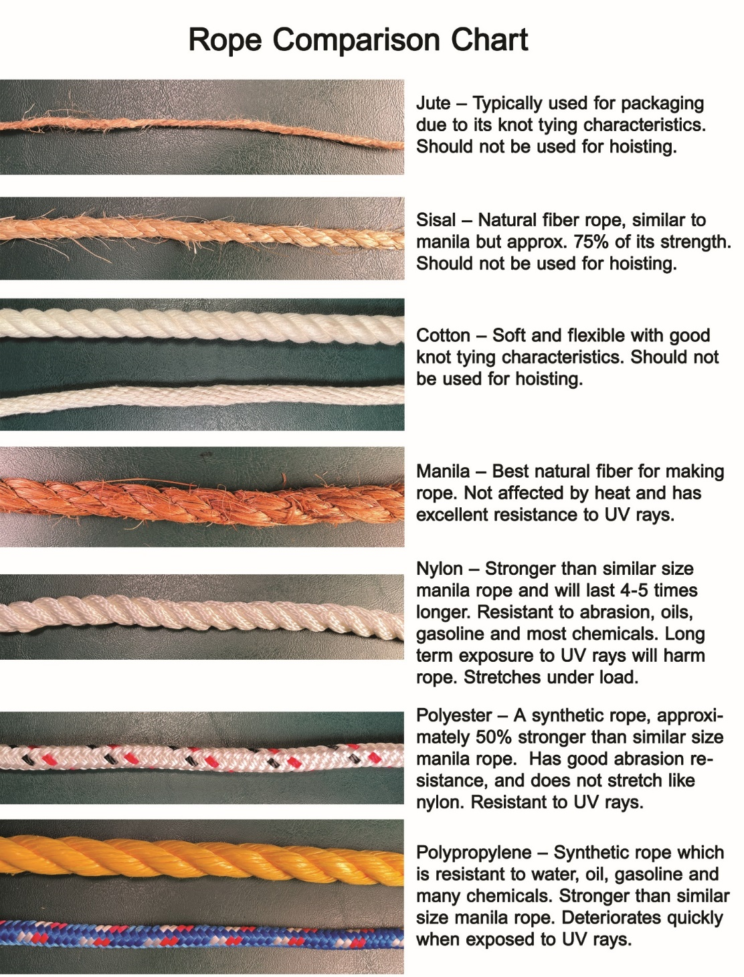
Rigging and Hoisting
Ropes
Natural, synthetic, and steel ropes are all used to hoist loads in the elevator industry. The type of rope chosen to hoist a particular load varies depending on the characteristics of the load and the environmental conditions on the jobsite.
It’s important to know the difference between rope types and identify which are safe to use for hoisting.

Slide 7

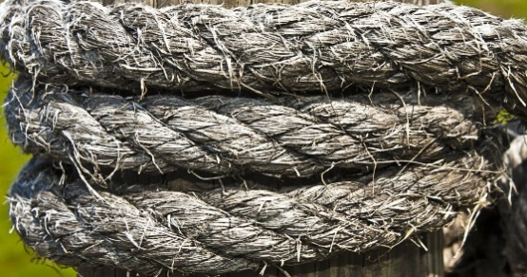
Rigging and Hoisting
Manila Rope Characteristics
Natural manila rope is commonly used for hoisting because it costs less and is less subject to stretch than synthetic fiber ropes. Manila is the best natural fiber used for making rope. Good quality manila rope has a light-yellow color with a silvery or pearly luster; dark colored fibers are not as strong and are less resistant to wear.
Notes:
All natural fiber ropes absorb moisture and are subject to rot and mildew. To maintain manila rope’s maximum strength, it is important to keep it dry and to dry it quickly if it gets wet. Never store manila rope on the floor, especially on a concrete floor where it can absorb moisture. Store it in an open-sided crate blocked up several inches from the floor and allow plenty of air circulation in the storage room. If coiled correctly, the rope coil can be suspended from hooks or pegs, allowing maximum air circulation.

Slide 8
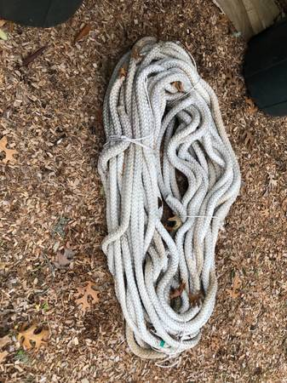
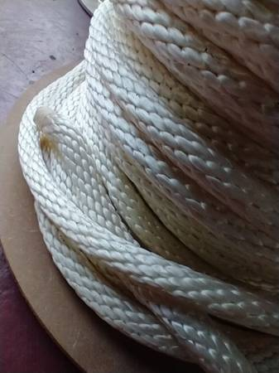
Rigging and Hoisting
Synthetic Rope Characteristics
Synthetic fiber ropes have a much greater breaking strength than natural fiber ropes. Nylon, polyester, polypropylene, polyethylene, and Kevlar® are among the materials used, with nylon and polyester ropes most commonly used for hoisting. Nylon rope is much stronger than the same diameter manila rope and has excellent abrasion resistance. However, nylon rope stretches under load, which may be a disadvantage in certain hoisting applications.
Notes:
Synthetic fiber ropes are impervious to moisture and will not rot or mildew, even under the worst conditions of repeated wetting. However, some synthetics deteriorate slightly when exposed to sunlight. Polyester is completely resistant to sunlight, nylon shows some effects after long exposure, and polyethylene and polypropylene deteriorate rather rapidly under ultraviolet rays.
Synthetic fiber ropes cost more than manila ropes, but their longer life may offset the higher initial cost. Synthetic ropes are resistant to most commonly encountered chemicals. Where breaking strength of manila rope can vary widely because of environmental and processing factors, breaking strength of synthetic fiber ropes is made constant by rigid manufacturing controls.

Slide 9
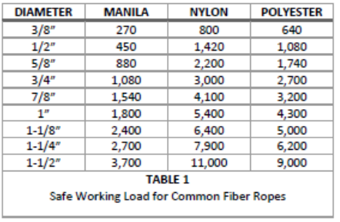
Rigging and Hoisting
Safe Working Load
Breaking strength is the tension at which a rope will tear under a load. Manufacturers determine breaking strength using testing devices. The safe working load of a rope is determined by dividing the breaking strength by a safety factor . Tables are published using a safety factor of 5. For example, a rope having a breaking strength of 5,000 lbs. would be rated as having a safe working load of 1,000 lbs. (5,000 ÷ 5).
Notes:
REMEMBER: VALUES GIVEN IN THE TABLES APPLY TO NEW ROPES USED UNDER FAVORABLE CONDITIONS, AND DO NOT INCLUDE THE EFFECTS OF KNOTS.
The values shown in Table 1 are for new rope. Rope loses strength as it is used and reused. In the field, it is better to allow a safety factor of 10, which is half the value shown in Table 1. A safety factor of 10 is also recommended when the rope has been in use for a period of time. Apply a higher safety factor when using a fiber rope for power hoisting, e.g., with a capstan .

Slide 10
Rigging and Hoisting
Knowledge Check
The only natural fiber rope suitable for hoisting is?
The most common synthetic fiber rope is made of?
Manilla
Nylon

Slide 11
Rigging and Hoisting
Inspecting Ropes
Inspect the entire length of ropes often to be certain they are safe for continued use. The following faults may be cause for rejection:
• Broken yarns or strands
• Spots or sections of rot or mildew
• Abrasion and wear
• Cuts or burns
• Dirt between fibers
• Water soaking and freezing
Ropes that do not pass inspection should be tagged as defective and returned. After inspecting the rope surface, check its internal condition. Untwist strands slightly to open the rope for interior examination. The inside should be clean and bright like a new rope. When inspecting a large diameter rope, open one strand using a blunt object and draw out an inside yarn. Poor condition of the yarn indicates the rope has been overloaded.
If the interior contains dirt or is stained, showing evidence of rot or mildew, do not use the rope for hoisting. Mildewed rope gives off a musty odor.

Slide 12
Rigging and Hoisting
Storage
Never store a rope that is wet. Make sure the rope is thoroughly dry and store it in a cool place with good air circulation.
Do not store ropes near a source of intense heat or in a room subject to extreme high temperature. Heat can damage both natural and synthetic fiber ropes - natural fiber ropes can lose up to 20% of their strength, and some synthetic ropes can lose as much as 50% of their strength.

Slide 13
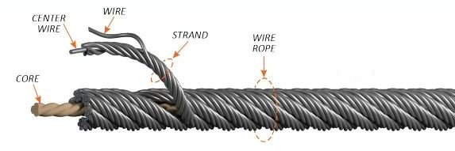
Rigging and Hoisting
Wire Rope
Wire Rope Characteristics
Wire rope is made up of fine wires laid down in a spiral to form strands. Several strands are then laid down in spirals together over a central core to form the completed rope.
While wear is usually uniform throughout a length of wire rope, broken wires are generally found in one particular section.
Before using wire rope for rigging or hoisting, always examine the entire length of the rope carefully, or you could miss a section having dangerously broken wires.

Slide 14
Rigging and Hoisting
Inspection
Wire hoisting rope and wire rope slings must be visually inspected before each day's use by a designated person.
Always check the twists or lay of the rope. It is not sufficient to check only the condition of the wire rope; end fittings and other components should also be inspected for any damage that could make the sling unsafe.
Wire rope slings can provide a margin of safety by showing early signs of failure.

Slide 15
Rigging and Hoisting
Slings
Choosing the correct sling can be very challenging. Each year, accidents and deaths occur because someone made the wrong choice.
Loads, headroom, and environmental conditions must all be considered carefully as part of the sling selection process.
The sling that you choose must be capable of safely holding the largest load you intend to pick combined with the weight of anything that will be picked by the sling (including lifting devices such as spreader bars/beams , grabs, shackles, etc.). It must also be made of the right material for your specific rigging task and jobsite conditions.

Slide 16
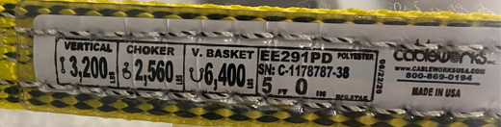
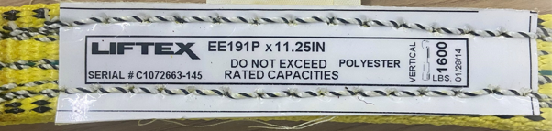
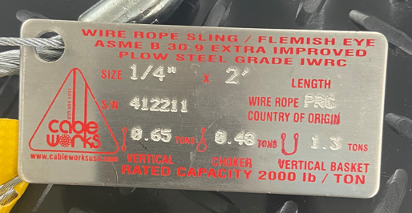
Rigging and Hoisting
Choosing the Proper Sling
Rated Load
All slings must be labeled with an identification tag that displays specific information required by OSHA, including the rated load that the sling is designed to handle. This rating is the safe load limit that can be picked and held by this sling, considering the safety factor or design factor.

Slide 17
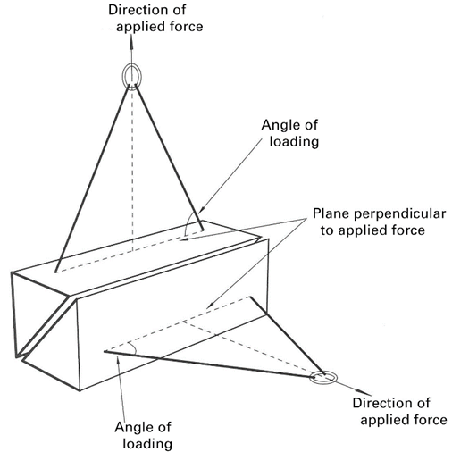
Rigging and Hoisting
Rated Load cont.
Rated loads are based on:
Material strength
Design factor
Type of hitch
Angle of loading
Diameter of curvature over which the sling is used
Fabrication efficiency
The rated load is derived by dividing the safety factor into the nominal strength of the sling (as described earlier). This is done to allow for things that may be missed by the rigger such as variations in the load that could cause uneven loading, or wear / damage that is not apparent.

Slide 18
Rigging and Hoisting
Rated Load cont.
You may also find information on the rated load for the different types of hitches that can be made. NEVER exceed the rated load of a sling or any other hoisting device.
Some might think the safety factor gives them leeway to exceed rated load. This is not true and is a risky practice.
Equipment damage, serious injury, or death can result from exceeding the rated load, even for a short period of time.

Slide 19
Rigging and Hoisting
Sling Length
A sling of the proper length for the pick must be used. The shorter your sling, the smaller your sling angles will be, reducing capacity. This will be covered in more detail later. The environment that you will be working in is also a very important consideration. Using synthetic slings in a steel production plant that has high temperatures and sparks is not a good practice.
Sling Type
There are four main types of sling materials:
wire rope
Chain
Mesh
synthetic.
Some companies prohibit the use of certain slings. Your applications and your company’s policies will determine the one you choose.

Slide 20

Rigging and Hoisting
Wire Rope Slings
Because of its strength, durability, low cost, abrasion resistance, ability to lift hot materials, and ability to conform to the shape of the loads on which it is used, wire rope is a commonly used sling material in the construction industry and other industries where heavy loads and rugged conditions exist.

Slide 21
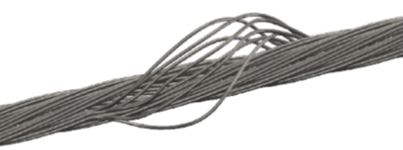
Rigging and Hoisting
Protection
The ability of wire rope to withstand abrasion is determined by the size and number of individual wires used to make up the rope. All wire rope has a minimum bend radius. Breaks can develop during small radius bends, causing fatigue failure.
Blocking or padding should be used when picking loads that place small radius bends on the wire rope sling. To prevent injuries and prolong the life of a wire rope sling, protect your slings.
Misuse or abuse of wire rope slings will cause failure and greatly shorten a sling’s life expectancy. Kinks or bird caging, or the unraveling or spreading of the individual sections of wire rope, are signs of structural damage often caused by abuse.

Slide 22
Rigging and Hoisting
Inspection
Wire rope slings must be visually inspected before each day's use by a designated person. Always check the twists or lay of the sling. It is not sufficient to check only the condition of the wire rope; end fittings and other components should also be inspected for any damage that could make the sling unsafe.
Repair
Any sling requiring repairs, including its fittings or end attachments, should be taken out of service, tagged, and sent to your employer.

Slide 23
Rigging and Hoisting
Removal
Wire rope sling needs to be removed from service if it has:
missing or illegible sling identification
broken wires
severe localized abrasion or scraping resulting in a reduction from nominal diameter of more than 5%
kinking, crushing, bird caging, or any other damage resulting in damage to the rope structure
evidence of heat damage
fittings that are cracked, deformed, or worn to the extent that the strength of the sling is substantially affected
severe corrosion of the rope or fittings
other conditions, including visible damage, that cause doubt as to the continued use of the sling

Slide 24
Wire Rope Slings
Rigging and Hoisting
Advantages
Disadvantages
Low initial cost
Lighter weight than alloy chain
Low strength to weight ratio
Difficult to inspect
Easily kinked
Internal corrosion
Not repairable

Slide 25

Rigging and Hoisting
Synthetic Slings
Synthetic slings can be both web and round, and are widely used for rigging where loads must be protected from damage. Their light weight, flexibility, and reduction of fatigue and strain on the rigger make them very popular.
Synthetic slings can be found in many different capacities and lengths.
Synthetic slings are commonly made of nylon, polypropylene, or polyester-type yarns. Nylon is the most popular and best general purpose synthetic sling material.

Slide 26
Rigging and Hoisting
Synthetic Web Slings
Construction
Synthetic web slings are constructed of a flat layer of webbing. This webbing can be made into plys to increase the strength of the sling. The more plys, the stronger the sling (slings are typically made of single and double ply).
Identification
All synthetic web slings must have a manufacturer installed identification tag

Slide 27
Rigging and Hoisting
Synthetic Web Slings cont.
Inspection
Synthetic web sling inspections must include the following:
Each shift, before the sling is used, a visual inspection for damage shall be performed. Slings used in severe or special service should be inspected before each use.
Inspection shall be conducted on the entire length, including splices and fittings.

Slide 28
Rigging and Hoisting
Removal Criteria
A synthetic webbing sling shall be removed from service if any of the following conditions are present:
missing or illegible sling identification
acid or caustic burns
melting or charring of any part of the sling
holes, tears, cuts, or snags
broken or worn stitching in load-bearing splices
excessive abrasive wear
knots in any part of the sling
discoloration and brittle or stiff areas on any part of the sling, which may mean chemical or ultraviolet/ sunlight damage
fittings that are pitted, corroded, cracked, bent, twisted, gouged, or broken
other conditions, including visible damage, that cause doubt as to the continued use of the sling

Slide 29
Rigging and Hoisting
Synthetic Round Slings
Construction
Synthetic round slings, while made of the same materials as web slings, employ different construction. They have a synthetic yarn core, wrapped in a continuous circular fashion. There is a double sleeved outer jacket that surrounds and protects the core.
Identification
All synthetic round slings must have a manufacturer installed identification tag.
Some manufacturers use color-coded outer jackets to indicate capacities of the sling. Each color represents a different capacity. Be sure to know what the color code is for your particular sling. IMPORTANT! Different companies may have different color codes for synthetic round slings. Always check the sling’s capacity tag.

Slide 30
Rigging and Hoisting
Synthetic Round Slings cont.
Inspection
Synthetic round sling inspections must include the following:
Each shift, before the sling is used, a visual inspection for damage shall be performed. Slings used in severe or special service should be inspected before each use.
Inspection shall be conducted on the entire length, including splices and fittings.

Slide 31
Rigging and Hoisting
Removal
According to ASME B30.9-2018 section 9-6.9.5, the following factors indicate when a synthetic round sling needs to be removed from service:
A polyester round sling shall be removed from service if any of the following conditions are present:
(a) missing or illegible sling identification (see Section 9-6.7)
(b) acid or caustic burns
(c) evidence of heat damage
(d) holes, tears, cuts, abrasive wear, or snags that expose the core yarns
(e) broken or damaged core yarns
(f) weld splatter that exposes core yarns
(g) knots in the round sling, except for core yarn knots inside the cover installed by the manufacturer during the fabrication process
(h) fittings that are pitted, corroded, cracked, bent, twisted, gouged, or broken
(k) other conditions, including visible damage, that cause doubt as to the continued use of the sling

Slide 32
Synthetic Slings
Rigging and Hoisting
Advantages
Disadvantages
Light weight
Easy to rig
Low initial cost
Reduced load damage
Low heat resistance
  194° F.
Subject to cuts and abrasion
Subject to chemicals and UV
Cannot be repaired

Slide 33
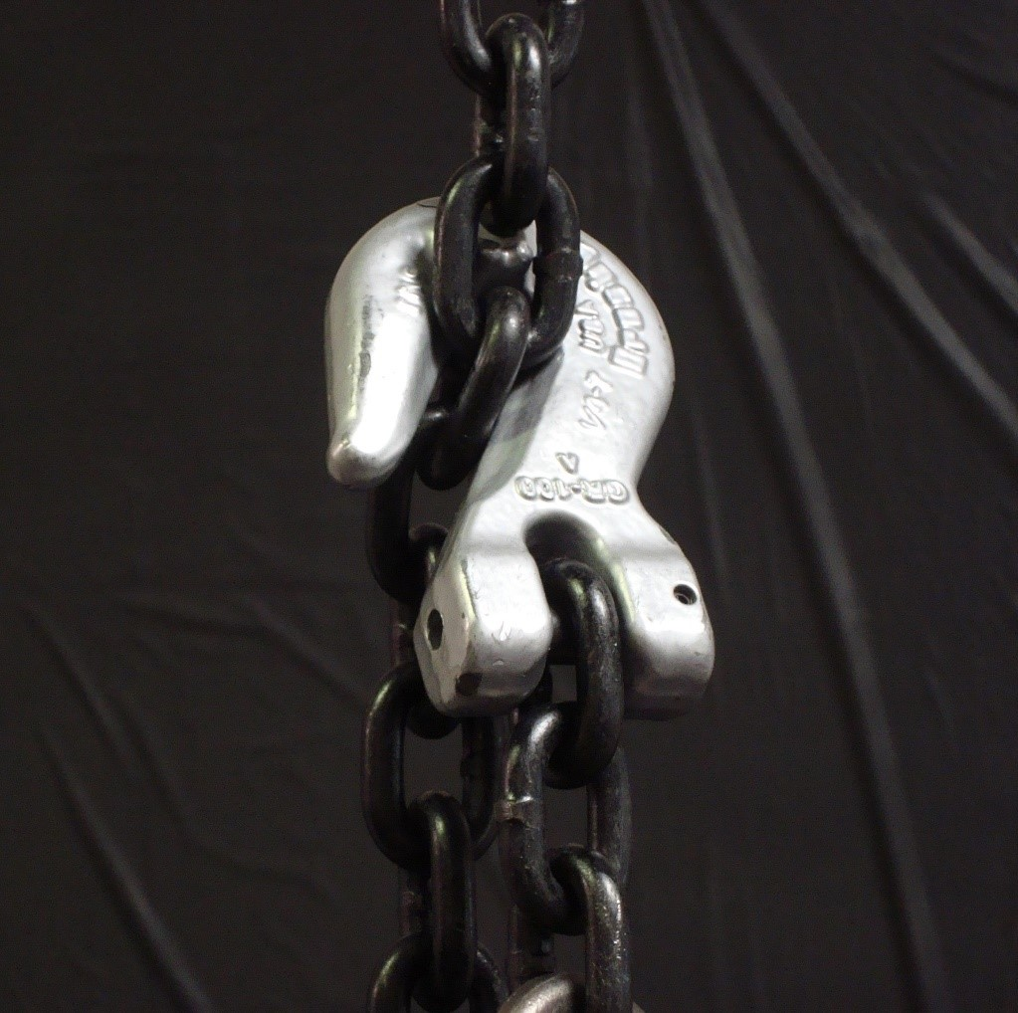
Rigging and Hoisting
Chain Slings
Chain slings offer a combination of superior strength, ease of handling, and durability. Chain slings are typically used in steel mills, foundries, and heavy machining operations that require repetitive lifts. A combination of heavy loads, elevated working temperatures, and severe lift conditions usually dictate that an alloy chain sling be used.
As with wire rope, alloy steel chains are often used because of their strength, durability, abrasion resistance, ability to lift hot materials, and ability to conform to the shape of the loads on which they are used.
Rarely are alloy chain slings used in the elevator industry. If used for rigging, all chain slings must be 8, 10, 80, or 100 grade.

Slide 34
Alloy Chain Slings
Rigging and Hoisting
Advantages
Disadvantages
Flexible
Impact resistant
Easy to inspect
Can be used at relatively high temperatures
Completely repairable
Minimum elongation
Corrosion resistant
Durable
Heavy
Moderate initial cost

Slide 35
Rigging and Hoisting
Metal Mesh Slings
Metal mesh slings are widely used in machine shops, steel warehouses, metalworking and other industries where loads are abrasive, hot, have sharp edges, or will tend to cut web slings. Unlike nylon and wire rope slings, metal mesh slings resist abrasion and cutting. Mesh slings also usually have wide load bearing surfaces that greatly enhance load balancing.
Construction
Metal mesh slings have a smooth, flat, load-bearing surface that grips the load firmly without extensive stretching, easily maintaining balanced loads.
Rarely are metal mesh slings used in the elevator industry.

Slide 36
Metal Mesh Slings
Rigging and Hoisting
Advantages
Disadvantages
Flexibility
Wide bearing surface
Resists abrasion and cutting
Resists corrosion
Subject to crushing
Any broken wire is cause for removal from service

Slide 37
Rigging and Hoisting
Knowledge Check
T/F. OSHA requires slings to be visually inspected before every use.
The wire rope sling you are using does not have a manufacturer data tag attached. What should you do with the sling?
True
Remove the sling from service

Slide 38
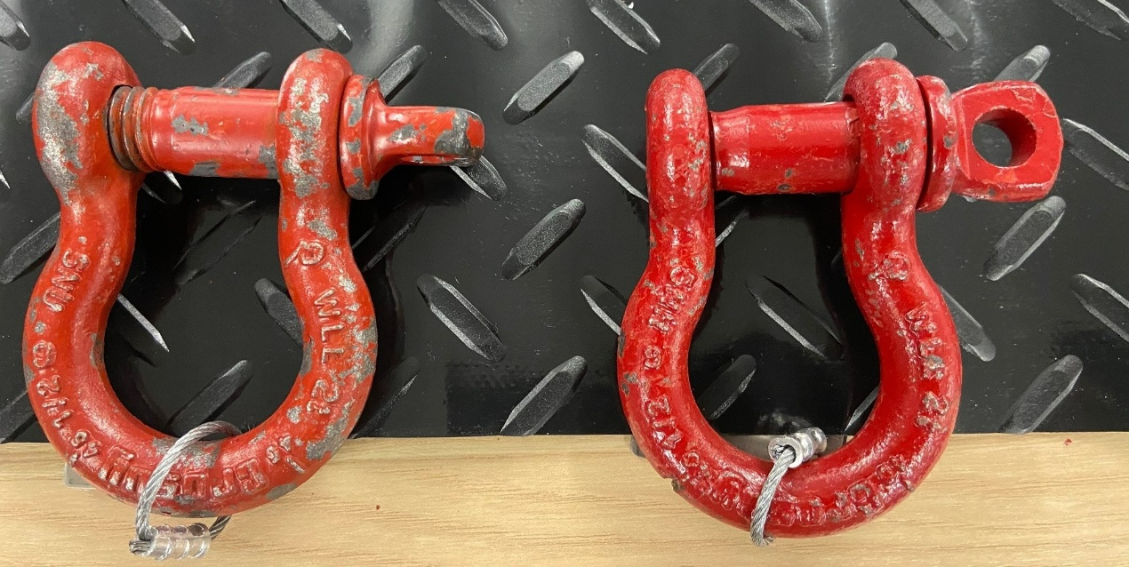
Rigging and Hoisting
Shackles
There many different types of shackles available. The most common type used in the elevator industry is the screw pin shackle . When working with screw pin shackles, it is important to check frequently for signs of overloading, such as stretched rings or flattening of the round parts. Never use a shackle that shows signs of distortion.
Bad Shackle Good Shackle

Slide 39
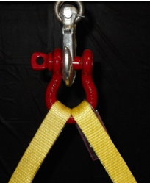
Rigging and Hoisting
When using shackles, always follow these important safety guidelines:
While attaching synthetic slings to shackles, be sure not to pinch or bind the eyes on the slings. If the sling eyes do bind or pinch, you must use a larger shackle.
Slings should never be hung on the shackle pin; always place sling eyes in the body of the shackle.
When a load is placed on a hook, it must be hung by the shackle pin.
Never have an included angle greater than 120° on a shackle.

Slide 40
Rigging and Hoisting
Rigging
The characteristics of the load that you have to pick and the environment that you are working in will play a crucial role in determining the rigging equipment and the type and configuration of the slings that you select.
These factors will also determine the correct hitch to choose to connect the rigging equipment to the load.
Rigging Equipment
There are many different types of rigging equipment to choose from. Always refer to the manufacturer’s specifications for ratings. All hoisting equipment must be inspected for wear or damage before each use. Any damaged equipment must be removed from service immediately.

Slide 41
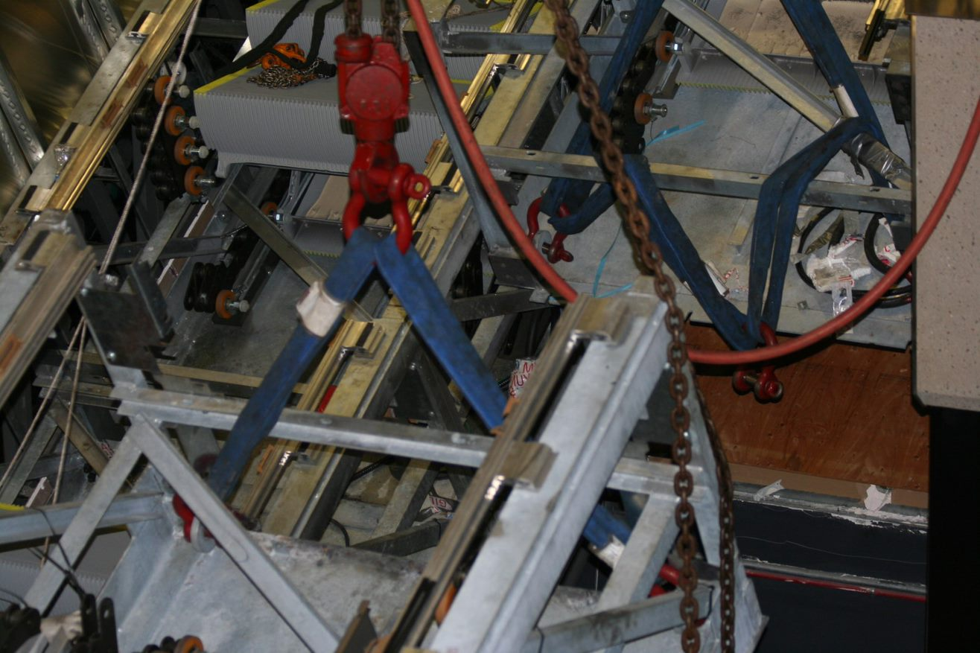
Determining Load Weight
Rigging and Hoisting
You must know the actual or calculated weight of the object or materials being lifted.
Include weight of rigging equipment and hardware in the calculation.

Slide 42
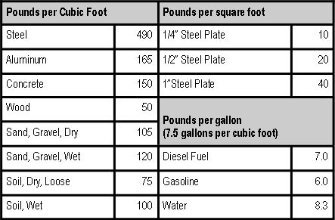
Determining Load Weight
Rigging and Hoisting
Actual weight can be obtained from engineering data, shipping papers, catalogs.
Calculated weight can be determined based on common materials:
  Volume of object
  Weight of material
  Adjusted for air (voids)

Slide 43
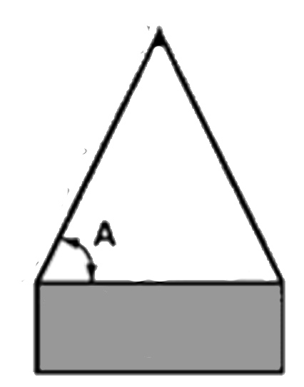
Sling Angle
Rigging and Hoisting
When the two legs do not form a 90° angle, great care must be taken to determine the sling angle. The sling angle is the measured angle formed between the horizontal plane (the load) and the sling. As the sling angle decreases, the tension in each leg increases. Because of this, a sling angle of less than 30° should never be used.

Slide 44
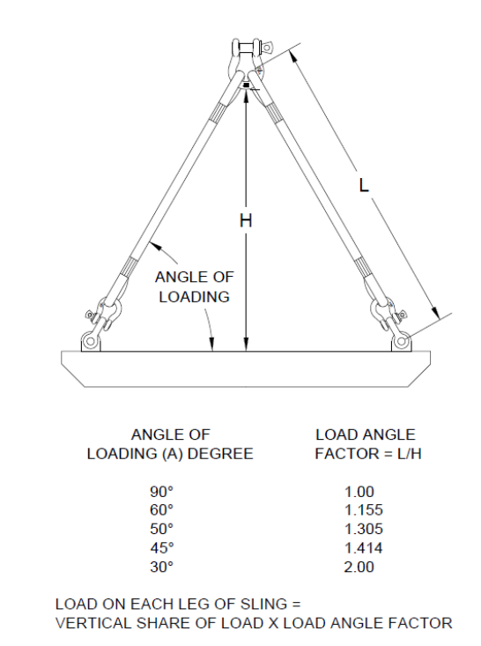
Rigging and Hoisting
A single sling rigged to a load at 90° will carry the entire load. When two slings are rigged at 90°, each sling carries half of the load. To determine the tension when two slings are used, you must use the multiplier shown in the figure (load angle factor) to find the tension in a sling at the standard angles.

Slide 45
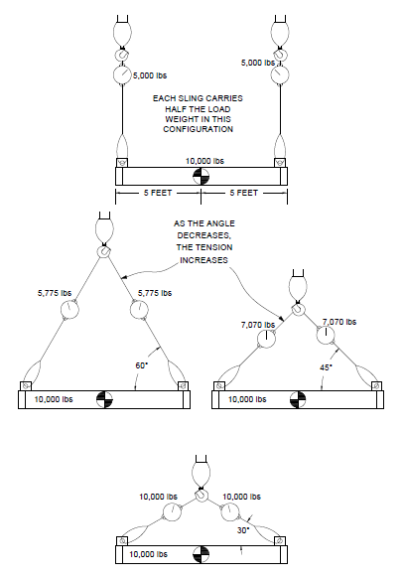
Rigging and Hoisting
The effects of sling angles can be seen here.

Slide 46
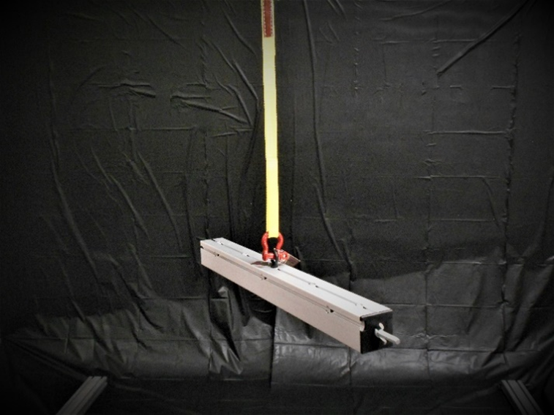
Rigging and Hoisting
Types of Hitches
Vertical Hitch
The simplest connection you can make is a vertical hitch using a single vertical sling (called the single leg method). This vertical hitch is used where there is a single point to connect to. When a sling is used in a vertical hitch, the full lifting capacity of the sling can be utilized. A sling rated at 1,000 lbs. can be used to lift 1,000 lbs.

Slide 47
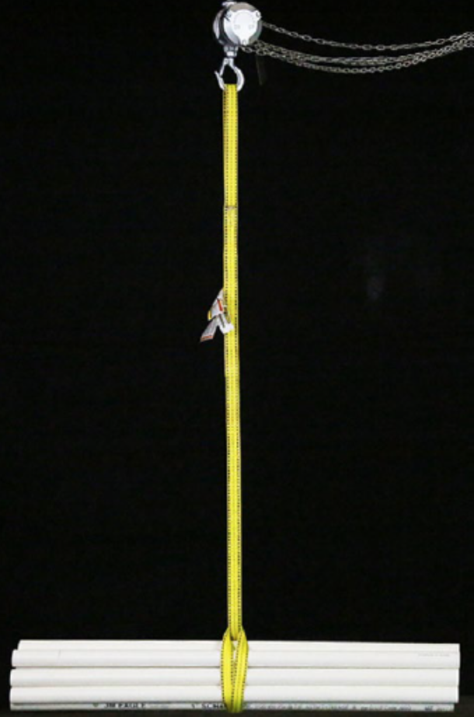
Rigging and Hoisting
The Chocker Hitch
The choker hitch tightens around the load as tension is applied, hence its name. This hitch tends to keep a load from shifting. Due to the stress created at the choke point, slings rigged with this hitch achieve only about 75% of their potential capacity (this is a minimum reduction). A sling rated at 1,000 lbs. may only be able to lift a load of 750 lbs. or less.

Slide 48
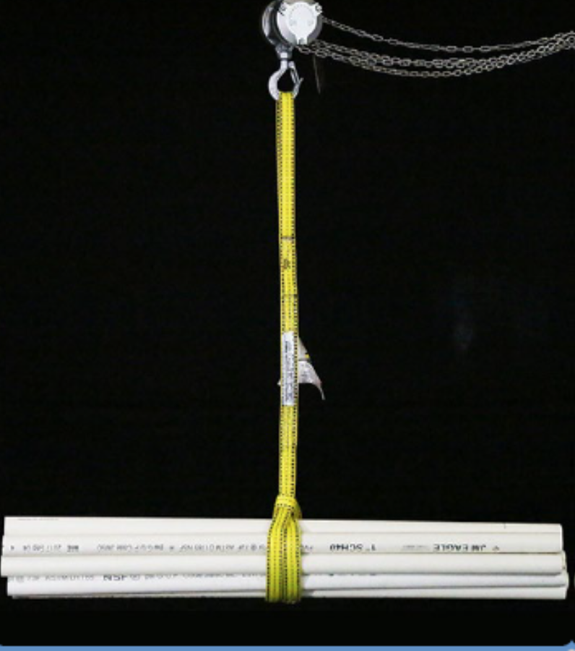
Rigging and Hoisting
Double Wrap Choker Hitch
EXCELLENT LOAD CONTROL FOR LOOSE MATERIALS AND GRIP ON SMOOTH SURFACES
75-80% OF SINGLE LEG CAPACITY
SLING WRAP MUST LAY SIDE BY SIDE
DO NOT OVERLAP AT BOTTOM OF LOAD

Slide 49
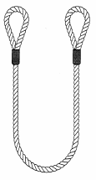
Vertical Basket Hitch
Rigging and Hoisting
Basket Hitch
In a basket hitch , the sling cradles the load. This basket allows for two legs of the sling to extend from the load, acting as the equivalent of two slings. As long as the two legs form a 90° angle with the horizontal plane, the sling’s capacity is essentially doubled. A 5,000-lbs. sling would now have the capacity of 10,000 pounds. This type of hitch is commonly used with more than one sling, because the load could easily fall out using a single sling.

Slide 50
Rigging and Hoisting
Multiple Leg Slings
Symmetrical loads are also lifted with multiple leg slings of the same sling length. Multiple leg slings may have up to four legs. Bridles , which are pre-made slings with multiple legs, may also be purchased.
If you are hoisting loads that are asymmetrical, be sure to have a qualified person analyze the rigging so as not to overload any one sling. (Asymmetrical loads have more weight on one side of the load to be picked or have an irregular shape - a geared elevator machine would be an example of an asymmetrical load.)

Slide 51
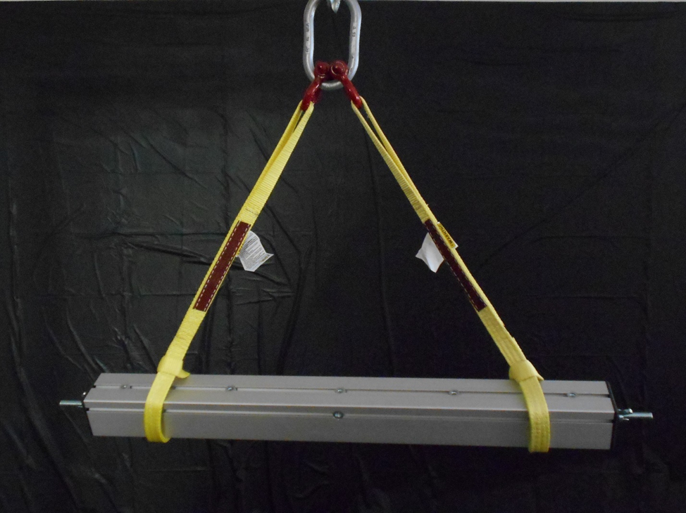
Rigging and Hoisting
Two-leg Method
The two-leg method of rigging the load requires the load to be attached at two different points with two single leg slings or a two-leg sling. The load is attached at a point on each end of the object or load being lifted, making a triangle shape.
This method is used on long slender loads such as pipes or construction material. It does not require the rigger to know the center of gravity, and is much safer than the single-leg choke method because the load is more stable when being lifted.

Slide 52
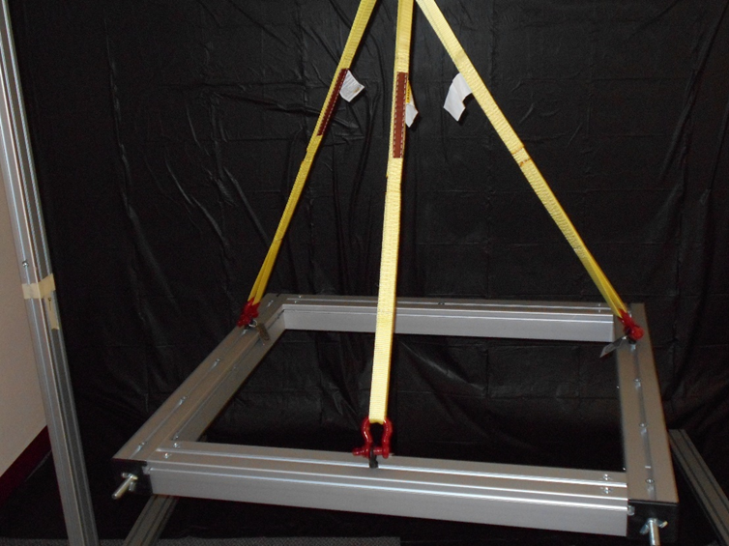
Rigging and Hoisting
Three-leg Method
The three-leg method is a common method used when lifting large circular objects or loads that have unusual shapes where the center of gravity is hard to determine. A three-leg sling arrangement is used at three different attachment points to ensure the load remains stable and does not overload and break one leg of the sling. Using the three-leg method is also one of the safest ways to rig an asymmetrical load, because the weight of the load is equally distributed among three different points

Slide 53
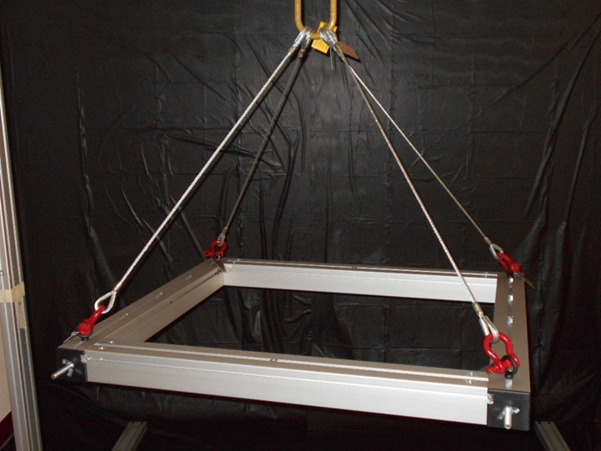
Rigging and Hoisting
Four-leg Method
The four-leg method of rigging the load requires the load to be attached at four different points with four single-leg slings, two two-leg slings, or a four-legged bridle. The load is attached at a point on each end of the object or load being lifted, making a four-sided pyramid shape.
The four-leg method is commonly used to lift wide, rectangular equipment, such as a geared machine.

Slide 54
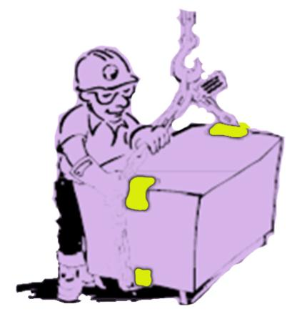
Edge Protection
Rigging and Hoisting
Padding and Blocking
Where necessary, to pass a sling around sharp corners of a load, add padding or blocking. Slings hoisting lightweight loads may be padded with several layers of scrap cardboard at corners. Soft wood blocking must be used to pad slings hoisting heavy machinery and parts. White pine or other soft wood blocking allows the sling to bite in around corners, producing a longer radius bend and protecting the sling. Pre-manufactured blocking made of a polymer or Kevlar / synthetic pads may also be used.

Slide 55
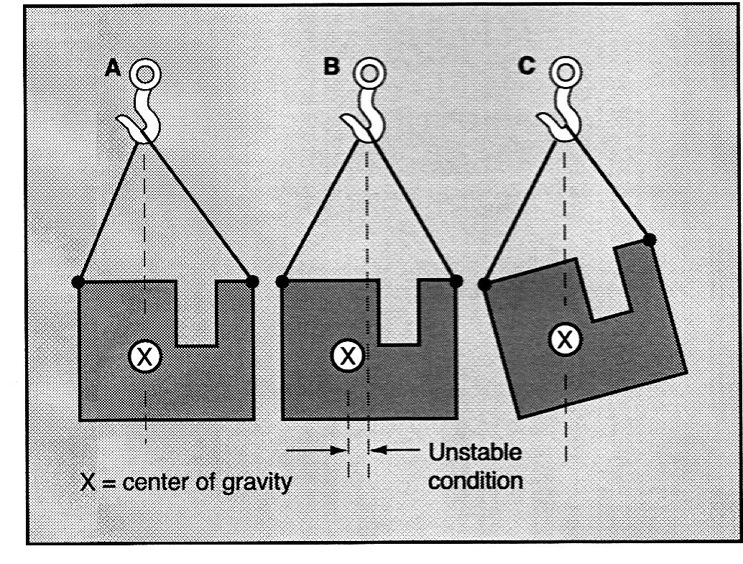
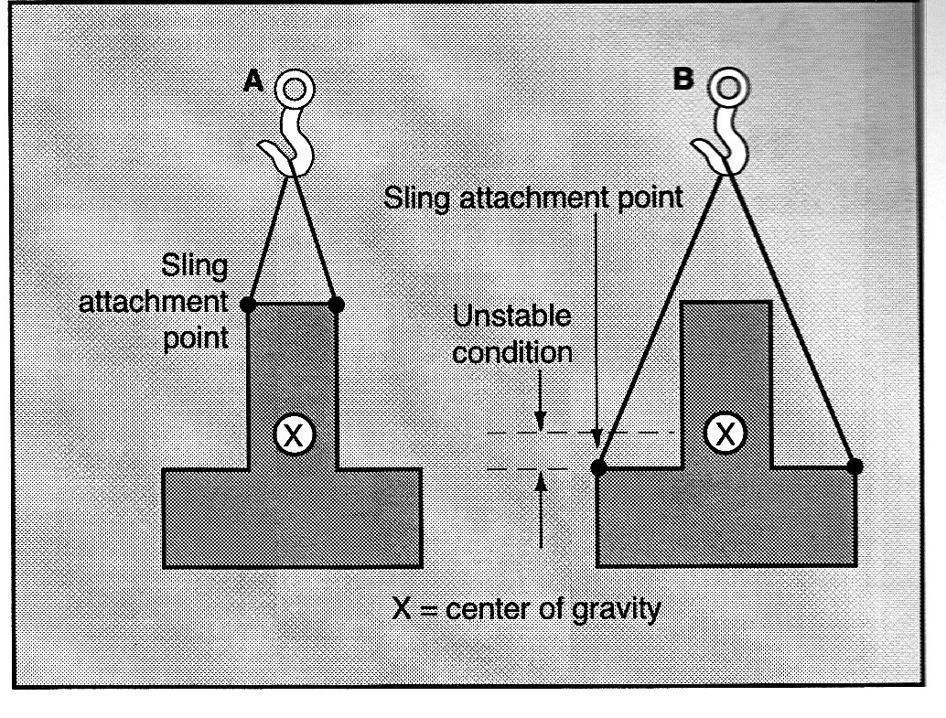
Load Stability
Rigging and Hoisting
Capture the Center-of-Gravity
  When suspended an object will always center itself under the lift point.
  Center the lift above the center of gravity, not the physical center of the object.

Slide 56
Landing the Load
Rigging and Hoisting
Plan where the load will be landed before lifting.
  Consider the weight, type, and shape of load.
  Land the load on a firm, flat surface.

Slide 57
Landing the Load
Rigging and Hoisting
Land load on blocks / cribbing to allow removal of slings.
  NEVER land a load directly on the slings.
  Chock cylindrical loads to prevent rolling.
Slowly relieve tension on hoist and rigging.

Slide 58
Rigging and Hoisting
Knowledge Check
A sling applied so it is prevented from tightening around a load is called a ___ hitch?
A sling applied to tighten around a load as tension is applied is called a ____ hitch?
3. Slings must be ___ at sharp corners.
Basket or vertical
Choker
Padded

Slide 59
Rigging and Hoisting
  What are some types of manual and power hoisting equipment used for rigging and hoisting?
Notes:
Left to right: well wheel, chain fall, lever hoist, chain fall driver, snatch block, power winch, capstan

Slide 60
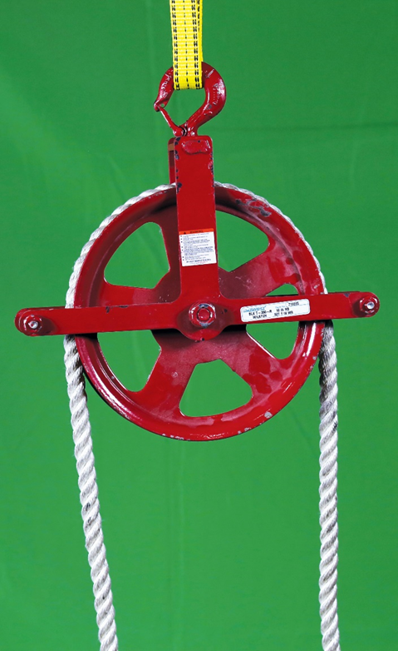
Rigging and Hoisting
Manual Hoisting Equipment
Well Wheel
Basic hand hoisting devices use a hemp or synthetic fiber rope. The simplest is the well wheel
A well wheel consists of a large diameter grooved wheel or sheave enclosed in a frame. Wheel diameter is commonly between 12" and 16". A long rope is passed over the wheel, with the groove keeping it in place. Attached to one end is a hook for the load. The other end is free. A person at a lower level pulls the rope, hoisting the load.

Slide 61
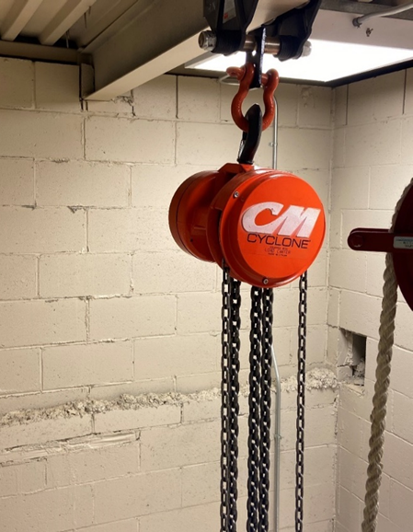
Rigging and Hoisting
Chain Falls
Spur geared chain falls are the standard in elevator work. Safety latches are required on the top and bottom hooks. Spur geared chain falls are available in capacities from 500 lbs. to 12 or 15 tons. Use a chain fall of sufficient capacity for the load you intend to lift, and when in doubt– go big! Never overload any type of hoist.
Load picking distance of a spur geared chain fall is limited only by the length of the load chain (also called the drop chain).

Slide 62
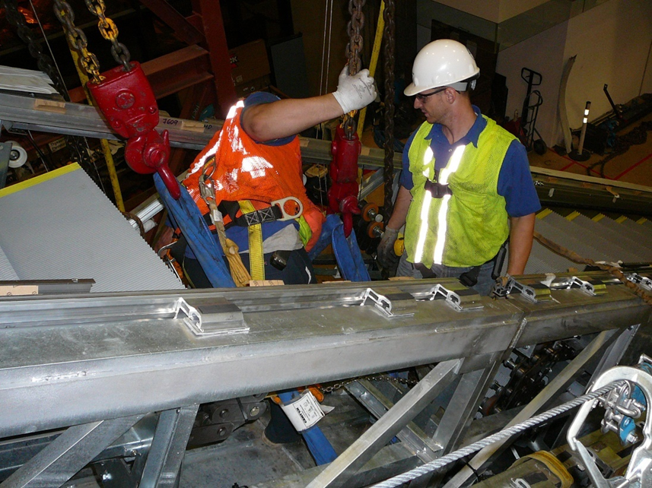
Rigging and Hoisting
Chain falls are also made with hooks fitted with a sprocket wheel. The load chain drops down, passes through the sprocket, and dead-ends back at the hoist. This is called a compound pick. It cuts hoisting speed in half but doubles the capacity.

Slide 63
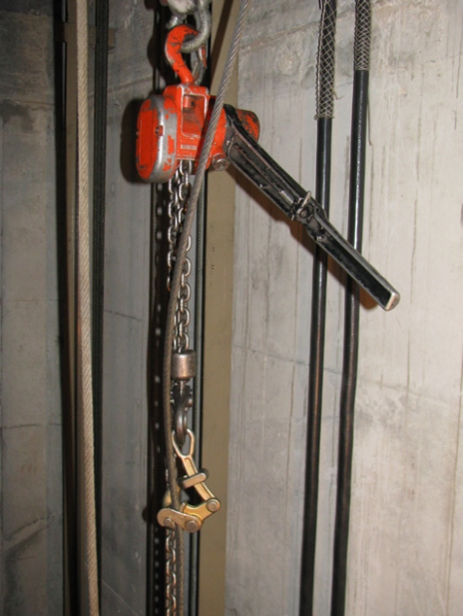
Rigging and Hoisting
Lever Hoists
Lever hoists are useful for raising loads short distances. Lever hoists are known by many different names, two of the most common being come-along and Coffing hoist .
The load-carrying member of a lever hoist may be wire rope, sprocket chain, or link chain.
Wire rope lever hoists are light duty; commonly, 300-500 lbs. They can be used in motor removal and replacement and are often employed during freight door installations.

Slide 64
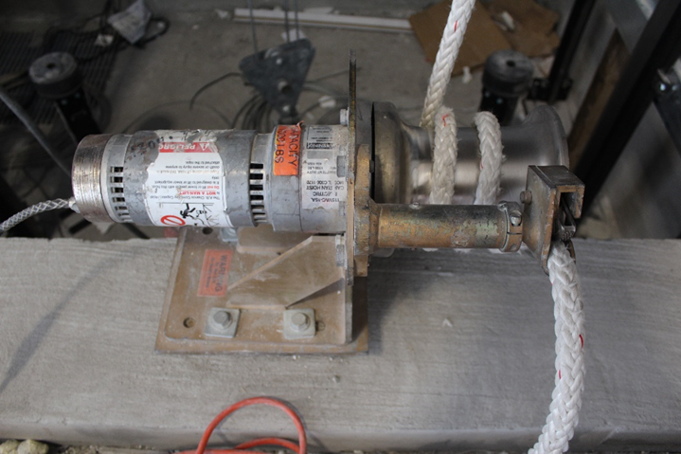
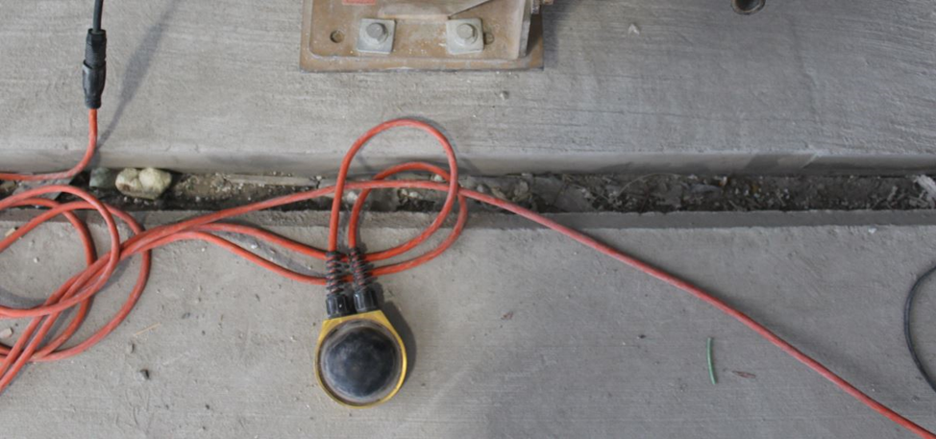
Rigging and Hoisting
Power Hoisting Equipment
Capstans
The lifting power of a well wheel may be increased by using a capstan . A capstan is a power-driven metal drum or spool having wide flanges at each end. The drum surface is polished smooth.
Capstans are intended for use with fiber rope and cannot be used with wire rope. Attempting to use wire rope on a capstan will result in accidents, injury, and damaged equipment. Only use a constant pressure switch to operate capstans such as the momentary foot switch shown.

Slide 65
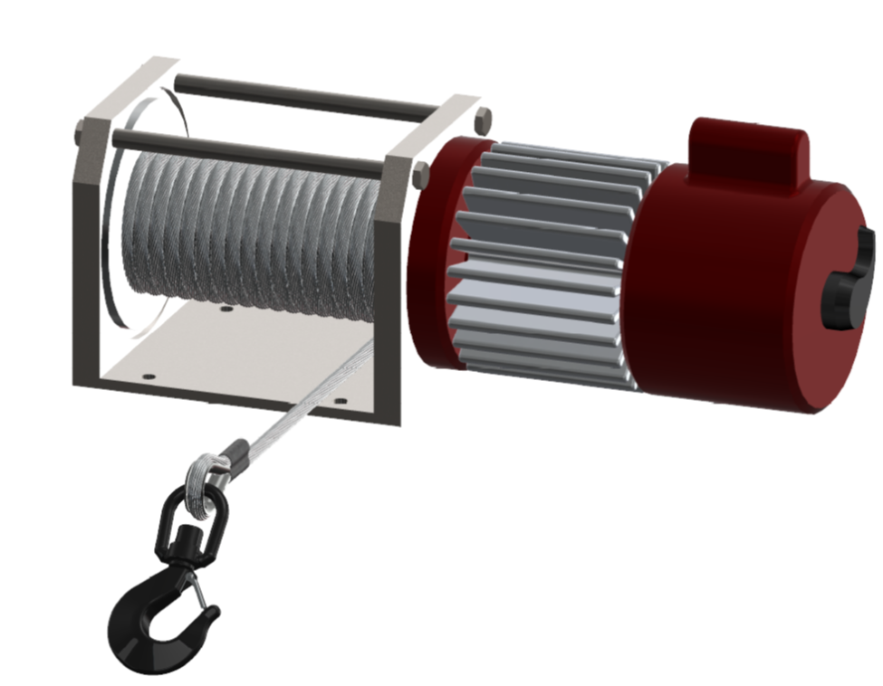
Rigging and Hoisting
Power Winches
On a low-rise, single car installation, a chain fall is generally sufficient for hoisting. On a high-rise installation, or when several elevators are being installed, a power winch is often used. The power winch consists of an electric motor or a gasoline engine driving a drum through a gearbox. The drum is large enough to contain several hundred feet of wire rope.
The gearbox provides forward and reverse gears for hoisting or lowering. The gearbox also includes a free-wheel setting to allow rapid paying out of the wire rope.
A brake is included on the winch to hold the load whenever hoisting is interrupted.
Wire rope used for hoisting must be visually inspected before each day's use by a designated person. Always check the twists or lay of the wire rope. It is not sufficient to check only the condition of the wire rope; end fittings and other components should also be inspected for any damage that could make the sling unsafe.

Slide 66
Rigging and Hoisting
Electric Chain Fall
Electric chain falls provide power hoisting but are not widely used in elevator installation for several reasons. First, the initial cost is high, and they are very heavy. The weight is considerably greater than hand operated falls of similar capacity. It is therefore a great deal more difficult to hang the fall, or to move it as necessary. Most electric chain falls require 220 V electric power. On some installations, 110 V electric power is all that is available until quite late in the construction schedule. Hoisting speed is very slow when compared to a winch. Also, the electric chain fall may not withstand use in a dusty construction environment unless specifically designed for that purpose.
For these and other reasons, you are not likely to see electric chain falls in general use on elevator installations.

Slide 67
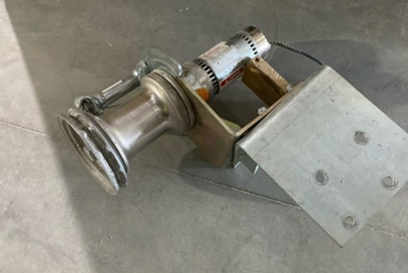
Rigging and Hoisting
Chain Fall Driver
A hand-operated chain fall can be driven by a power-operated chain fall driver. The chain fall driver is powered by a small electric motor. Forward and reverse push buttons, as well as an emergency stop button, are fitted in the control box. The capstan shown includes a chain driver attachment.

Slide 68
Rigging and Hoisting
Knowledge Check
The ___ chain fall is most commonly used in elevator work. ?
13. Wire rope lever hoists are used for light loads, commonly ___ to ____ lbs. ?
Spur geared
300-500

Slide 69
Rigging and Hoisting
  What are some types of supports used for rigging and hoisting?
Notes:
L-R: adjustable beam clamp, trolley beam clamp, portable gantry

Slide 70
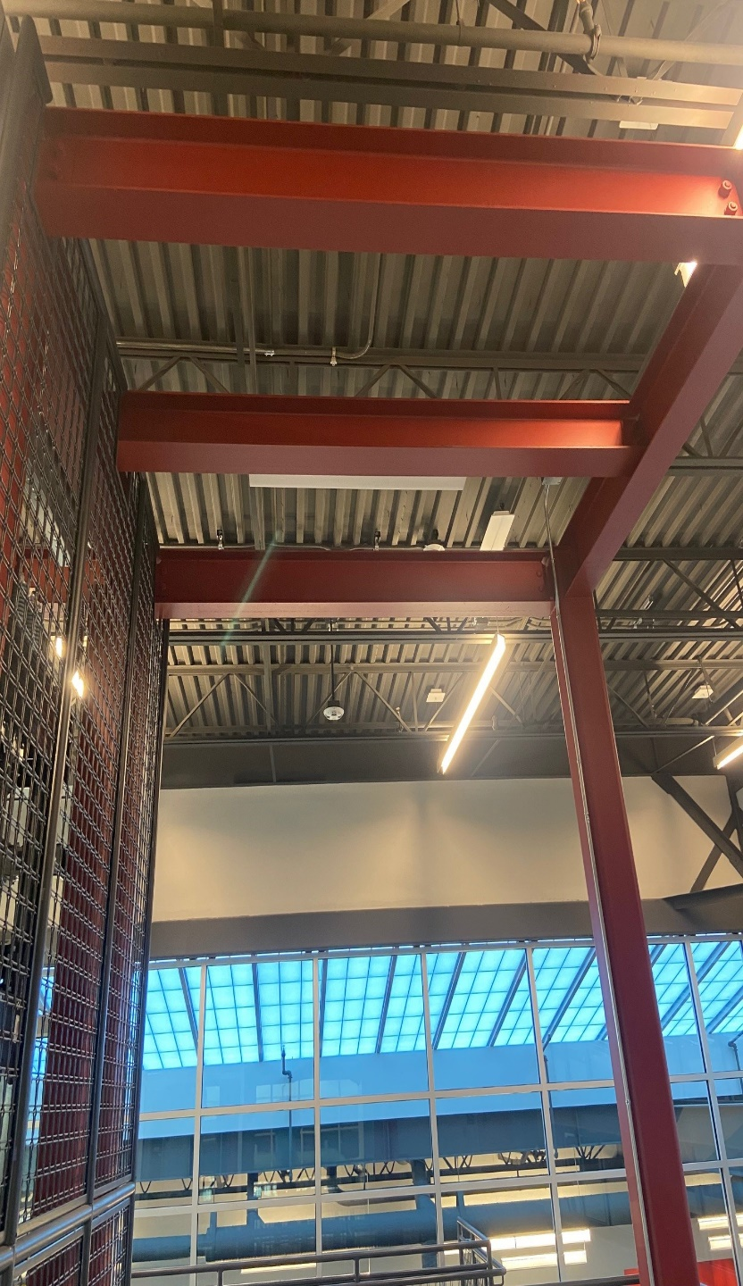
Rigging and Hoisting
Hoisting Beam
On high rise or multi-car elevator installations, one or more steel hoisting beams are usually installed by the general contractor. Hoisting beam size is calculated by the architect, based on loads to be hoisted.
The hoisting beam rests on and is supported by the building structure.
Reminder: 1926.502(d)(15) states
anchorages used for attachment of personal fall arrest equipment shall be independent of any anchorage being used to support or suspend platforms and capable of supporting at least 5,000 pounds (22.2 kN) per employee attached, or shall be designed, installed, and used as follows:
(i) as part of a complete personal fall arrest system which maintains a safety factor of at least two; and
(ii) under the supervision of a qualified person.

Slide 71
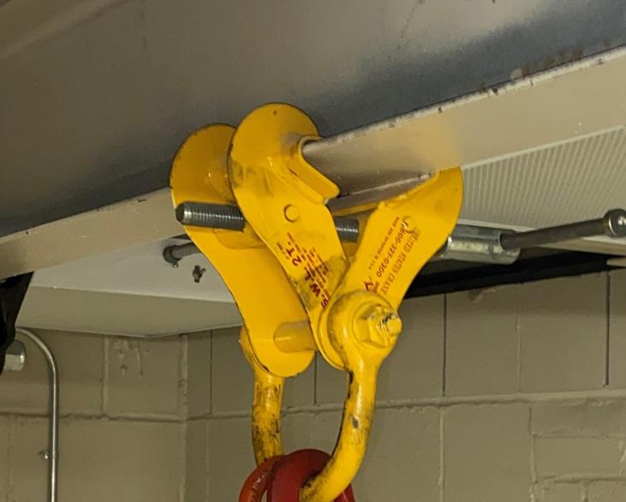
Rigging and Hoisting
Beam Clamps
A beam clamp is an arrangement of formed steel plates secured together by bolts, which are fastened to the lower flange of an “I” beam and used to suspend hoisting equipment (such as chain falls).
When picking loads from beams of different sizes, use an adjustable beam clamp. It should be rated to support the total load, and may easily adapt to a variety of beam widths.
When using beam clamps which are supported by the lower flange of the hoisting beam, consider the following:
How much of a load is already being carried by the beam
The capacity of the lower flange of the beam
Never load the lower flange to more than 50% of the load which could be handled by the full capacity of the beam.

Slide 72
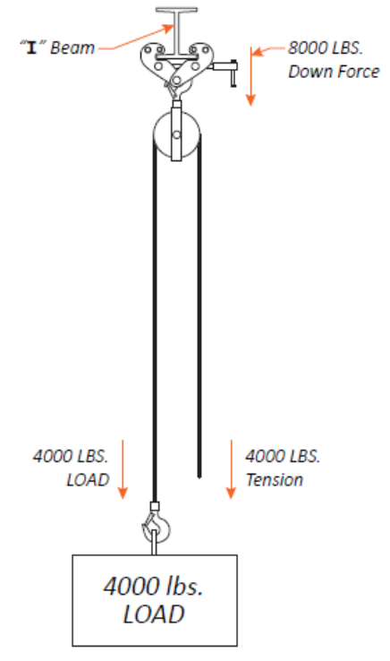
Rigging and Hoisting
Stresses in Overhead Beams
Before using an overhead beam for hoisting, be aware of the stresses imposed. A winch working from a point lower than the hoisting beam exerts a downward pull on the beam. If the hoist rope passes over a single sheave making a direct pick, the down load on the beam is double the weight of the load being hoisted. If a 4,000 lbs. machine is hoisted by a direct pick, the down force on the beam (neglecting friction) is 8,000 lbs. The figure illustrates the physics involved.

Slide 73
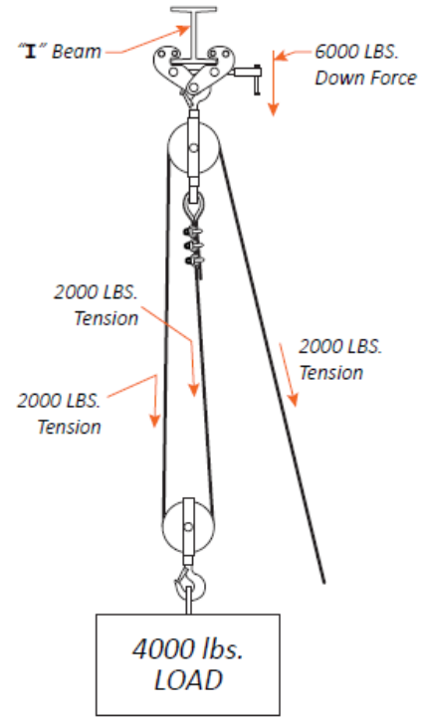
Rigging and Hoisting
Stresses in Overhead Beams
Downward force on the hoisting beam can be reduced by adding sheaves to compound the lift. As an example, add another sheave at the point of load attachment, and dead-end it above. The figure illustrates this.

Slide 74
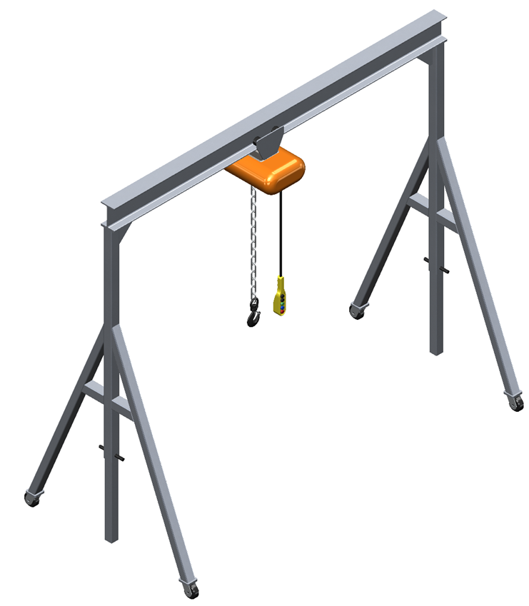
Rigging and Hoisting
Portable Gantry or A-frame
For certain hoisting situations, a portable A-frame or gantry can be used. Usually made of lightweight aluminum alloy, it can be knocked down for transport.
When using an A-frame, always place it on a solid and even footing. Using a frame on soft soil or uneven surfaces is extremely dangerous; the load will try to keep moving, causing the frame to tip over if it becomes off-balance. Anchor the A-frame to the floor to ensure it does not move when lifting trusses for installations.
Before beginning to use an A-frame, make certain its rating meets the capacity of the load.

Slide 75
Rigging and Hoisting
Knowledge Check
With a single overhead sheave on a straight pick, load on the hoisting beam is ____ times weight of load.
Adding multiple sheaves (increases/decreases) downward force on the hoisting beam.
Two
decreases

Slide 76
Rigging and Hoisting
Following a Lift Plan
Prior to any hoisting operation, a written or verbal lift plan must be created by a lift director with the appropriate qualifications. A lift director will design the lift, decide what rigging equipment will be used, and be responsible for the safety of all personnel.
A lift plan must include:
• Safety considerations
• Rigging material available
• Capacity of rigging material
• Weight and dimensions of the load
• Personnel necessary to safely pick the load
• Safety factors and surrounding hazards (public safety, protecting surrounding property, power lines, other electrical hazards, weather conditions, etc.)

Slide 77
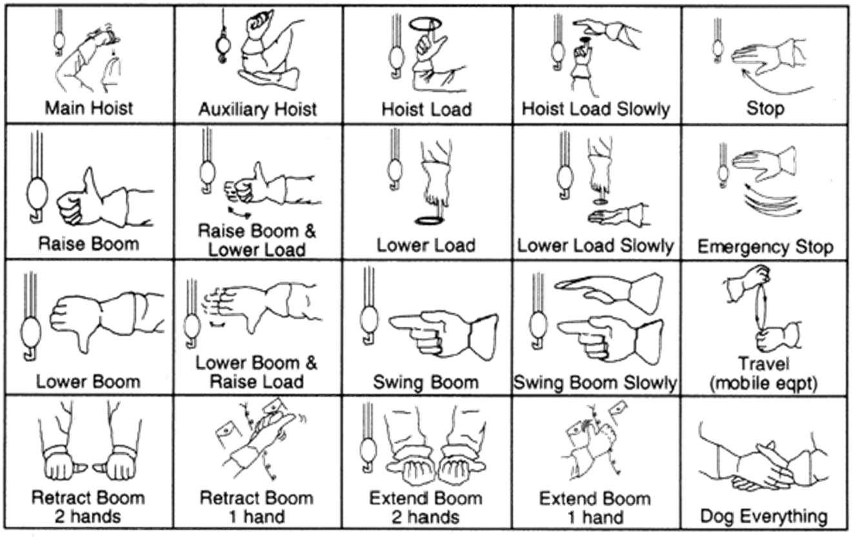
Rigging and Hoisting
Hand Signals
Hand signals can be used where line-of-sight contact is not restricted. A standard set of hand signals has been agreed upon, as shown below.

Slide 78
Rigging and Hoisting
Verbal Commands
Verbal commands may also be used, as long as they are established before the lift. OSHA 1926.1421(b) requires that once the voice signals are agreed upon, workers need not meet again to discuss voice signals unless another worker is substituted, there is confusion about the voice signals, or a voice signal is to be changed.
Voice commands must contain, in order:
1. Function (Hoist, Travel, etc.)
2. Direction, distance and/or speed
3. Stop command
For example:
• Hoist, Hoist Up, 10 Feet, Hoist Stop
• Swing, Swing Right, 5 Feet, Swing Stop
• Travel, Travel Forward, 3 Feet, Travel Stop
OSHA also requires that when using verbal commands, the operator, signal person, and lift supervisor (if there is one) must be able to effectively communicate in the language used.

Slide 79
Rigging and Hoisting
Cautions to Workers
Elevator Constructors and other workers on the jobsite should always follow these important safety guidelines.
Ensure that all portions of the body are kept away from the areas between the sling and the load and between the sling and the crane or hoist hook
Never stand in line with or next to the legs of a sling that is under tension
Never stand or pass under a suspended load
Never ride the sling or the load, unless the load is specifically designed and tested for carrying personnel
Never inspect a sling by passing bare hands over the wire rope body - broken wires may cause injury
Always wear the proper PPE

Slide 80
Rigging and Hoisting
Safe Rigging Practices
Ensure that slings are hitched in a manner providing control of the load
Ensure that sharp edges in contact with slings are padded with material of sufficient strength to protect the sling
Ensure that slings are shortened or adjusted only by methods approved by the sling manufacturer or a qualified person
During lifting with or without a load, be alert for possible snagging
Ensure that in a basket hitch, the load is balanced to prevent slippage
When using a basket hitch, ensure that the legs of the sling contain or support the load from the sides, above the center of gravity, so that the load remains under control
Ensure that in a choker hitch, the choke point is only on the sling body - never on a fitting

Slide 81
Rigging and Hoisting
Safe Rigging Practices cont.
Ensure that slings are not constricted, bunched, crossed at the bottom of the load, or pinched by the load, hook, or any fitting
Ensure that the load applied to the hook is centered in the base (bowl) of the hook to prevent point loading on the hook, unless the hook is designed for point loading
Minimize sling rotation
Do not shorten or lengthen a sling by knotting or twisting
Do not rest loads on the sling
Do not pull a sling from under a load when the load is resting on the sling
Do not drag slings on the floor or over abrasive surfaces
Do not use slings made with wire rope clips as a choker hitch
Do not allow shock loading
All rigging and hoisting equipment being used for the pick, including the hoist beam, must be rated for the load being hoisted

Slide 82
Rigging and Hoisting
Environmental Considerations
Chemically Active Environments
The strength of ropes and slings may be degraded by chemically active environments. This includes exposure to chemicals in the form of solids, liquids, gases, vapors, or fumes. The manufacturer or a qualified person should be consulted before ropes and slings are used in chemically active environments.
Temperature
Polyester and nylon rope and slings shall not be used in contact with objects or at temperatures above 194°F (90°C) or below −40°F (−40°C).
Sunlight and Ultraviolet Light
The strength of synthetic rope and slings is degraded by exposure to sunlight or ultraviolet light. The rope or sling manufacturer or a qualified person should be consulted for additional retirement or inspection requirements. For additional degradation information, see CI 2001-04.

Slide 83
Rigging and Hoisting
Summary
You will use rigging and signaling skills in construction, service, and repair throughout your entire career.
You learned about the variety of ropes used in the industry, and about the different types of rigging devices such as slings and shackles. You also learned how to safely and properly rig a load with different types of hitches.
Manual hoisting equipment and power hoisting devices are used to do the heavy work. You learned how they work and when to use them.
We concluded with a section on setting up hoist supports and how to properly conduct the hoisting procedure through hand and audible signals.

Slide 84
Rigging and Hoisting
Through the Alliance between OSHA’s 10 Regional Offices and the Elevator Contractors of America (ECA), Elevator Industry Work Preservation Fund (EIWPF), International Union of Elevator Constructors (IUEC), National Association of Elevator Contractors (NAEC), National Elevator Industry Educational Program (NEIEP), and National Elevator Industry Inc. (NEII), collectively known as The Elevator Industry Safety Partners, developed this Industry Specific Training for informational purposes only. It does not necessarily reflect the official views of OSHA or the U.S. Department of Labor. May 2021
Under the Occupational Safety and Health Act, employers are responsible (http://www.osha.gov/as/opa/worker/employer-responsibility.html) for providing a safe and healthy workplace and workers have rights (https://www.osha.gov/workers). OSHA can help answer questions or concerns from employers and workers. OSHA's On-Site Consultation Program (https://www.osha.gov/consultation) offers free and confidential advice to small and medium-sized businesses, with priority given to high-hazard worksites. For more information, contact your regional or area OSHA office (https://www.osha.gov/contactus/bystate), call 1-800-321-OSHA (6742), or visit https://www.osha.gov/.

Slide 85

Rigging and Hoisting

