Slide 1
Electrical Hazards

Slide 2
ELECTRICAL HAZARDS
Focus Four
Objectives
By the end of the session students will be able to:
List common causes of electrical injuries.
List ways to reduce exposure to electrical hazards.
Describe what to do if a co-worker gets shocked.

Slide 3
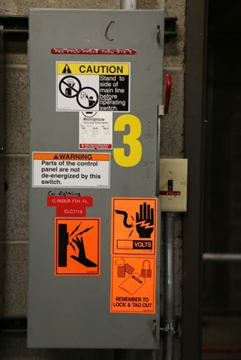
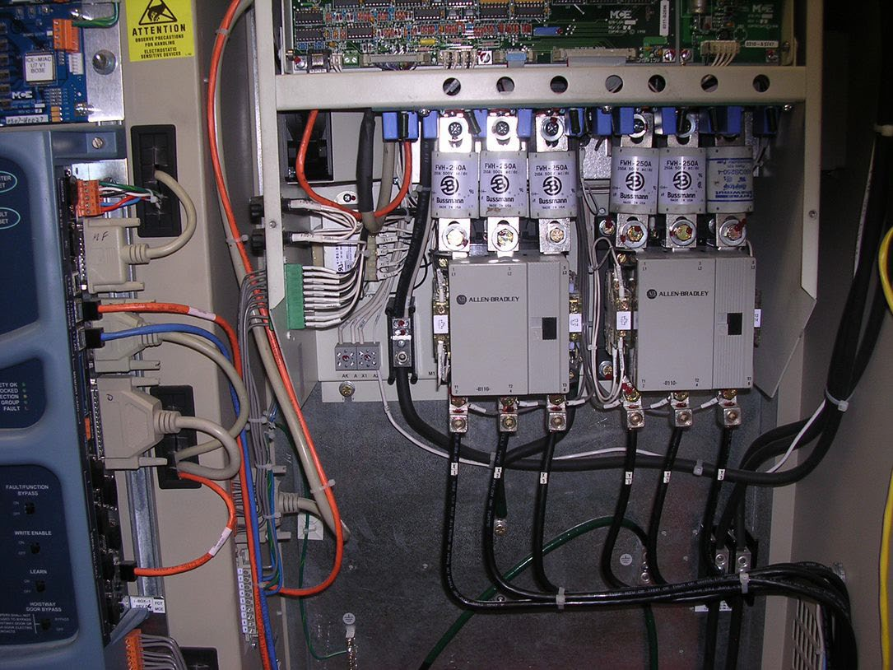
ELECTRICAL HAZARDS
Focus Four
Electricity Can Kill You
Contact with live circuits in electrical panels or exposed wiring
Contact with overhead power lines
Improperly maintained cords and power tools
Arc-Flash

Slide 4
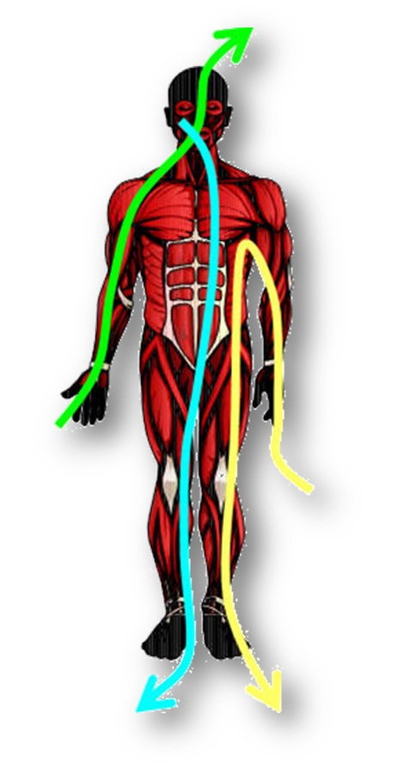
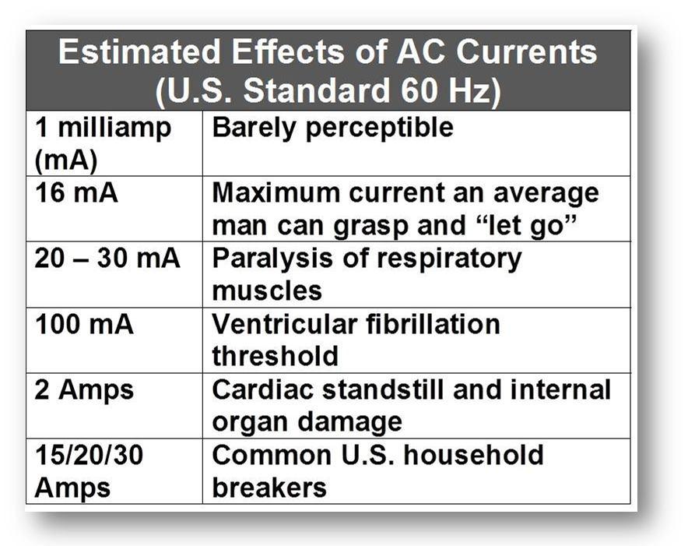
ELECTRICAL HAZARDS
Focus Four
Effects of Electricity on People
Harm is related to amps, duration of contact, and the path by which current passes through the body.

Slide 5
ELECTRICAL HAZARDS
Focus Four
Electrocution deaths caused by electric parts in construction over 170 deaths annually
Switchboards, switches, fuses; 13%
Power lines, transformers, convertors; 39%
Electrical wiring—building; 37%
5

Slide 6
ELECTRICAL HAZARDS
Focus Four
Elevator Industry-Related Electrical Hazards
Fatality Type | Total
Falls | 5
Struck-By | 5
Caught In/Betwee | 11
Electrocution | 6
Total Fatalities | 27
Fatalities
Struck-By 19%
Caught In/Between 41%
Since 2012, 22% of Elevator Constructor deaths have been Electricity-related.
Falls
Struck-By
Caught In/Between Electrocution
Falls 18%
Electrocution 22%
FOCUS FOUR ACCIDENTS BEGINNING--JANUARY 2012
ON THE JOB FATALITIES BEGINNING--JANUARY 2012

Slide 7
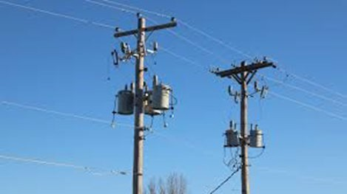
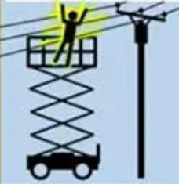
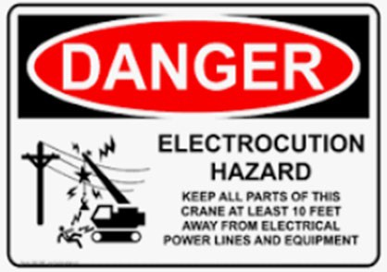
ELECTRICAL HAZARDS
Focus Four
Working Around Power Lines
Overhead power lines carry extremely high voltage.
Contact can cause electrocution, burns, and falls from elevations.
Equipment contact with power lines can cause explosions and fire.

Slide 8
ELECTRICAL HAZARDS
Focus Four
Power Line Facts
Overhead lines are typically not insulated. The covering on high power lines is generally a weather protection, not insulation.
In cranes or backhoe-type equipment, operators are normally safe when equipment accidentally touches a power line… if they stay inside their equipment.
Workers on the ground who come in contact with power lines are 8 times more likely to be killed than workers inside equipment or vehicles.

Slide 9
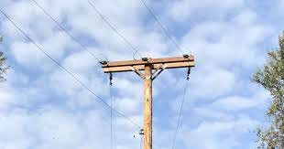
ELECTRICAL HAZARDS
Focus Four
Working Safely Around Overhead Power Lines
Locate overhead lines
before starting the job
Keep at least 10 feet away from 50 kV or less
Always assume that lines are energized
De-energize and ground power lines when working within 10’

Slide 10
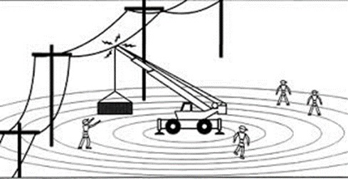
ELECTRICAL HAZARDS
Focus Four
If Equipment Contacts a Power Line the Ground May Become Energized!
Electricity dissipates with the resistance of the ground
As potential drops, fields develop around the electrified machine
If you step across a line of unequal potential, you could be electrocuted

Slide 11
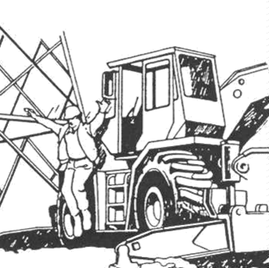
ELECTRICAL HAZARDS
Focus Four
What to Do If Equipment Contacts Overhead Power Lines
If you are not on or in the equipment… stay away from it!!
Do not touch the machine or outriggers
If you are operating it, stay in it until power is shut off
If you must get out, jump with your feet together
Hop or shuffle away
11

Slide 12
ELECTRICAL HAZARDS
Focus Four
Elevator Industry-Related Electrical Hazards
Even though as an Elevator Constructor you may not be operating this equipment outside of the building, you should be aware of the potential for these accidents to happen.
A crane that becomes energized from overhead power lines could energize the load or any crane attachments.
Remember, simply being in the vicinity of a piece of equipment that becomes energized could cause you injury.

Slide 13
ELECTRICAL HAZARDS
Focus Four
Working Around Temporary Electrical Circuits on Job Sites
We will discuss four specific topics regarding temporary construction wiring:
GFCIs
Assured equipment grounding
Extension cords
Electrical panel boxes

Slide 14
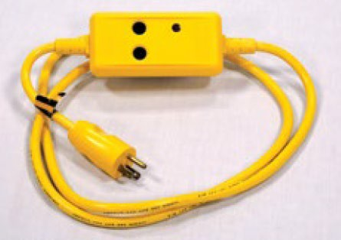
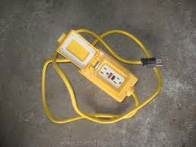
ELECTRICAL HAZARDS
Focus Four
Ground Fault Circuit Interrupters (GFCI)
Protect workers from shock by limiting duration of electrical shock*
Monitor the difference in current between the hot and neutral wires
Trip between 4-6 mA and shut off electricity in 1/40th of a second
Must be used on all 120 volt, single-phase 15 and 20 amp receptacles
14

Slide 15
ELECTRICAL HAZARDS
Focus Four
Assured Equipment Grounding Program
Required If GFCIs are not used
Winter
Spring
Inspection ensures your protection
The most common color- coding system uses these colors to indicate inspection has been done
Summer
Fall
15

Slide 16
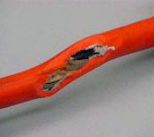
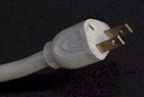
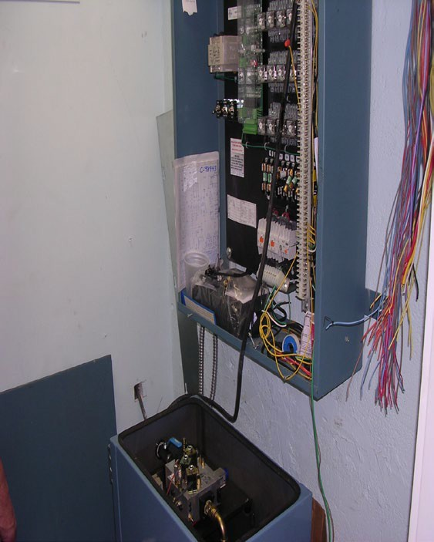
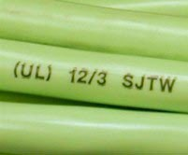
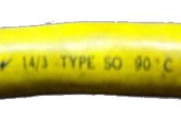
ELECTRICAL HAZARDS
Focus Four
Extension Cords
Inspect your cords
Ensure the insulation isn’t damaged
Confirm the grounding prong is intact
Don’t run cords through windows, doors, or holes in a wall without protection
Should be labeled and must be 3-wire type designed for hard or extra
hard use
16

Slide 17
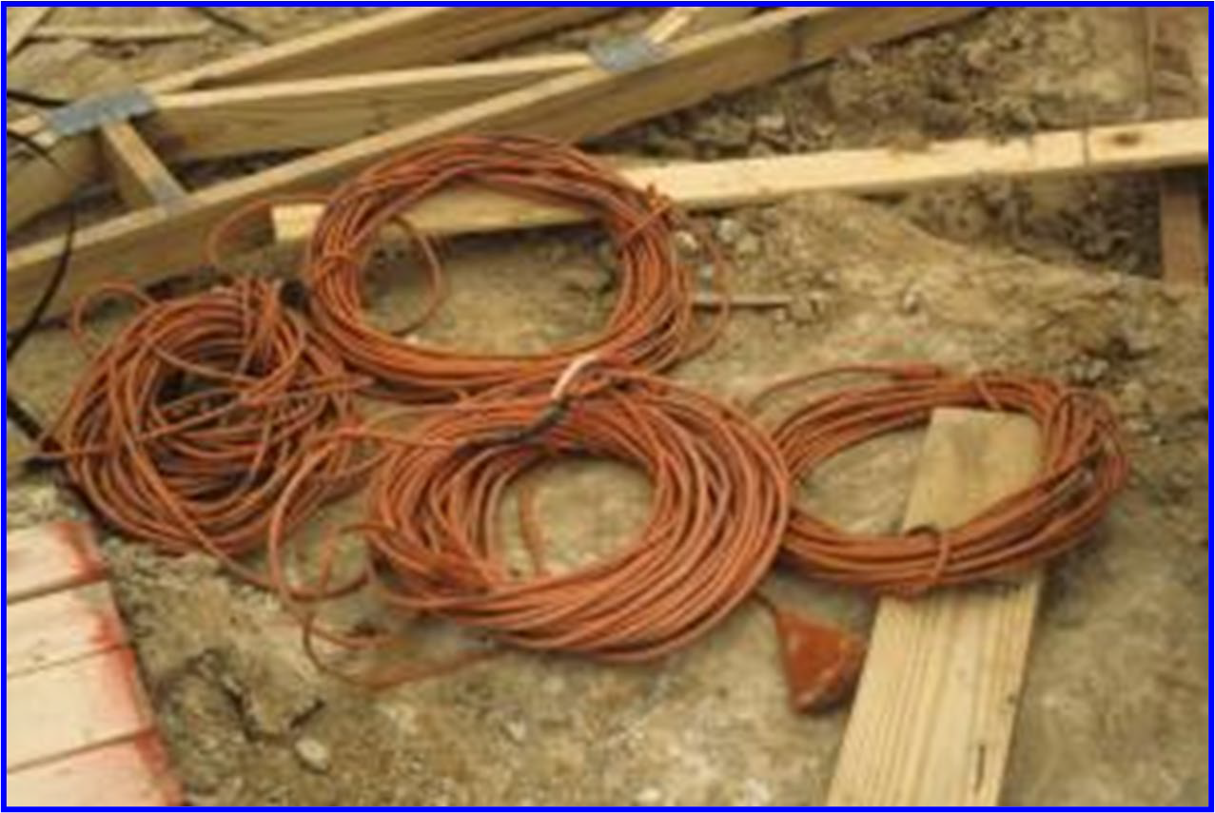
ELECTRICAL HAZARDS
Focus Four
Recognize Any Hazard(s)?

Slide 18
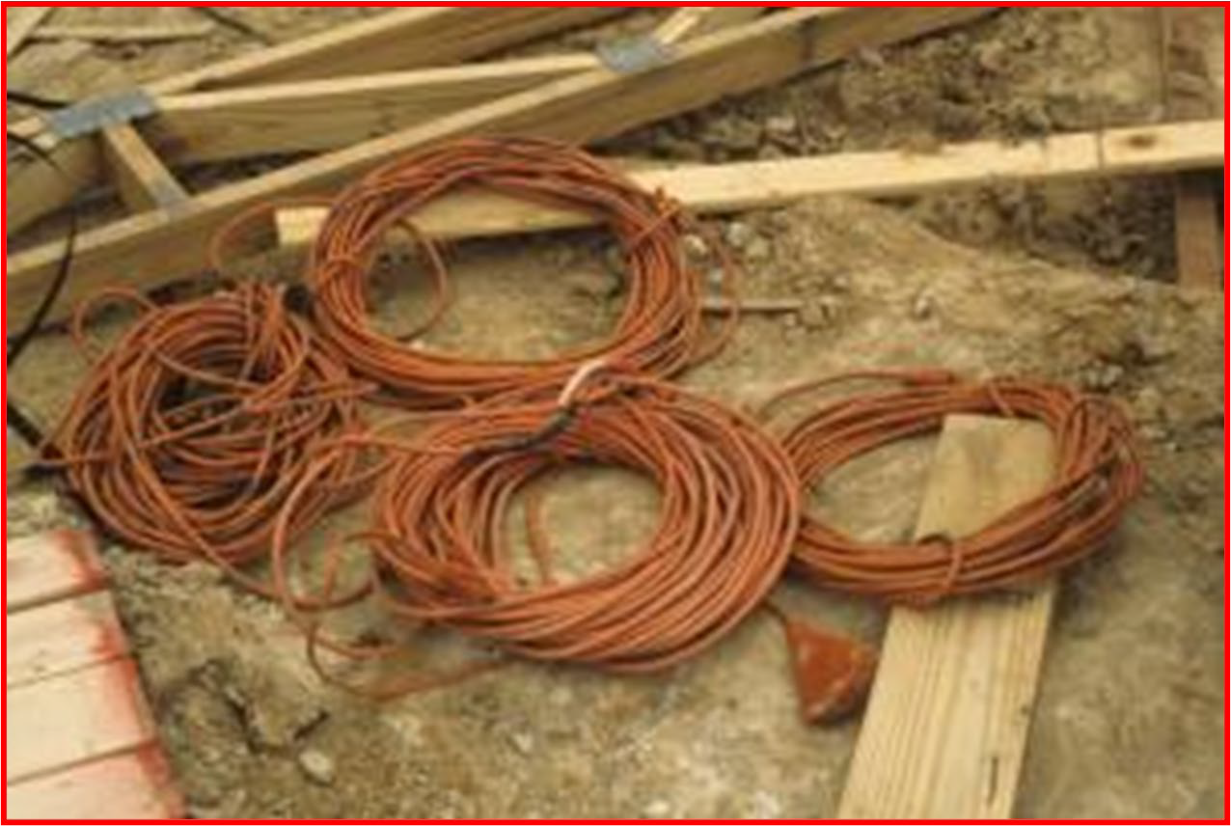
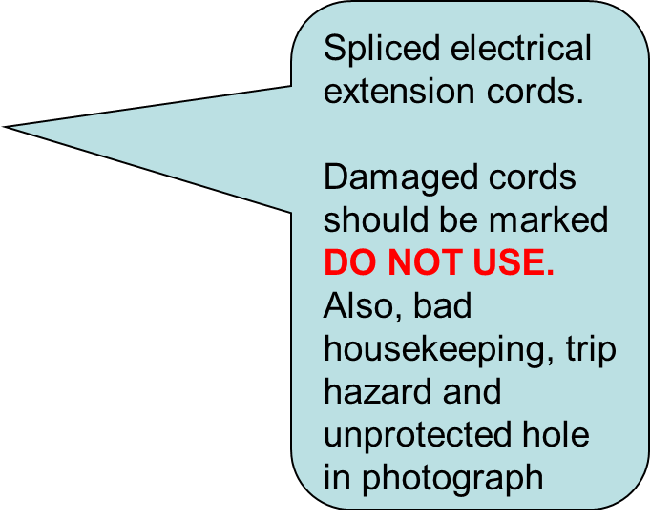
ELECTRICAL HAZARDS
Focus Four
Yes

Slide 19
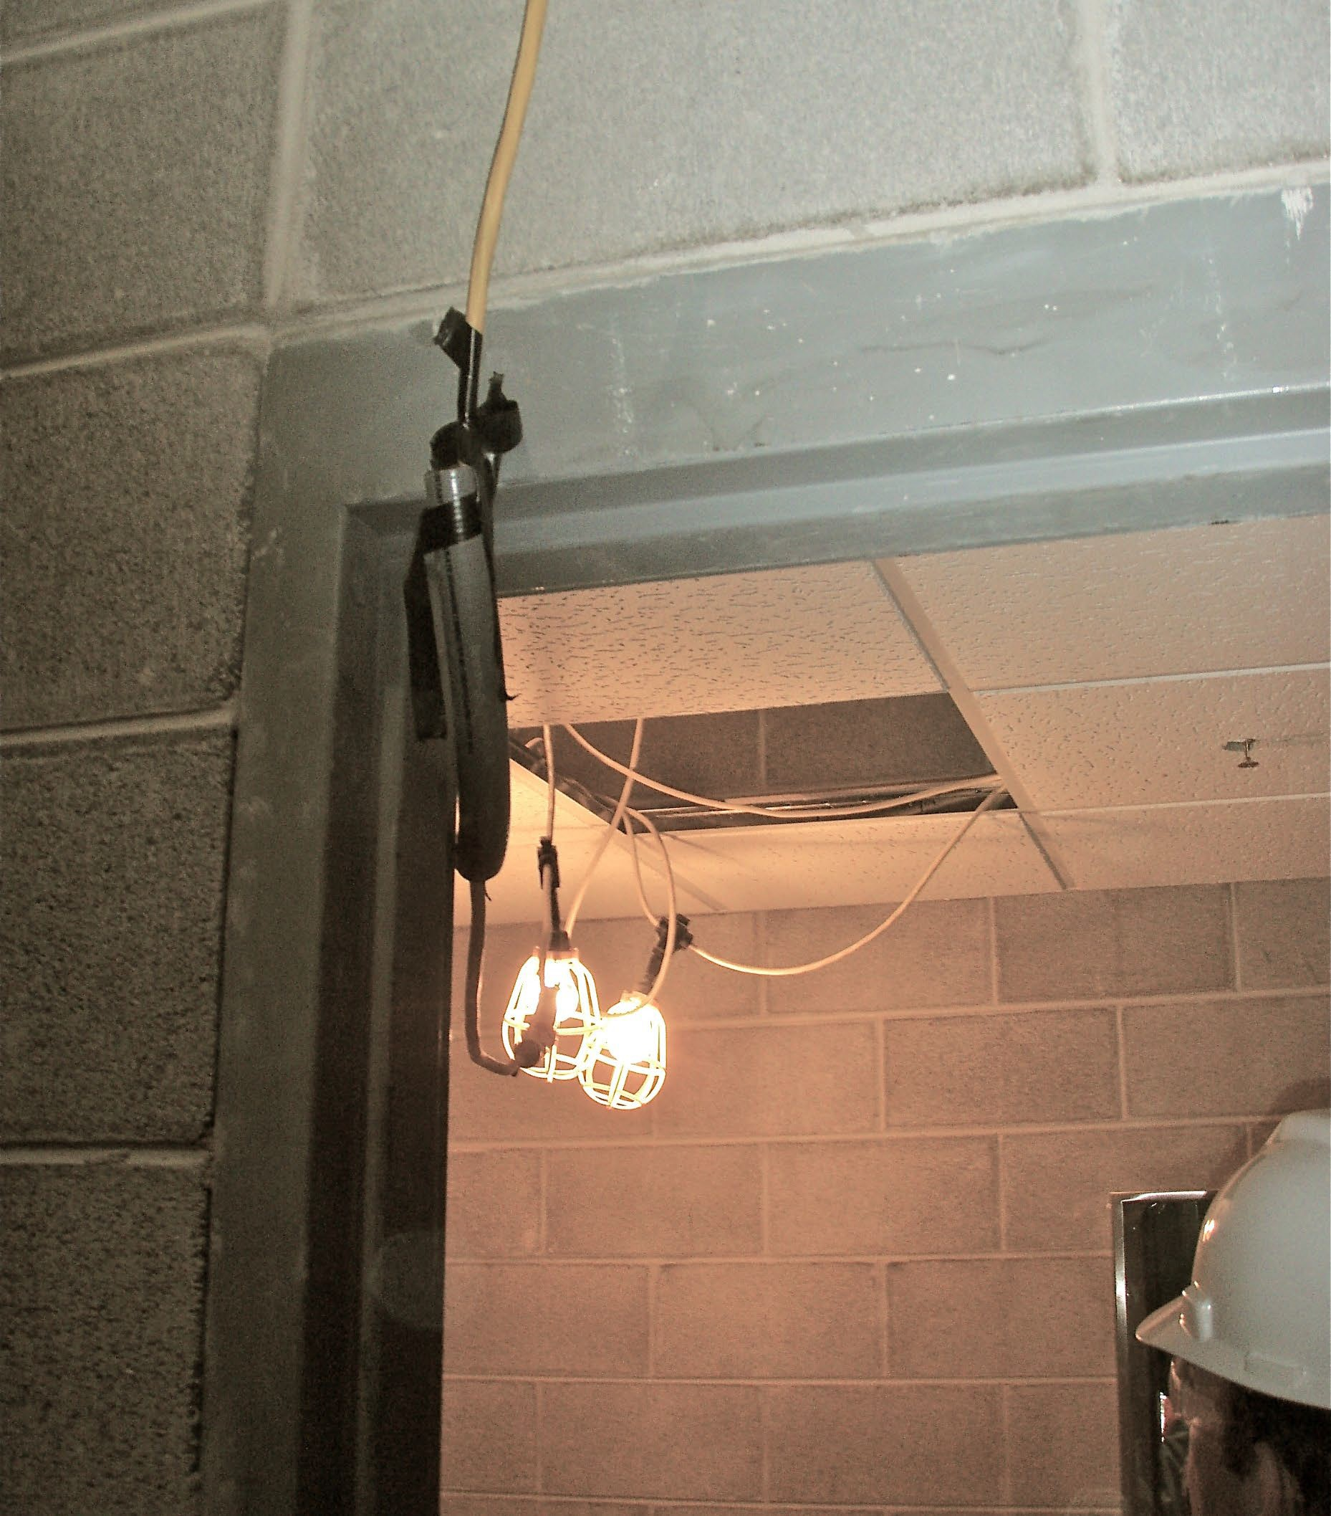
Recognize Any Hazard(s)?

Slide 20
Yes
Is this foam really adequate to protect this cord?
Flexible cords and cables may pass through doorways or other pinch points, if protection is provided to avoid damage

Slide 21
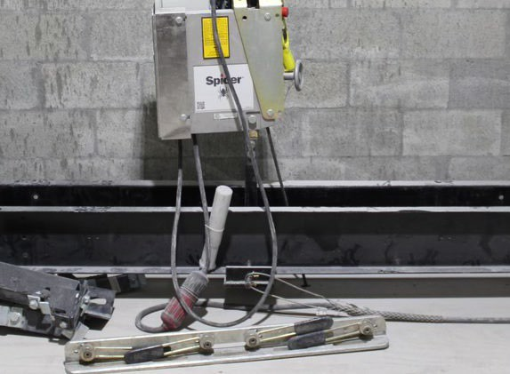
ELECTRICAL HAZARDS
Focus Four
Always provide proper strain relief when hanging any type of cord.

Slide 22
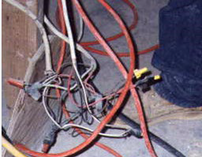
ELECTRICAL HAZARDS
Focus Four
Temporary Wiring Hazards:
Wiring like this must be protected in closed junction boxes.
Exposed wires are an electric shock hazard.
Even when properly wired, job site conditions change, and temporary electrical components can become unsafe from rough treatment over time
22

Slide 23
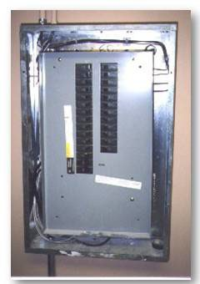
ELECTRICAL HAZARDS
Focus Four
Workers could be exposed to live wires around the perimeter of this box
Energized electrical panels must be completely covered with a hard cover (original intended equipment)
Do not use cardboard as a cover
23

Slide 24
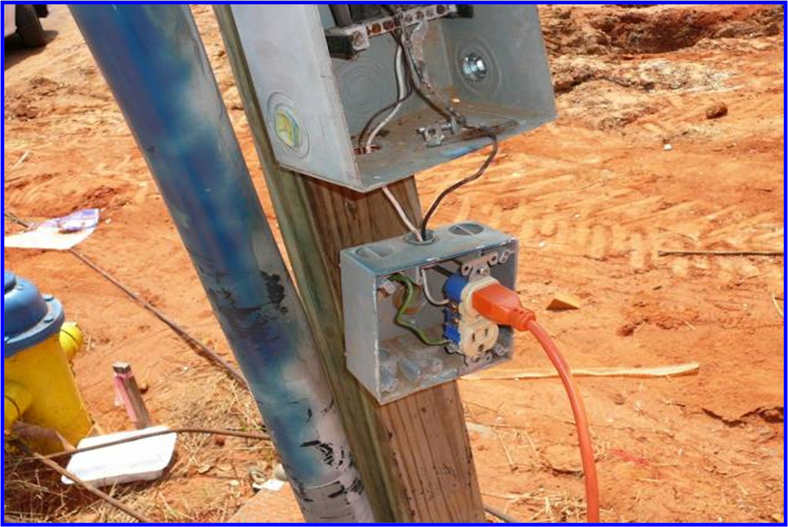
ELECTRICAL HAZARDS
Focus Four
Recognize Any Hazard(s)?

Slide 25
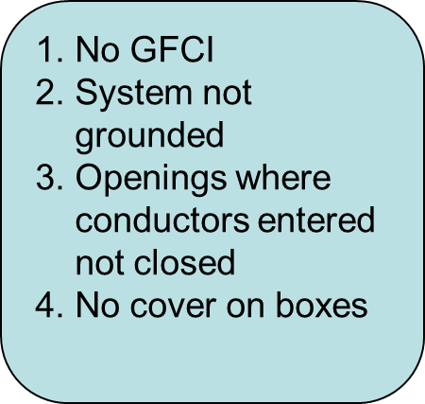
ELECTRICAL HAZARDS
Focus Four
YES

Slide 26
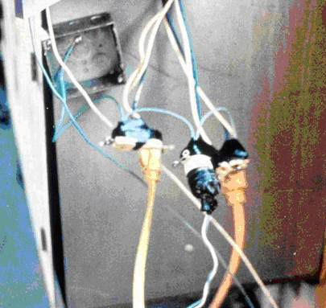
ELECTRICAL HAZARDS
Focus Four
Recognize Any Hazard(s)?

Slide 27
ELECTRICAL HAZARDS
Focus Four
Recognize Any Hazard(s)?
These cords are improperly wired directly to the electrical circuit
Not protected by a GFCI
Two-wire cords are not grounded and not rated for hard or extra-hard service
27

Slide 28
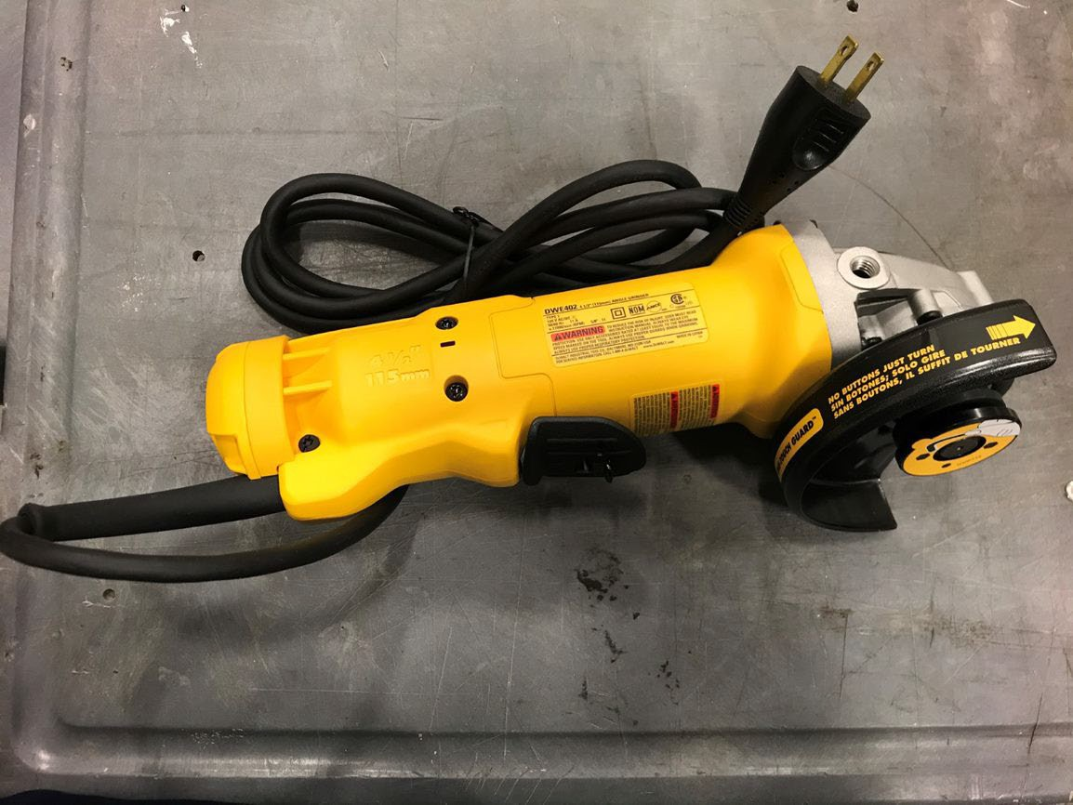
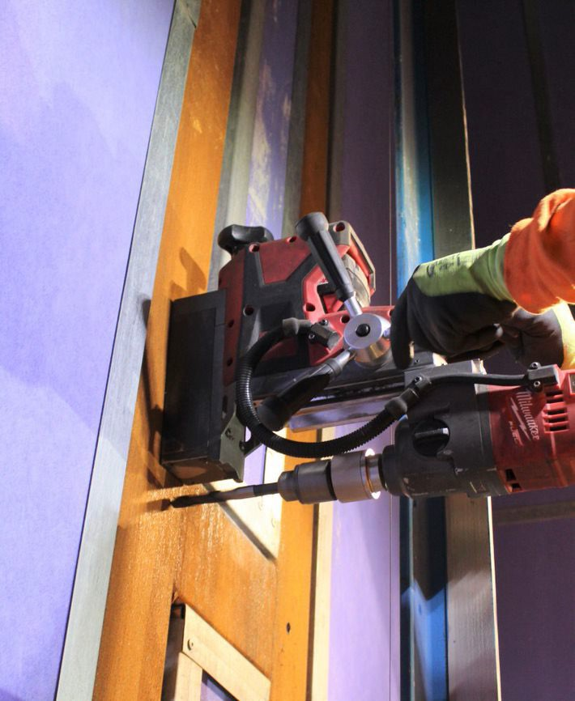
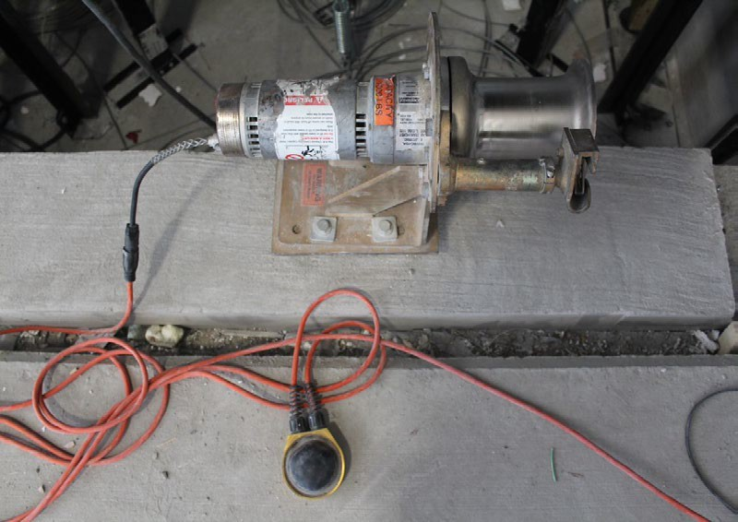
ELECTRICAL HAZARDS
Focus Four
Power Tool Safety
Keep cords away from water, heat, oil, and sharp edges
Disconnect tools when not in use, before servicing, and when changing accessories such as blades
Never yank the cord to disconnect it from the receptacle.
Never carry a tool by the cord
ALL power tools must be double-insulated or have a 3- wire cord
28

Slide 29
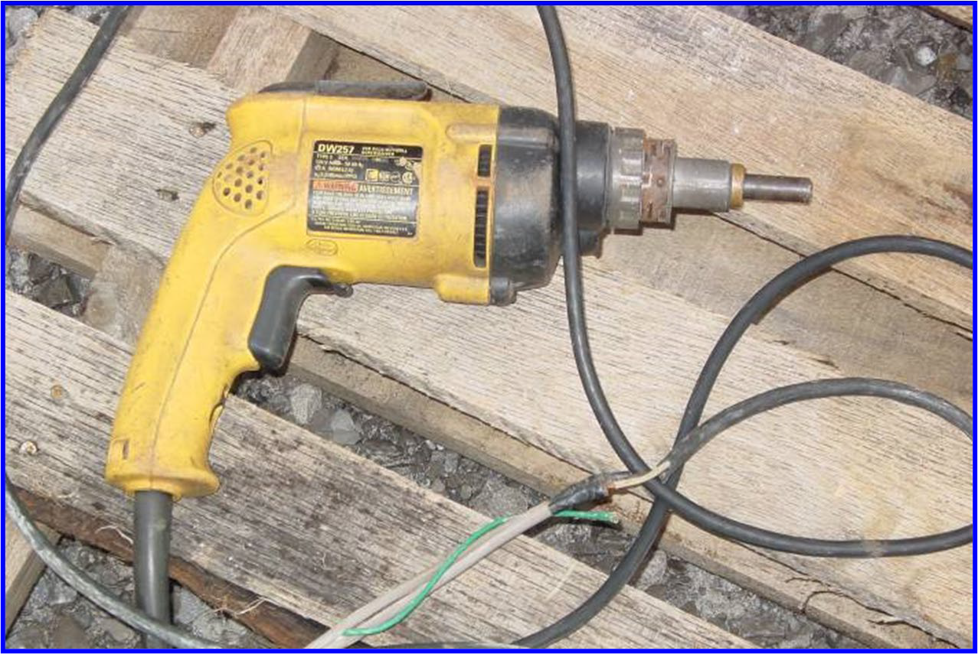
ELECTRICAL HAZARDS
Focus Four
Recognize Any Hazard(s)?

Slide 30
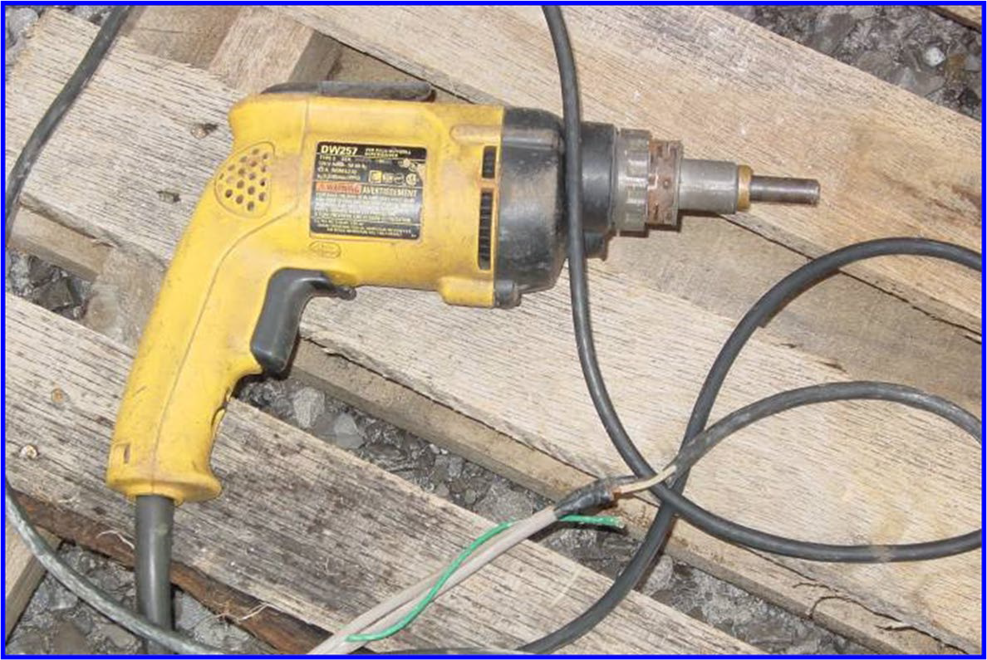
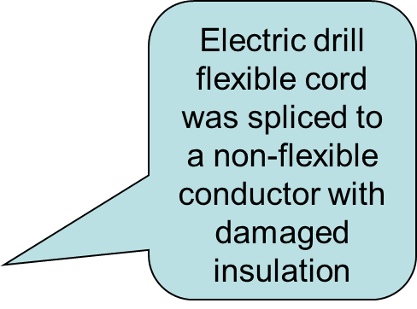
ELECTRICAL HAZARDS
Focus Four
YES

Slide 31
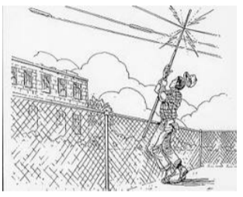
ELECTRICAL HAZARDS
Focus Four
What Should You Do If Someone Does Gets Shocked?
If possible, turn off the power.
Have someone call 911 and get an AED if available
Do not touch the worker in contact with live electric current. You could get shocked and become a second victim
Use nonconductive material to
remove the person from the power source (a board, rope, etc.)
When the scene is safe, start CPR or other first aid.
31

Slide 32
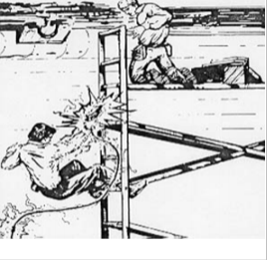
ELECTRICAL HAZARDS
Focus Four
Accident Report:
One employee was climbing a metal ladder to hand an electric drill to the journeyman installer on a scaffold about five feet above him. When the victim reached the third rung from the bottom of the ladder, he received an electric shock that killed him. The investigation revealed that the extension cord had a missing grounding prong and that a conductor on the green grounding wire was making intermittent contact with the energizing black wire thereby energizing the entire length of the grounding wire and the drill's frame. The drill was not double insulated.
INSPECTION RESULTS: As a result of its investigation, OSHA issued citations for violations of construction standards.
32

Slide 33
ELECTRICAL HAZARDS
Focus Four
Lockout/Tagout
§ 1926.416 General requirements.
(a) Protection of employees—(1) No employer shall permit an employee to work in such proximity to any part of an electric power circuit that the employee could contact the electric power circuit in the course of work, unless the employee is protected against electric shock by deenergizing the circuit and grounding it or by guarding it effectively by insulation or other means.
33

Slide 34
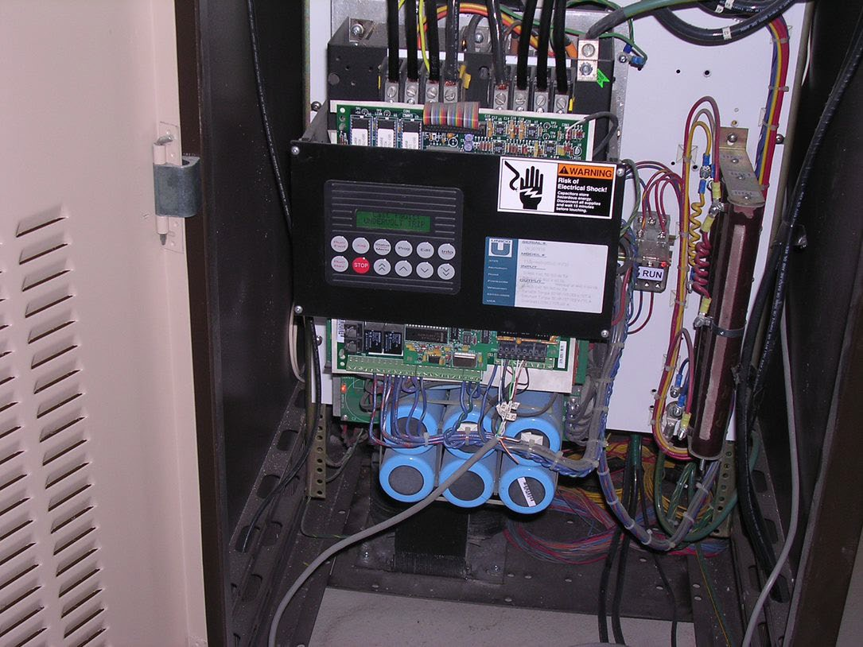
ELECTRICAL HAZARDS
Focus Four
Lockout/Tagout
When work is performed on a conveyance requiring employees to place any part of their body within range of energized circuits, pinch points, points of operation, rotating or oscillating parts or where operation is not required, the conveyance must be completely de-energized, locked out and tagged. If operation is required, proper protective guards or insulation must be in place.
If troubleshooting or testing must be performed with the power on, refer to your company’s live electrical safe work practices policy.
Once the problem is identified, shut the power off, then lock out and tag out the conveyance before performing the repair.
34

Slide 35
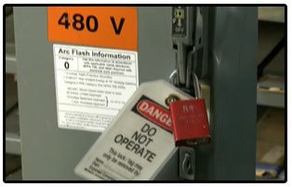
ELECTRICAL HAZARDS
Focus Four
Lockout/Tagout
Lockout/Tagout
A lockout/tagout procedure is required after equipment is de- energized to make sure that it is not accidentally re-energized.
Your employer determines the lockout/tagout procedure and must provide training on that procedure. Your employer provides the locks and tags. As an employee, you are responsible for installing these devices as instructed.
Lockout/tagout equipment needs to be unique and readily identifiable as lockout/tagout devices. These locks and tags are not to be used for any other purpose.
35

Slide 36
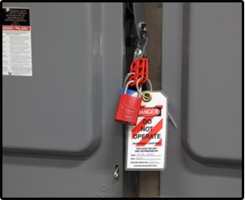
ELECTRICAL HAZARDS
Focus Four
Lockout/Tagout
For lockout/tagout procedures, only key or combination locks may be used. All lockout devices must list the name of the person who installed it, which is normally written on the tag. This individual is responsible for holding on to the key or combination until the lock is removed.
Tags used along with a lockout device need to contain a statement prohibiting unauthorized operation of the disconnecting means or unauthorized removal of the device.
Tags need to be made of a material that cannot be easily torn off and must be securely attached, following your company’s guidelines. Do not reuse a tag filled out for another task.
36

Slide 37
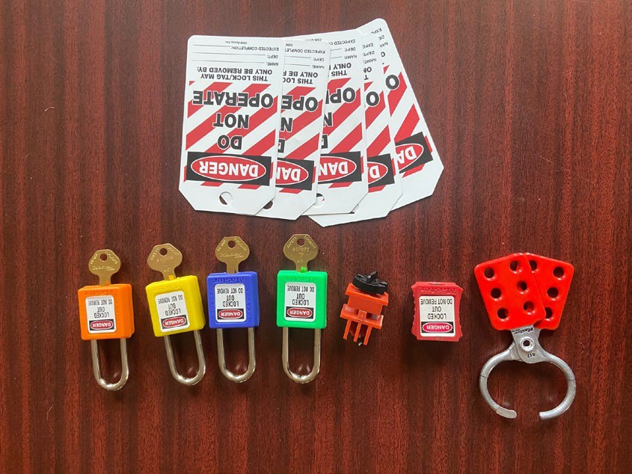
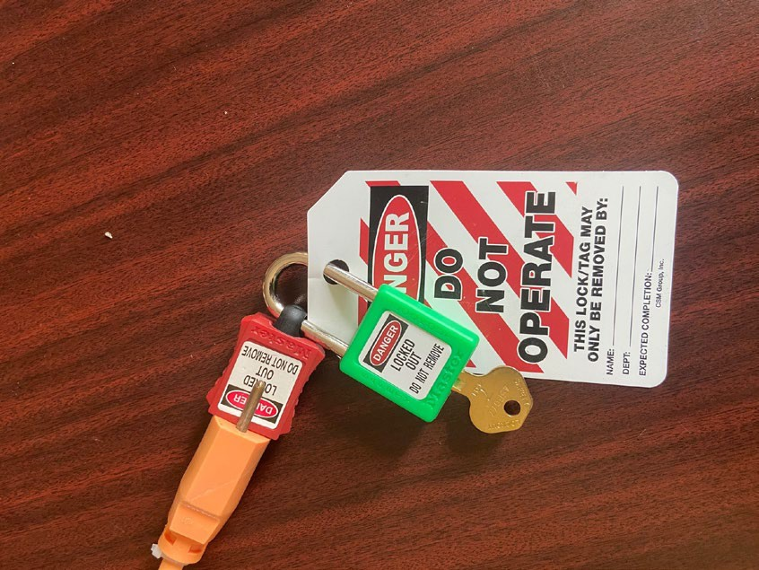
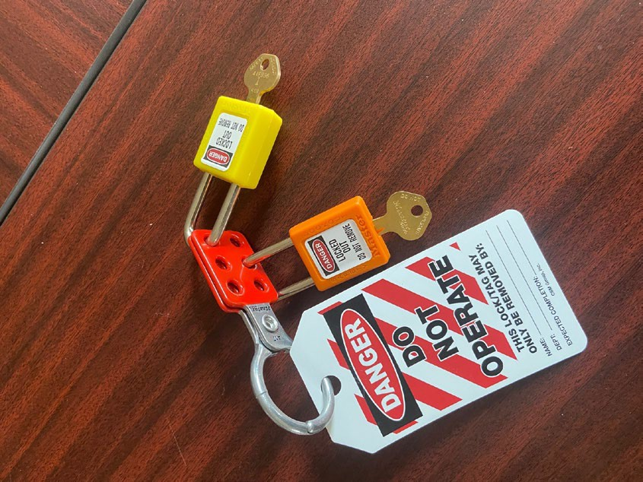
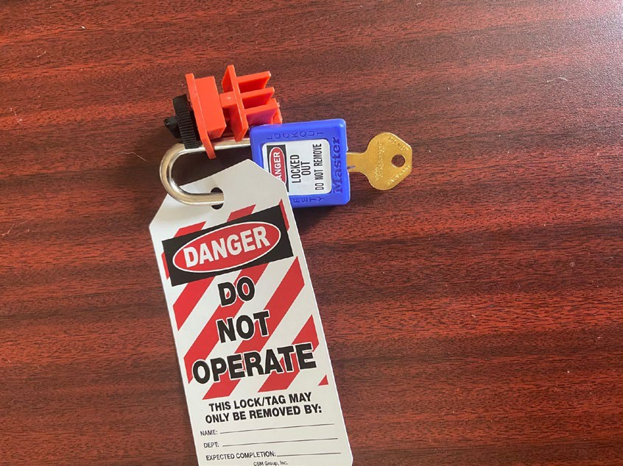
ELECTRICAL HAZARDS
Focus Four
Lockout/Tagout
LOTO equipment must be identifiable as LOTO specific
LOTO for power tools or equipment with a plug
LOTO for circuit breakers
LOTO for multiple locks
37

Slide 38
ELECTRICAL HAZARDS
Focus Four
Lockout/Tagout
Following is a general step by step process for performing LOTO. Always follow your company's policy and procedures.
Lockout/Tagout (LOTO) Sequence of Steps
Gain control of the conveyance and ensure that it is secured from public access. Make sure all necessary PPE and diagnostic hardware is readily available prior to commencing energy shut down.
Identify and locate the specific circuit or conveyance and corresponding disconnect you intend to de-energize. Stand to the side and face away while switching off the disconnect.
38

Slide 39
ELECTRICAL HAZARDS
Focus Four
Lockout/Tagout
Lockout/Tagout (LOTO) Sequence of Steps cont.
Place the appropriate lock to isolate the equipment. NOTE: If more than one employee is working on the equipment that is locked out, each employee shall place his/her personal lock on the disconnect.
Place a “Danger: Do Not Operate” tag with the following four items: company name, employee name, date and a contact number.
39

Slide 40
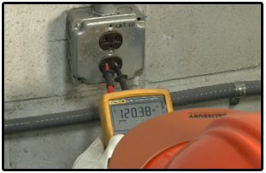
ELECTRICAL HAZARDS
Focus Four
Lockout/Tagout
Lockout/Tagout (LOTO) Sequence of Steps cont.
5. Identify a known LIVE voltage source, and test the functionality of the multimeter or non-contact voltage detector against this source.

Slide 41
ELECTRICAL HAZARDS
Focus Four
Lockout/Tagout
Lockout/Tagout (LOTO) Sequence of Steps cont.
6. Test and verify that the voltage has been disconnected (DEAD) with a non-contact voltage detector or a multimeter. Check each leg to ground. For ungrounded or above-ground systems, check leg to leg to complete verification of absence of energy.
NOTE: If only de-energizing the mainline, be aware that the controller may still have live 110/120-volt circuit for cab lighting and fan. Also verify that voltage has been dissipated from capacitors and AC Drive units.

Slide 42
ELECTRICAL HAZARDS
Focus Four
Lockout/Tagout
Lockout/Tagout (LOTO) Sequence of Steps cont.
7. Reverify that the functionality of the multimeter or non-contact voltage detector worked properly before and after the measurement. Check against a known LIVE voltage source.
8. Ensure that all potentially hazardous stored energy is relieved, disconnected, restrained, and otherwise rendered safe. Hydraulic elevator units must be landed on buffers, pipe stands, or have rail blocks installed when working on the pressurized system. Mechanical safeguarding of escalators and moving walks shall be put in place to protect from stored energy.

Slide 43
ELECTRICAL HAZARDS
Focus Four
Lockout/Tagout
Lockout/Tagout (LOTO) Sequence of Steps cont.
Perform work.
Re-energize the conveyance following these steps:
Replace all guards and remove all tools
Recheck to ensure control of the conveyance and that is secure from public access
The employee(s) who applied personal locks shall remove their own lock and tag
Make sure all workers are safe and accounted for before equipment and circuits are unlocked and turned back on
Stand to the side and face away, announce “power going on” when powering the disconnect on
Check that the conveyance has been properly returned to
service
43

Slide 44
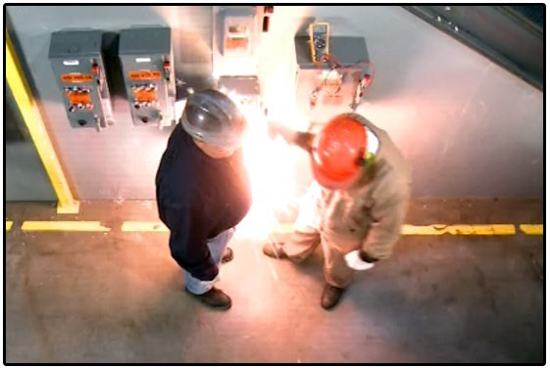
ELECTRICAL HAZARDS
Focus Four
Arc Flash
What is an Arc Flash?
An arc flash is a sudden, unexpected discharge of electricity that travels through the air between conductors, or from conductor to ground.
This short circuit releases enormous amounts of energy as light and heat.
The results can be devastating. When an unprotected person is nearby, serious injury and even death can occur.

Slide 45
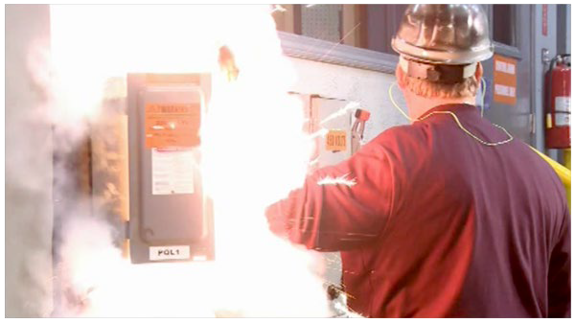
ELECTRICAL HAZARDS
Focus Four
Arc Blast
What is an Arc Blast?
An arc flash almost always results in an arc blast. An arc blast is the high-pressure explosion caused by a sudden arc fault.
Although an arc flash and an arc blast are two distinct parts of a split-second phenomenon, for the duration of this course we’ll usually refer to them together as an arc flash.

Slide 46
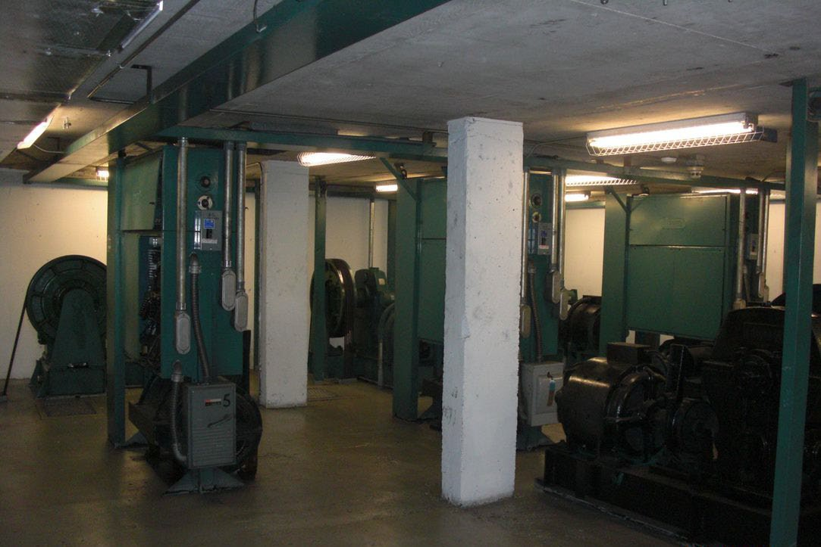
ELECTRICAL HAZARDS
Focus Four
Common Causes of Arc Flash
Common causes include:
Dust
Dropping tools
Accidental touching
Condensation
Material failure
Corrosion
Faulty installation
Wiring errors

Slide 47
ELECTRICAL HAZARDS
Focus Four
Results of an Arc Flash
Results of an Arc Flash:
It takes little imagination to predict how much damage an arc flash can do to you or one of your coworkers. The blast radius can exceed ten feet, injuring everyone in its path. The dangers associated with arc flash are:
Thermal Energy
The sun burns at about 10,000 degrees Fahrenheit. By comparison, an arc flash can generate temperatures as high as 35,000 degrees Fahrenheit. At this extraordinarily high temperature, all known materials vaporize instantly, causing them to rapidly expand. The resulting fire can spread rapidly, resulting in catastrophic burns, smoke inhalation or death
Ultraviolet Energy
The arc’s high intensity flash can cause blindness
Acoustical Energy
The sound can reach 140 decibels, causing permanent hearing loss

Slide 48
ELECTRICAL HAZARDS
Focus Four
Results of an Arc Flash cont.
Pressure Wave
The pressure wave caused by the blast can hit a worker’s chest with a force greater than 2,000 pounds per square foot causing internal injuries, collapsed lungs, broken bones and/or falls.
Debris
In the explosion that results from the rapid expansion of these materials, droplets of molten metal spray with such force that they can penetrate the body like shrapnel. Depending on the force of the blast this debris can be ejected a great distance from the source of the blast, injuring nearby workers.

Slide 49
ELECTRICAL HAZARDS
Focus Four
Arc Flash Injuries
Due to the violent nature of an arc flash, injuries are serious. This type of accident kills hundreds of workers every year.
If a person survives an arc flash, extended medical care is often required. Burn recovery is an incredibly painful process.
It’s not uncommon for an arc flash survivor to never regain their past quality of life.

Slide 50
ELECTRICAL HAZARDS
Focus Four
Arc Flash Prevention
Preventing an arc flash incident starts by following up-to-date safe work practices and procedures. The National Fire Protection Association, or NFPA, publishes current safe work practices that will enable you to recognize and avoid arc flash hazards.
Almost all arc flash accidents happen when workers are untrained or ignore safe work practices.
Never work on an electrical task without being properly qualified for the work being performed.
50

Slide 51
ELECTRICAL HAZARDS
Focus Four
Arc Flash Standards
Who sets the standards for arc flash safety?
National Fire Protection Association (NFPA)
National Electrical Safety Code (NESC)
National Electrical Code (NEC)
Occupational Safety and Health Administration (OSHA)

Slide 52
ELECTRICAL HAZARDS
Focus Four
Electrically Safe Working Conditions
What are Electrically Safe Working Conditions?
In general, OSHA determines what is required to create electrically safe working conditions, and NFPA 70E describes how to create electrically safe working conditions.
An electrically safe working condition is defined as a state in which an electrical conductor or circuit part has been disconnected from energized parts, locked and tagged in accordance with established standards, tested to ensure the absence of voltage, and grounded if determined necessary.
In a few words:
work de-energized whenever possible.

Slide 53
ELECTRICAL HAZARDS
Focus Four
Responsibilities
Responsibility for Safe Conditions
Both employers and employees have responsibilities for creating electrically safe working conditions
Employers need to establish the safety-related work practices and train workers.
Employees need to implement the safe work practices
It’s vital that you follow safe work practices. The consequences are too extreme to take a chance

Slide 54
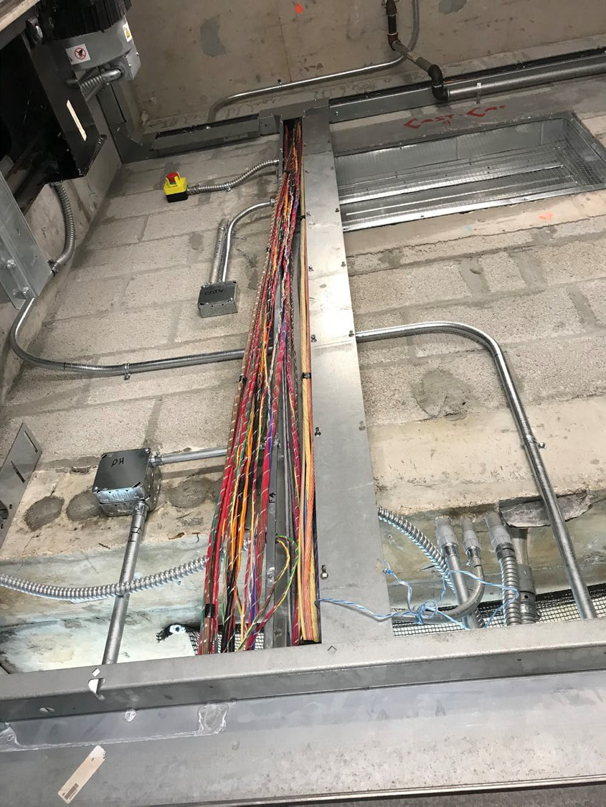
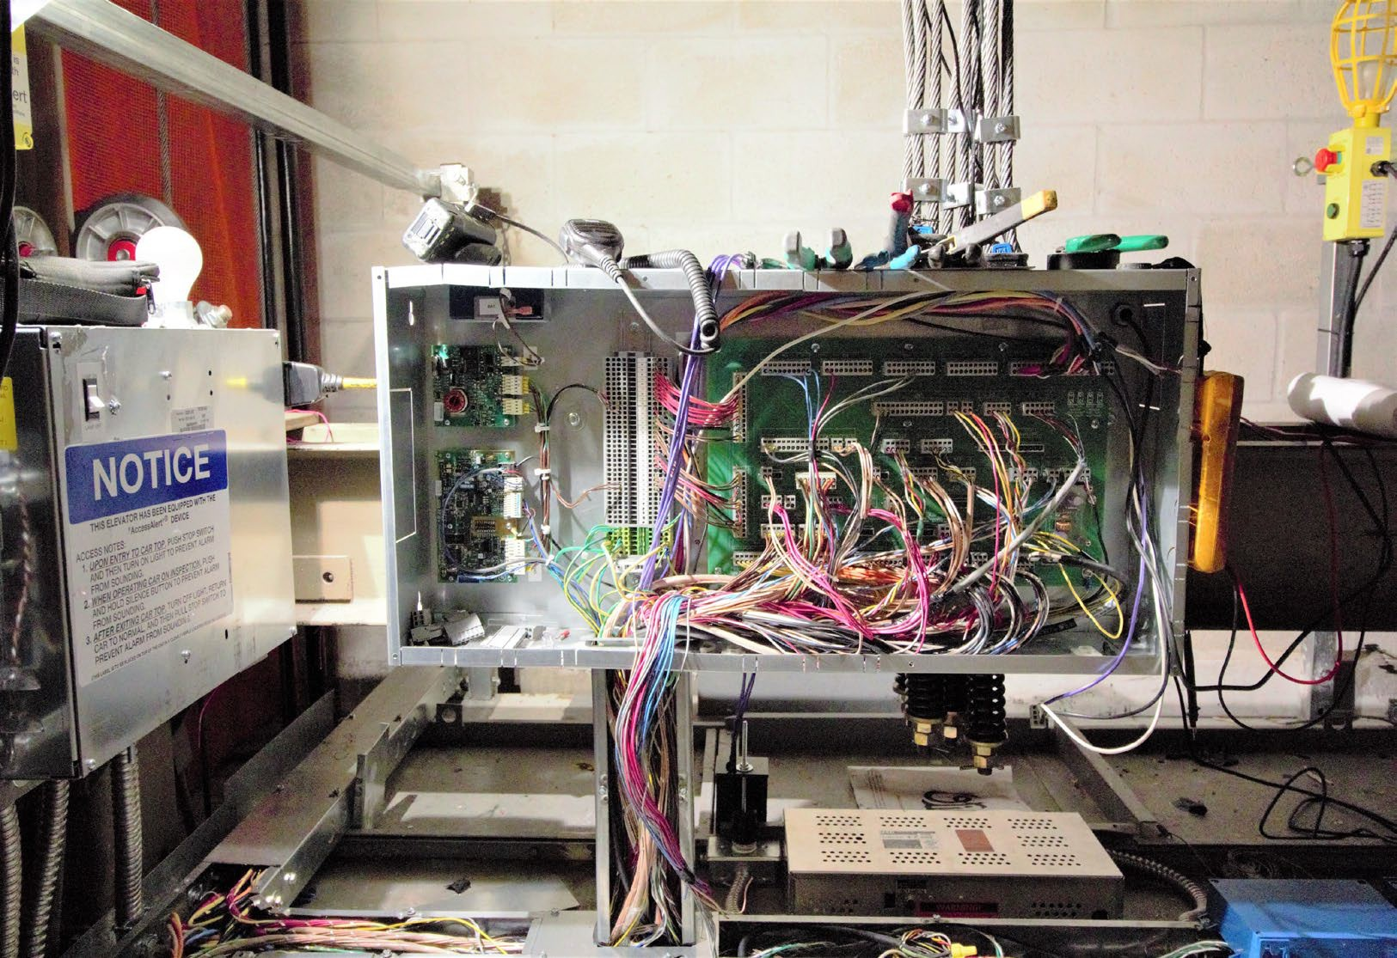
ELECTRICAL HAZARDS
Focus Four
Elevator Industry-Related Electrical Hazards
To eliminate the risk for contact with live electrical wiring, hoistway and car connections should be made before controller connections.

Slide 55
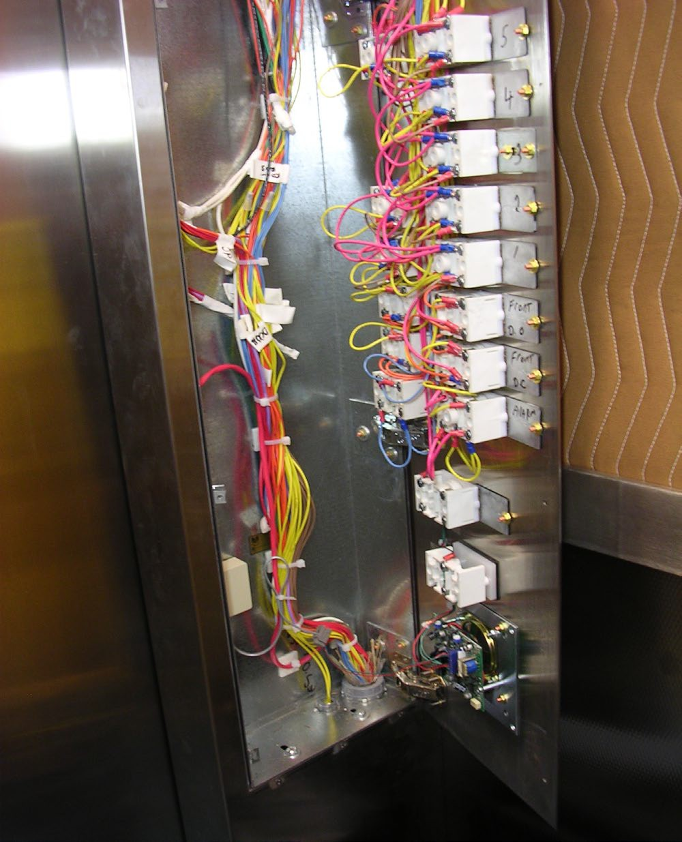
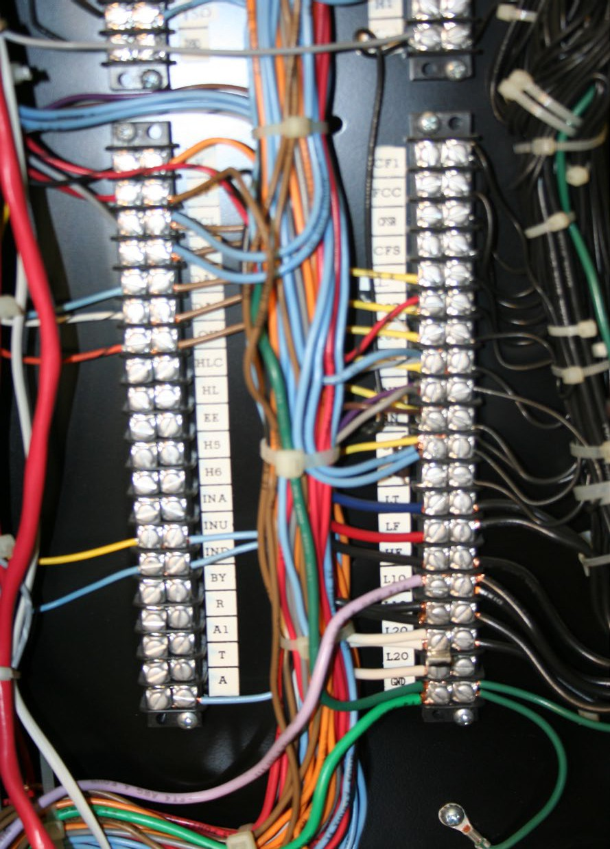
ELECTRICAL HAZARDS
Focus Four
Elevator Industry-Related Electrical Hazards
Car top junction boxes, car operating panels, and controllers should be neat and organized when construction wiring is complete.
55

Slide 56
ELECTRICAL HAZARDS
Focus Four
Elevator Industry-Related Electrical Hazards
Do you see the hazard here?
There is no protection for the wires being brought into this box. It’s just a matter of time until vibration wears away the wires insulation and the live conductor contacts the metal.
Protection must be provided any time cables or wires are brought into a box or controller. This can be accomplished with a bushing or other edge protection.

Slide 57
ELECTRICAL HAZARDS
Focus Four
Elevator Industry-Related Electrical Hazards
Control cabinet doors should be closed any time work is not being done. This will eliminate accidental contact with any live components. The controller may be located inside the hoistway and only accessible from the car top. Whenever possible, perform LOTO procedures before doing any work inside the control panel. Always follow your company’s LOTO and live work processes.

Slide 58
ELECTRICAL HAZARDS
Focus Four
Elevator Industry-Related Electrical Hazards
Escalators and moving walks present some challenges for wiring and LOTO. Tight quarters require you to be in close proximity to caught in/between and electrical hazards. Always perform LOTO procedures and secure the unit from unintended movement before putting yourself in a position for potential injury.

Slide 59
ELECTRICAL HAZARDS
Focus Four
Hazard Identification
Can you identify the hazards in these next slides?
Look at the picture and identify the hazards.
Have a discussion about possible solutions.

Slide 60
ELECTRICAL HAZARDS
Focus Four
Recognize Any Hazard(s)?

Slide 61
ELECTRICAL HAZARDS
Focus Four
Yes

Slide 62
ELECTRICAL HAZARDS
Focus Four
Recognize Any Hazard(s)?

Slide 63
ELECTRICAL HAZARDS
Focus Four
Yes
Crossing electrical line must be supported, protected, or removed to safeguard workers

Slide 64
ELECTRICAL HAZARDS
Focus Four
Recognize Any Hazard(s)?

Slide 65
ELECTRICAL HAZARDS
Focus Four
Yes
Scaffold was erected 4 ½ feet from 7.2 kV power lines

Slide 66
ELECTRICAL HAZARDS
Focus Four
Recognize Any Hazard(s)?

Slide 67
ELECTRICAL HAZARDS
Focus Four
Yes
Continuous path to ground not maintained; multiple cords used for fixed equipment

Slide 68
ELECTRICAL HAZARDS
Focus Four
Recognize Any Hazard(s)?

Slide 69
ELECTRICAL HAZARDS
Focus Four
Yes
Employer was operating a stand fan without grounding protection

Slide 70
ELECTRICAL HAZARDS
Focus Four
Recognize Any Hazard(s)?

Slide 71
ELECTRICAL HAZARDS
Focus Four
Yes

Slide 72
ELECTRICAL HAZARDS
Focus Four
Electrical Hazards Summary
Contact with overhead power lines causes the most electrocutions. Stay at least 10 feet away
Use GFCIs for worker protection on 120V, 15- 20-amp circuits
Make sure power is off when servicing or repairing tools and equipment
Inspect all electrical tools and cords before use.
Do not touch a worker in contact with electric current. Shut off power. If it is not possible to shut off the power, use a nonconductive material to move them or move the source of
electricity.
72

Slide 73
ELECTRICAL HAZARDS
Focus Four
Through the Alliance between OSHA’s 10 Regional Offices and the Elevator Contractors of America (ECA), Elevator Industry Work Preservation Fund (EIWPF), International Union of Elevator Constructors (IUEC), National Association of Elevator Contractors (NAEC), National Elevator Industry Educational Program (NEIEP), and National Elevator Industry Inc. (NEII), collectively known as The Elevator Industry Safety Partners, developed this Industry Specific Content for informational purposes only. It does not necessarily reflect the official views of OSHA or the U.S. Department
of Labor. May 2021
Under the Occupational Safety and Health Act, employers are responsible (http://www.osha.gov/as/opa/worker/employer-responsibility.html) for providing a safe and healthy workplace and workers have rights (https://www.osha.gov/workers). OSHA can help answer questions or concerns from employers and workers. OSHA's On-Site Consultation Program (https://www.osha.gov/consultation) offers free and confidential advice to small and medium-sized businesses, with priority given to high-hazard worksites. For more information, contact your regional or area OSHA office (https://www.osha.gov/contactus/bystate), call 1-800-321-OSHA (6742), or visit
https://www.osha.gov/.

Slide 74
ELECTRICAL HAZARDS
Focus Four
Any Questions?

